Slide 1
Understanding meta-analysis: “I think you’ll find it’s a bit more complicated than that” (Goldacre, 2008)

Slide 2
Understanding meta-analysis
A technique for aggregating results from different studies by converting empirical results to a common measure (usually effect size)
Standardized effect size is defined as:
Problems with meta-analysis
Variation in population variability
Selection of studies
Sensitivity of outcome measures

Slide 3
Variation in variability

Slide 4
Annual growth in achievement, by age
A 50% increase in the rate of learning for six-year-olds is equivalent to an effect size of 0.76
A 50% increase in the rate of learning for 15-year-olds is equivalent to an effect size of 0.1
Bloom, Hill, Black, and Lipsey (2008)

Slide 5
Variation in variability
Studies with younger children will produce larger effect size estimates
Studies with restricted populations (e.g., children with special needs, gifted students) will produce larger effect size estimates

Slide 6
Selection of studies

Slide 7
Feedback in STEM subjects
Review of 9000 papers on feedback in mathematics, science and technology
Only 238 papers retained
Background papers 24
Descriptive papers 79
Qualitative papers 24
Quantitative papers 111
Mathematics 60
Science 35
Technology 16
Ruiz-Primo and Li (2013)

Slide 8
Classification of feedback studies
Who provided the feedback (teacher, peer, self, or technology-based)?
How was the feedback delivered (individual, small group, or whole class)?
What was the role of the student in the feedback (provider or receiver)?
What was the focus of the feedback (e.g., product, process, self-regulation for cognitive feedback; or goal orientation, self-efficacy for affective feedback)
On what was the feedback based (student product or process)?
What type of feedback was provided (evaluative, descriptive, or holistic)?
How was feedback provided or presented (written, video, oral, or video)?
What was the referent of feedback (self, others, or mastery criteria)?
How, and how often was feedback given in the study (one time or multiple times; with or without pedagogical use)?

Slide 9
Main findings
Characteristic of studies included | Maths | Science
Feedback treatment is a single event lasting minutes | 85% | 72%
Reliability of outcome measures | 39% | 63%
Validity of outcome measures | 24% | 3%
Dealing only or mainly with declarative knowledge | 12% | 36%
Schematic knowledge (e.g., knowing why) | 9% | 0%
Multiple feedback events in a week | 14% | 17%

Slide 10
Sensitivity to instruction

Slide 11
Sensitivity of outcome measures
Distance of assessment from the curriculum
Immediate
e.g., science journals, notebooks, and classroom tests
Close
e.g., where an immediate assessment asked about number of pendulum swings in 15 seconds, a close assessment asks about the time taken for 10 swings
Proximal
e.g., if an immediate assessment asked students to construct boats out of paper cups, the proximal assessment would ask for an explanation of what makes bottles float
Distal
e.g., where the assessment task is sampled from a different domain and where the problem, procedures, materials and measurement methods differed from those used in the original activities
Remote
standardized national achievement tests.
Ruiz-Primo, Shavelson, Hamilton, and Klein (2002)

Slide 12
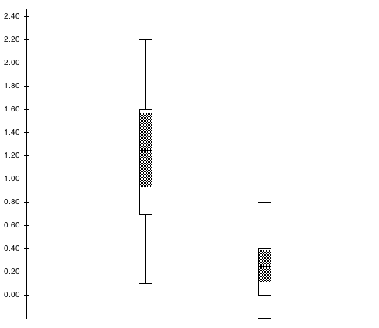
Impact of sensitivity to instruction
Effect size
Close
Proximal

