Slide 1
Why (classroom) formative assessment should be a priority for every school
NCTM conference, April 2017: San Antonio, TX
Dylan Wiliam (@dylanwiliam)
www.dylanwiliamcenter.com
www.dylanwiliam.net
Notes:
Description of Presentation:
Increased use of formative assessment raises student achievement, but too often implementation focuses on the least effective form of formative assessment-analysis of student data. This presentation explains why, to maximize impact on student achievement, formative assessment requires changing classroom practice, minute by minute and day by day.
Learning Outcomes:
Participants will learn why there are no such things as "formative assessments," why formative assessment that focuses on instructional data is less effective than formative assessment that focuses on classroom practice, and why, for teachers, implementing formative assessment is more a process of habit change than knowledge acquisition. Participants will also learn a variety of practical techniques for formative assessment that they can use in their classrooms immediately.
Focus on Math:
Throughout the presentation effective formative assessment will be modeled through the use of pedagogies of engagement, and pedagogies of responsiveness. Specifically, participants will be asked to indicate their responses to questions posed, and the presentation will then be responsive to participants' responses. Participants will also learn about the characteristics of effective questions in mathematics, and how feedback can be given in a way to move learning forward.

Slide 2
Outline
Why formative assessment needs to be a priority
Formative assessment: what it is and what it isn’t
Strategies and techniques of formative assessment
Supporting teachers in changing practice

Slide 3
What psychology tells us about learning
Review of the research on techniques that help students learn better
Focus on techniques that are relatively easy for students to use
Evaluation in terms of generalizability of findings across
  different material to be learned
  different learning conditions
  different kinds of student
  different measures of learning
Dunlosky, Rawson, Marsh, Nathan, and Willingham (2013)

Slide 4
1. Elaborative interrogation | Generating an explanation for why an explicitly stated fact or concept is true
2. Self-explanation | Explaining how new information is related to known information, or explaining steps taken during problem solving
3. Summarization | Writing summaries (of various lengths) of to-be-learned texts
4. Highlighting/underlining | Marking potentially important portions of to-be-learned materials while reading
5. Keyword mnemonic | Using keywords and mental imagery to associate verbal materials
6. Imagery for text | Attempting to form mental images of text materials while reading or listening
7. Rereading | Restudying text material again after an initial reading
8. Practice testing | Self-testing or taking practice tests over to-be-learned material
9. Distributed practice | Implementing a schedule of practice that spreads out study activities over time
10. Interleaved practice | Practice that mixes different kinds of problems, or study that mixes different kinds of material, within a single study session

Slide 5
Which of these consistently improves learning?
Elaborative interrogation
Self-explanation
Summarization
Highlighting/underlining
Keyword mnemonic
Imagery for text
Rereading
Practice testing
Distributed practice
Interleaved practice

Slide 6
“The new theory of disuse”
An item in memory is characterized by
  Storage strength
    how well learned an item is
    can only increase
  Retrieval strength
    how easy an item is to retrieve at a particular time
    goes up and down
Bjork (1992)

Slide 7
Storage strength and retrieval strength
 |  | Storage strength
 |  | Low | High
Retrieval strength | Low
 | High
Credit card number
First license plate number
Current hotel room number
Social security number

Slide 8
What
Storage strength and retrieval strength are increased by
  Re-studying an item
  Retrieving it from memory
  Retrieval has a greater impact than re-study
Retrieval and re-study increase:
  storage strength more when retrieval strength is low
  retrieval strength more when
    retrieval strength is low
    storage strength is high
Learners need “desirable difficulties” in learning

Slide 9
Why (classroom) formative assessment needs to be a priority

Slide 10
Why Strategic Formative Assessment?
One principle and one uncomfortable fact about the world
  The principle:
    “If I had to reduce all of educational psychology to just one principle, I would say this: The most important single factor influencing learning is what the learner already knows. Ascertain this and teach him [or her] accordingly.” (Ausubel, 1968 p. vi)
  The uncomfortable fact:
    Students do not learn what we teach.

Slide 11
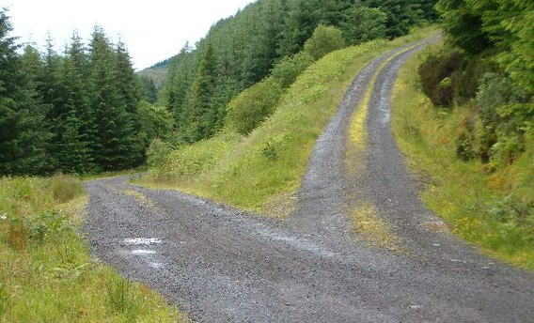
Building Plan “B” into Plan “A”

Slide 12
Relevant studies
Fuchs & Fuchs (1986)
Natriello (1987)
Crooks (1988)
Bangert-Drowns et al (1991)
Dempster (1991)
Dempster (1992)
Elshout-Mohr (1994)
Kluger & DeNisi (1996)
Black & Wiliam (1998)
Nyquist (2003)
Brookhart (2004)
Allal & Lopez (2005)
Köller (2005)
Brookhart (2007)
Wiliam (2007)
Hattie & Timperley (2007)
Shute (2008)
Kingston & Nash (2011, 2015)

Slide 13
Recent meta-analytic findings
Content area | N | 95% confidence interval for effect size
 |  | Lower | Mean | Upper
Mathematics | 19 | 0.14 | 0.17 | 0.20
English Language Arts | 4 | 0.30 | 0.32 | 0.34
Science | 17 | 0.06 | 0.19 | 0.31
Total | 40
Mean effect size ≈ 0.20
A big effect size
Equivalent to a 50% to 70% increase in the rate of learning
Kingston and Nash (2011, 2015)

Slide 14
Formative assessment: what it is and what it isn’t

Slide 15
Formative Assessment: A contested term
Long-cycle
Medium-cycle
Short-cycle
Across terms, teaching units
Within and between teaching units
Within and between lessons
Span
Four weeks to
one year
One to four weeks
Minute-by-minute and day-by-day
Length
Monitoring, curriculum alignment
Student-involved assessment
Engagement, responsiveness
Impact

Slide 16
What does formative assessment form?
 | Cycle length
 | Long | Medium | Short
Curriculum alignment | ✔
Monitoring progress | ✔ | ✔ | ✔
Student involved assessment |  | ✔ | ✔
Student engagement |  | ✔ | ✔
Teacher cognition about learning |  | ✔ | ✔
Responsive classroom practice |  |  | ✔

Slide 17
Strategies of formative assessment

Slide 18
Unpacking Formative Assessment
 | Where the learner is going | Where the learner is now | How to get the learner there
Teacher
Peer
Student
Clarifying, sharing, and understanding learning intentions
Eliciting evidence of learning
Providing feedback that moves learners forward
Activating students as learning
resources for one another
Activating students as
owners of their own learning

Slide 19
Unpacking Formative Assessment
 | Where the learner is going | Where the learner is now | How to get the learner there
Teacher
Peer
Student
Using evidence of achievement to adapt what happens in classrooms to meet learner needs

Slide 20
Practical techniques for classroom formative assessment

Slide 21
Clarifying, sharing and understanding learning intentions and criteria for success

Slide 22
Learning intentions and success criteria
In general, it is a good idea that students know where they are going
But,
  It is not always possible
  It is not always advisable
  It is hard to do well

Slide 23
Goals and horizons
Sometimes, you want all students to learn the same thing
  Goal-directed teaching
  Key aim: all students reach the same understanding
Sometimes it is OK when students learn different things
  Horizon-directed teaching
  Key aim: all students learn something of value in the subject

Slide 24
A standard middle school math problem…
Two farmers have adjoining fields with a common boundary that is not straight.
This is inconvenient for plowing.
How can they divide the two
fields so that the boundary
is straight, but the two
fields have the same
area as they had before?

Slide 27
How many rectangles?

Slide 28
Engineering effective discussions, activities, and classroom tasks that elicit evidence of learning

Slide 29
Kinds of questions: Israel
Which fraction is the smallest?
Success rate 88%
Which fraction is the largest?
Success rate 46%; 39% chose (b)
Vinner (1997)

Slide 30
Eliciting evidence
Key idea: questioning should
  cause thinking
  provide data that informs teaching
Improving teacher questioning
  generating questions with colleagues
  low-order vs. high-order not closed vs. open
  appropriate wait-time
Getting away from I-R-E (initiation-response-evaluation)
  basketball rather than serial table-tennis
  ‘No hands up’ (except to ask a question)
  ‘Hot Seat’ questioning

Slide 31
Principles of diagnostic questioning
A response from every student
  ABCD cards, mini-white boards, exit passes
Quick checks on understanding, not extended discussions
Decision-driven data-collection
The right response means the right thinking
  Distractor-driven multiple-choice questions
  Multiple correct responses

Slide 32
Distractor-driven multiple-choice questions (1)
What can you say about the means of the following two data sets?
Set 1: {10, 12, 13, 15}
Set 2: {10, 12, 13, 15, 0}
  The two sets have the same mean.
  The two sets have different means.
  It depends on whether you choose to count the zero.

Slide 33
Distractor-driven multiple-choice questions (2)
What is the median for the following data set?
38 74 22 44 96 22 19 53
  22
  38 and 44
  41
  46
  77
  This data set has no median

Slide 34
Multiple correct responses (1)
In which of these right triangles is a² + b² = c² ?
A
b
B
c
a
a
c
b
C
a
D
c
b
b
c
a
E
a
F
b
c
c
b
a

Slide 35
Multiple correct responses (2)
20 cm
What is the area of the semi-circle?
A. B. C. D. E.

Slide 36
Developing good questions
Start by identifying a “hinge-point” in a lesson plan—a point where you need to collect evidence from students in order to decide what to do next
Identify any relevant misconceptions
  by discussion with colleagues
  by asking the question as an “exit-pass”
Develop the question
Ask colleagues to look for possible false-positives
Trial the question with students, asking them to explain their choices

Slide 37
Providing feedback that moves learners forward

Slide 38
Kinds of feedback: Israel
264 low and high ability grade 6 students in 12 classes in 4 schools; analysis of 132 students at top and bottom of each class
Same teaching, same aims, same teachers, same classwork
Three kinds of feedback: grades, comments, grades+comments
 | Achievement | Attitude
Grades | no gain | High scorers: positive Low scorers: negative
Comments | 30% gain | High scorers: positive Low scorers: positive
Butler (1988)

Slide 39
Responses
 | Achievement | Attitude
Grades | no gain | High scorers: positive Low scorers: negative
Comments | 30% gain | High scorers: positive Low scorers: positive
What happened for students given both grades and comments?
  Gain: 30%; Attitude: all positive
  Gain: 30%; Attitude: high scorers positive, low scorers negative
  Gain: 0%; Attitude: all positive
  Gain: 0%; Attitude: high scorers positive, low scorers negative
  Something else

Slide 40
Effects of feedback
Kluger & DeNisi (1996) review of 3000 research reports
Excluding those:
  without adequate controls
  with poor design
  with fewer than 10 participants
  where performance was not measured
  without details of effect sizes
left 131 reports, 607 effect sizes, involving 12652 individuals
On average, feedback increases achievement
  Effect sizes highly variable
  38% (231 out of 607) of effect sizes were negative

Slide 41
Getting feedback right is hard
Response type | Feedback indicates performance…
 | falls short of goal | exceeds goal
Change behavior | Increase effort | Exert less effort
Change goal | Reduce aspiration | Increase aspiration
Abandon goal | Decide goal is too hard | Decide goal is too easy
Reject feedback | Feedback is ignored | Feedback is ignored

Slide 42
What is the purpose of feedback?
In general, the purpose of feedback is to improve the work of students on tasks they have not yet attempted.
  Focus on the reactions of the students, not the feedback
  Focus your students on growth, not preserving well-being
  Design feedback as part of a system
  Make feedback into detective work

Slide 43
Activating students as learning resources for one another

Slide 44
Help students be learning resources
Students assessing their peers’ work:
  “Pre-flight checklist”
  “Two stars and a wish”
  Choose-swap-choose
  Daily sign-in
Training students to pose questions/identifying group weaknesses
End-of-lesson students’ review

Slide 45
Activating students as owners of their own learning

Slide 46
Help students own their own learning
Students assessing their own work:
  With rubrics
  With exemplars
Self-assessment of understanding:
  Learning portfolio
  Traffic lights
  Red/green discs
  Coloured cups
  Plus/minus/interesting

Slide 47
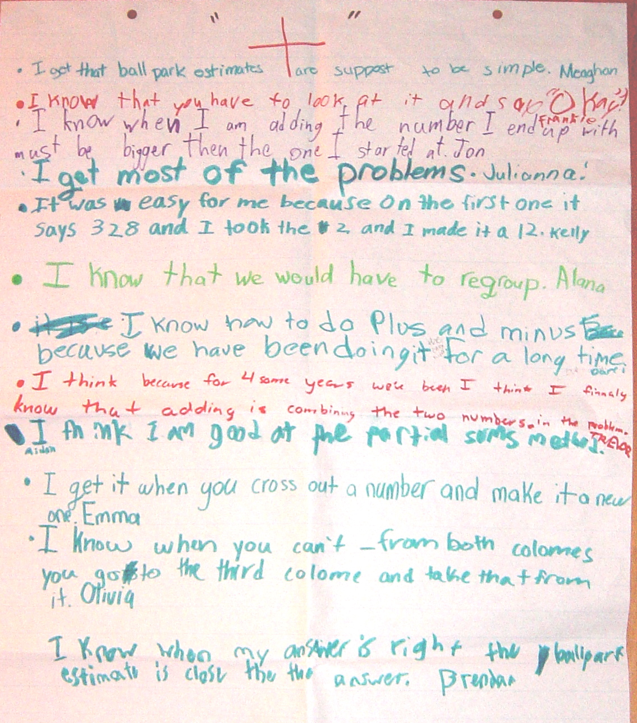

Slide 48
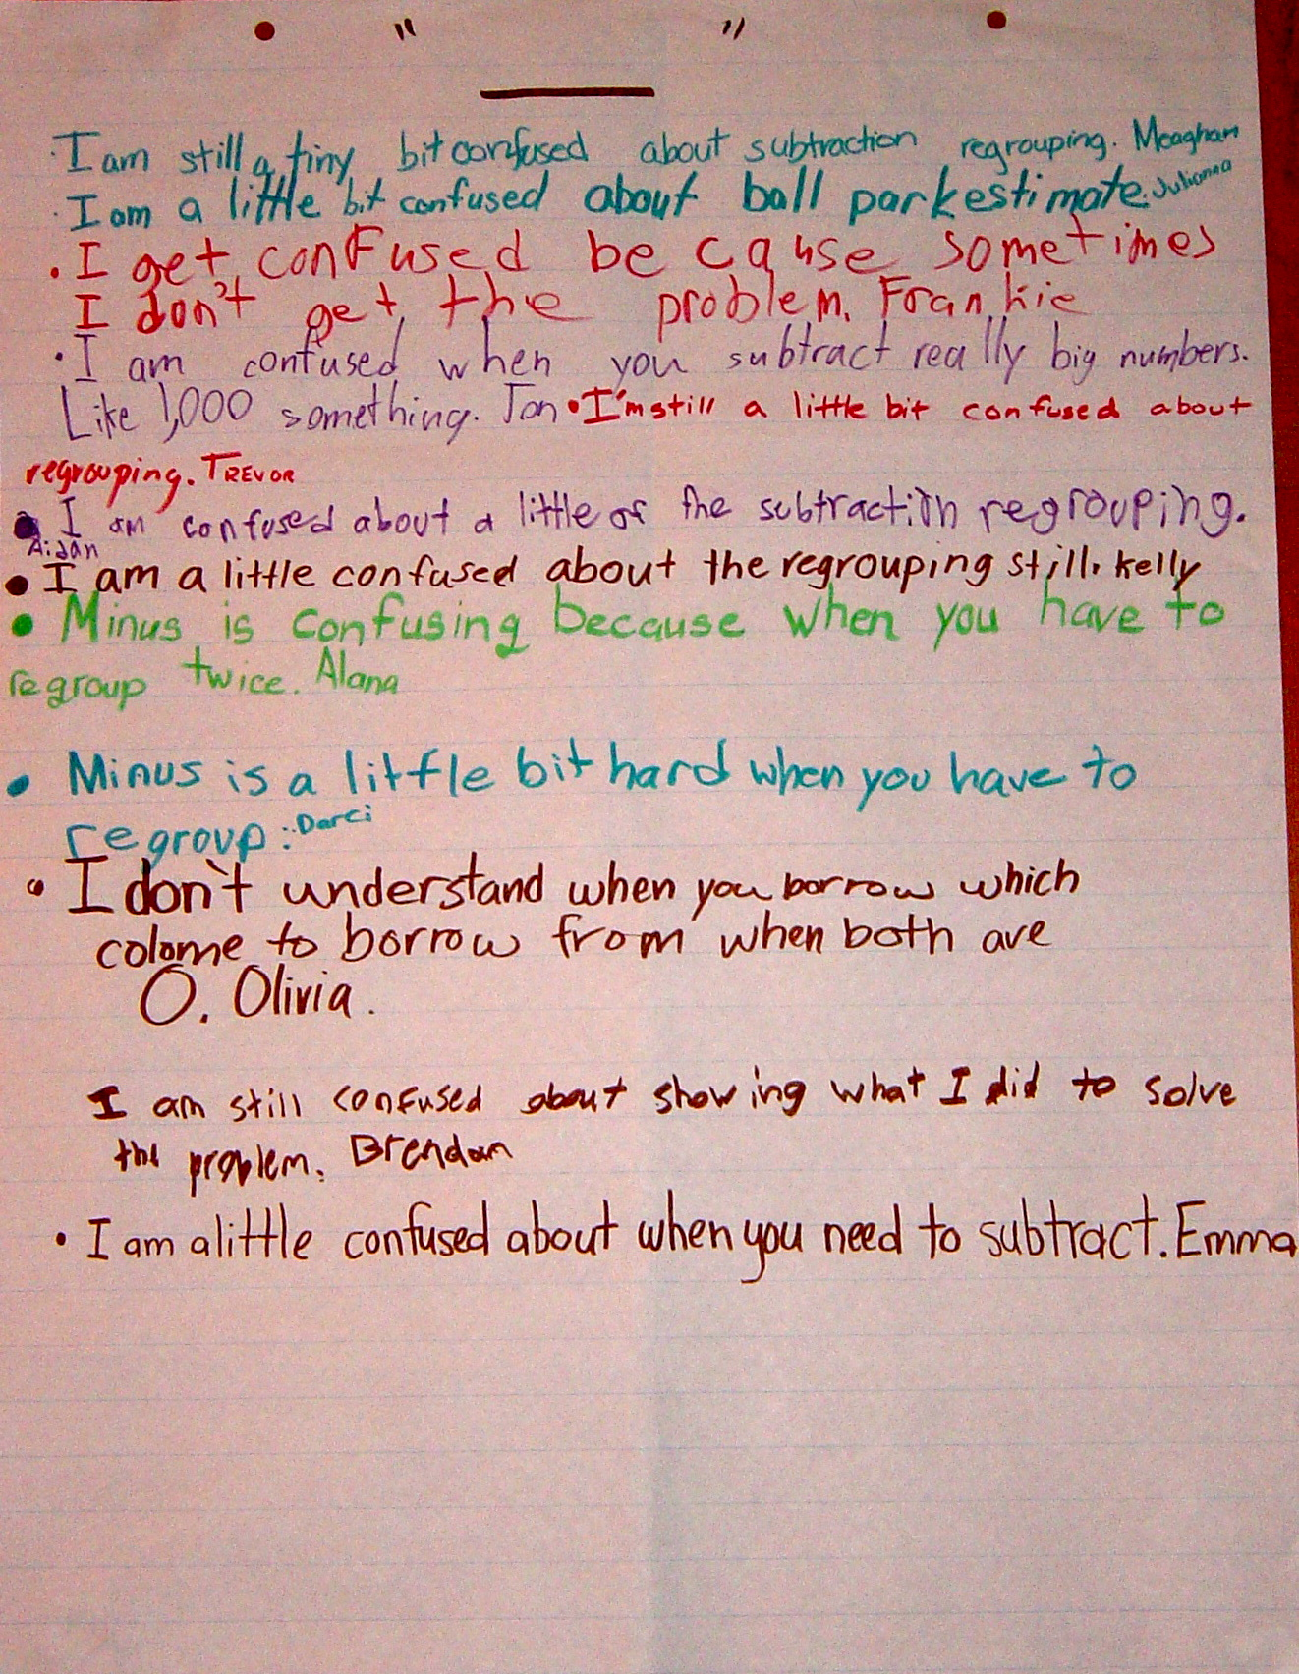

Slide 49
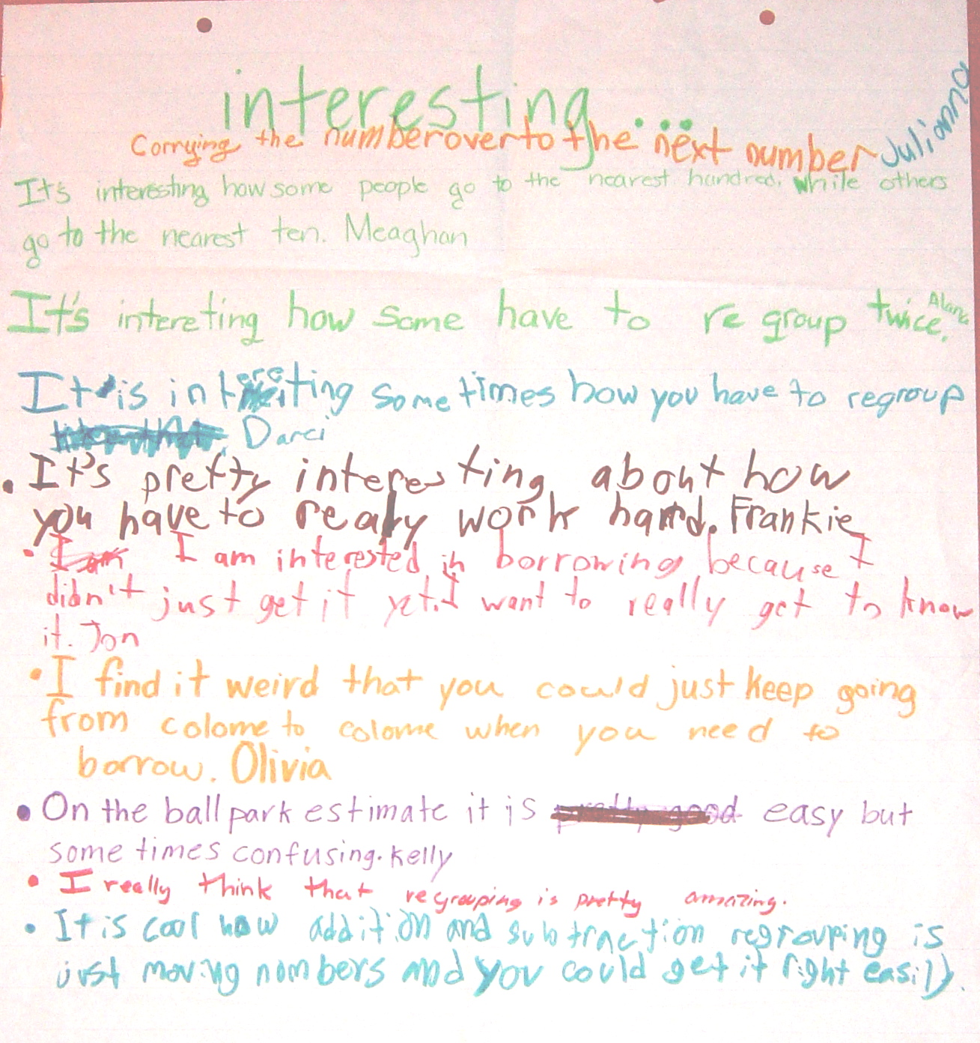

Slide 50
+/–/interesting: responses for “+”
I got that ball-park estimates are supposed to be simple
I know that you have to look at it and say “OK”
I know that when I am adding the number I end up with must be bigger than the one I started at
I get most of the problems
It was easy for me because on the first one it says 328 so I took the 2 and made it a 12
I know that we would have to regroup
I know how to do plus and minus because we have been doing it for a long time
I get it when you cross out a number and make it a new one
I know that when you can’t – from both colomes you go to the third colome and take that from it
I know that when my answer is right the ball park estimate is close to it

Slide 51
+/–/interesting: responses for “–”
I am still a tiny bit confused about subtraction regrouping
I am a little bit confused about ball park estimates
I get confused because sometimes I don’t get the problem
I am confused when you subtract really big numbers like 1,000 something
I’m still a little bit confused about regrouping
Minus is confusing when you have to regroup twice
Minus is a little bit hard when you have to regroup
I don’t understand when you borrow which colome you borrow from when both are 0
I am a little confused about when you need to subtract
I am still confused about showing what I did to solve the problem

Slide 52
+/–/interesting: responses for “interesting”
Carrying the number over to the next number
It’s interesting how some people go to the nearest hundred while some go to the nearest ten
It’s interesting how some have to regroup twice
It’s pretty interesting about how you have to work really hard
I am interested in borrowing because I didn’t just get it yet. I want to really get to know it
I find it weird that you could just keep going from colome to colome when you need to borrow
On the ball park estimate it is easy but sometimes hard
I really think that regrouping is pretty amazing
It is cool how addition and subtraction regrouping is just moving numbers and you could get it right easily

Slide 53
Help students own their own learning
Students assessing their own work:
  With rubrics
  With exemplars
Self-assessment of understanding:
  Learning portfolio
  Traffic lights
  Red/green discs
  Coloured cups
  Plus/minus/interesting
Practice self-testing

Slide 54
Supporting teachers in changing practice

Slide 55
A model for teacher learning
Content, then process
Content (what we want teachers to change):
  Evidence
  Ideas (strategies and techniques)
Process (how to go about change):
  Choice
  Flexibility
  Small steps
  Accountability
  Support

Slide 56
Supportive accountability
What is needed from teachers:
  A commitment to:
    The continual improvement of practice
    Focus on those things that make a difference to students
What is needed from leaders:
  A commitment to engineer effective learning environments for teachers by:
    Creating expectations for continually improving practice
    Keeping the focus on the things that make a difference to students
    Providing the time, space, dispensation, and support for innovation
    Supporting risk-taking

Slide 57
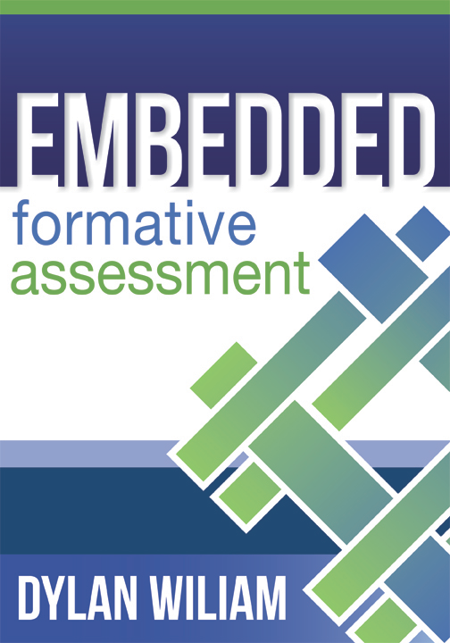
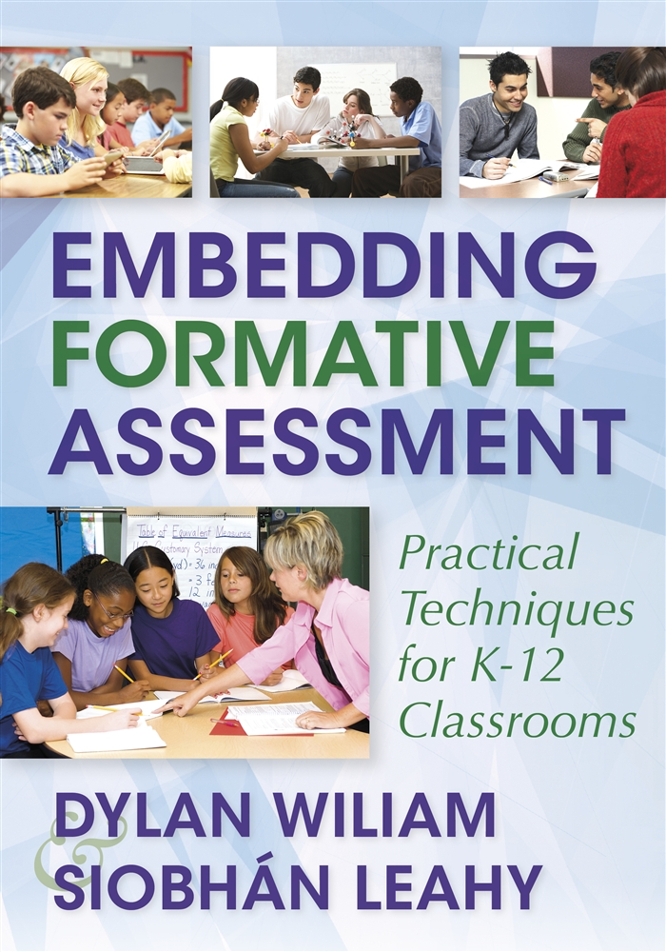


To find out more…
www.dylanwiliamcenter.com
www.dylanwiliam.net
Notes:
These are a few books you might consider. We would recommend you start with Embedding Formative Assessment. Maybe consider a book study.

