Slide 1
Dylan Wiliam (@dylanwiliam)
How formative assessment improves teacher effectiveness and student learning
www.dylanwiliamcenter.com

Slide 2
Why Strategic Formative Assessment?
A principle and an uncomfortable fact about the world
The principle:
"If I had to reduce all of educational psychology to just one principle, I would say this: The most important single factor influencing learning is what the learner already knows. Ascertain this and teach him [or her] accordingly” (Ausubel, 1968 p. vi)
The uncomfortable fact:
Students do not learn what we teach.
What is learning?
Learning is a change in long-term memory (Kirschner et al., 2006)
The fact that someone can do something now does not mean they will be able to do it in six weeks, but
If they cannot do something now, it is highly unlikely they will be able to do it in six weeks

Slide 3
Building Plan “B” into Plan “A”

Slide 4
Relevant studies
Fuchs & Fuchs (1986)
Natriello (1987)
Crooks (1988)
Bangert-Drowns et al. (1991)
Dempster (1991, 1992)
Elshout-Mohr (1994)
Kluger & DeNisi (1996)
Black & Wiliam (1998)
Nyquist (2003)
Allal & Lopez (2005)
Köller (2005)
Brookhart (2007)
Wiliam (2007)
Hattie & Timperley (2007)
Shute (2008)
Kingston & Nash (2011, 2015)

Slide 5
Formative Assessment: A contested term
Long-cycle
Medium-cycle
Short-cycle
Across terms, teaching units
Within and between teaching units
Within and between lessons
Span
Four weeks to
one year
One to four weeks
Minute-by-minute and day-by-day
Length
Monitoring, curriculum alignment
Student-involved assessment
Engagement, responsiveness
Impact

Slide 6
Unpacking Formative Assessment
 | Where the learner is going | Where the learner is now | How to get the learner there
Teacher
Peer
Student
Clarifying, sharing, and understanding learning intentions
Eliciting evidence of learning
Providing feedback that moves learners forward
Activating students as learning
resources for one another
Activating students as
owners of their own learning

Slide 7
Unpacking Formative Assessment
 | Where the learner is going | Where the learner is now | How to get the learner there
Teacher
Peer
Student
Using evidence of achievement to adapt what happens in classrooms to meet learner needs

Slide 8
An educational positioning system
A good teacher:
Establishes where the students are in their learning
Identifies the learning destination
Carefully plans a route
Begins the learning journey
Makes regular checks on progress on the way
Makes adjustments to the course as conditions dictate

Slide 9
Strategies and practical techniques for classroom formative assessment

Slide 10
Clarifying, sharing and understanding learning intentions

Slide 11
Share learning intentions
Keep the context out of the learning intention
Differentiate success criteria, not learning intentions
Generic, not specific criteria
Process versus product success criteria

Slide 12
Kinds of questions: Israel
Which fraction is the smallest?
Success rate 88%
Which fraction is the largest?
Success rate 46%; 39% chose (b)
Vinner (1997)

Slide 13
Share learning intentions
Keep the context out of the learning intention
Differentiate success criteria, not learning intentions
Process versus product success criteria
Generic, not specific criteria
Start with samples of work, rather than rubrics, to communicate quality
Quality cannot always be reduced to words
Ensure deep and surface features are not aligned
Don’t abdicate responsibility for quality

Slide 14
Engineering effective discussions, activities, and classroom tasks that elicit evidence of learning

Slide 15
Eliciting evidence
No hands up (except to ask a question)
Choose students at random
No opting out
Avoiding questions altogether
All-student response systems
Decision-driven data collection
Hinge-questions

Slide 16
Hinge questions

Slide 17
Principles of diagnostic questioning
A response from every student
ABCD cards, mini-white boards, exit passes
Quick checks on understanding, not extended discussions
Decision-driven data-collection
The right response means the right thinking
Distractor-driven multiple-choice questions
Multiple correct responses

Slide 18
Distractor-driven multiple choice questions
Janet was asked to do an experiment to find how long it takes for some sugar to dissolve in water. What advice would you give Janet to tell her how many repeated measurements to take?
Two or three measurements are always enough
She should take 5 measurements
If she is accurate she only needs to measure once
She should go on taking measurements until she knows how much they vary
She should go on taking measurements until she gets two or more the same
Osborne (2011)

Slide 19
Multiple correct responses (2)
20 cm
What is the area of the semi-circle?
A. B. C. D. E.

Slide 20
Distractor-driven and multiple correct responses
Identify the adverbs in these sentences:
The boy ran across the street quickly. (A) (B) (C) (D) (E)
Jayne usually crossed the street in a leisurely fashion. (A) (B) (C) (D) (E)
Fred ran the race well but unsuccessfully. (A) (B) (C) (D) (E)

Slide 21
Developing good questions
Start by identifying a “hinge-point” in a lesson plan—a point where you need to collect evidence from students in order to decide what to do next
Identify any relevant misconceptions
by discussion with colleagues
by asking the question as an “exit-pass”
Develop the question
Ask colleagues to look for possible false-positives
Trial the question with students, asking them to explain their choices

Slide 22
Providing feedback that moves learners forward

Slide 23
Effects of feedback
Kluger & DeNisi (1996) review of 3000 research reports
Excluding those:
without adequate controls
with poor design
with fewer than 10 participants
where performance was not measured
without details of effect sizes
left 131 reports, 607 effect sizes, involving 12652 individuals
On average, feedback increases achievement
Effect sizes highly variable
38% (231 out of 607) of effect sizes were negative

Slide 24
Getting feedback right is hard
Response type | Feedback indicates performance…
 | falls short of goal | exceeds goal
Change behavior | Increase effort | Exert less effort
Change goal | Reduce aspiration | Increase aspiration
Abandon goal | Decide goal is too hard | Decide goal is too easy
Reject feedback | Feedback is ignored | Feedback is ignored

Slide 25
Provide feedback that moves learning on
Focus on the reaction of the students, not the feedback
Develop a growth mindset in your students
Design feedback as part of a system
Concentrate on “personal bests”
Make feedback into detective work

Slide 26
Activating students as learning resources for one another

Slide 27
Cooperative learning: a research success story
Two essential components
Group goals:
so students are working as a group, not just in a group
Individual accountability:
the best learning efforts of every member of the group must be necessary for the group to succeed, and
the performance of each group member must be clearly visible and quantifiable to the other group members
Slavin, Hurley and Chamberlain (2003)

Slide 28
How does cooperative learning work?
Four mechanisms
Motivation: students help their peers to learn because, in well-structured cooperative learning settings, it is in their own interests to do so, and so effort is increased;
Social cohesion: students help their peers because they care about the group, again leading to increased effort;
Personalization: students learn more because more able peers can engage with the particular difficulties a student is having;
Cognitive elaboration: those who provide help in group settings are forced to think through the ideas more clearly.
Slavin, Hurley and Chamberlain (2003)

Slide 29
Help students be learning resources
Students assessing their peers’ work:
“Pre-flight checklist”
“Two stars and a wish”
Choose-swap-choose
Daily sign-in
End-of-lesson students’ review
Best composite test paper

Slide 30
Activating students as owners of their own learning

Slide 31
Help students own their own learning
Students assessing their own work:
With rubrics
With exemplars
Self-assessment of understanding:
Learning portfolio
Traffic lights
Red/green discs
Coloured cups
Plus/minus/interesting

Slide 32
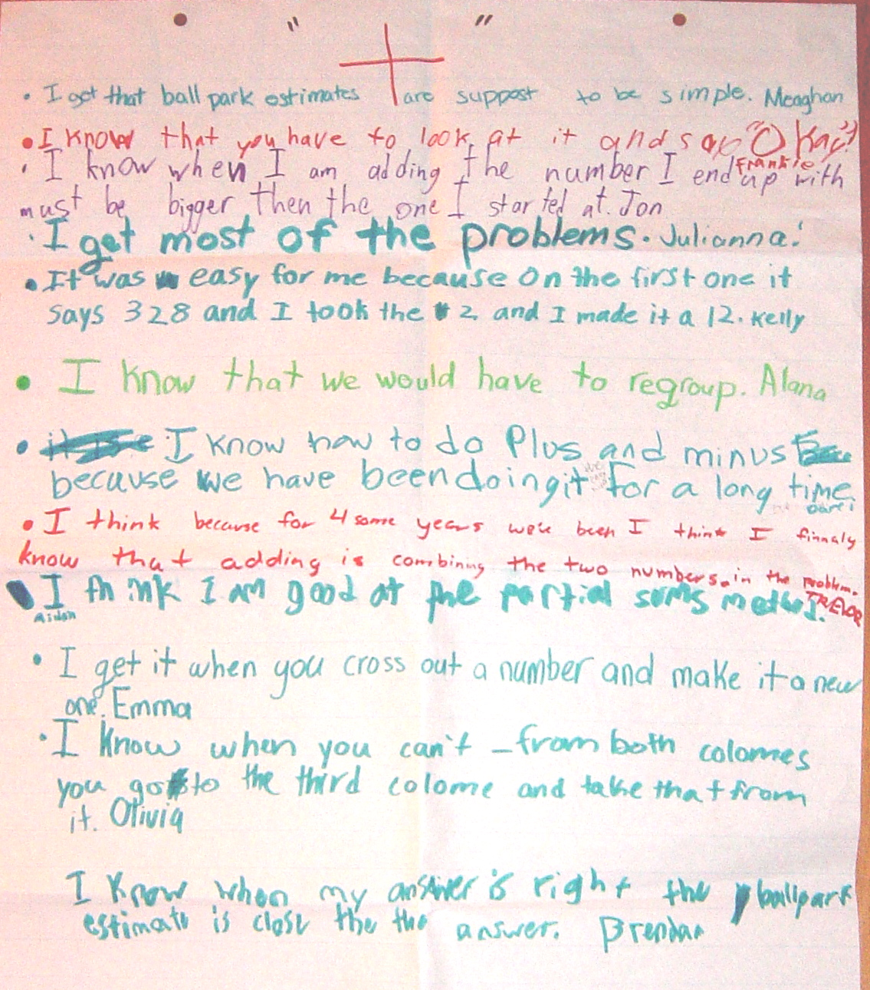

Slide 33
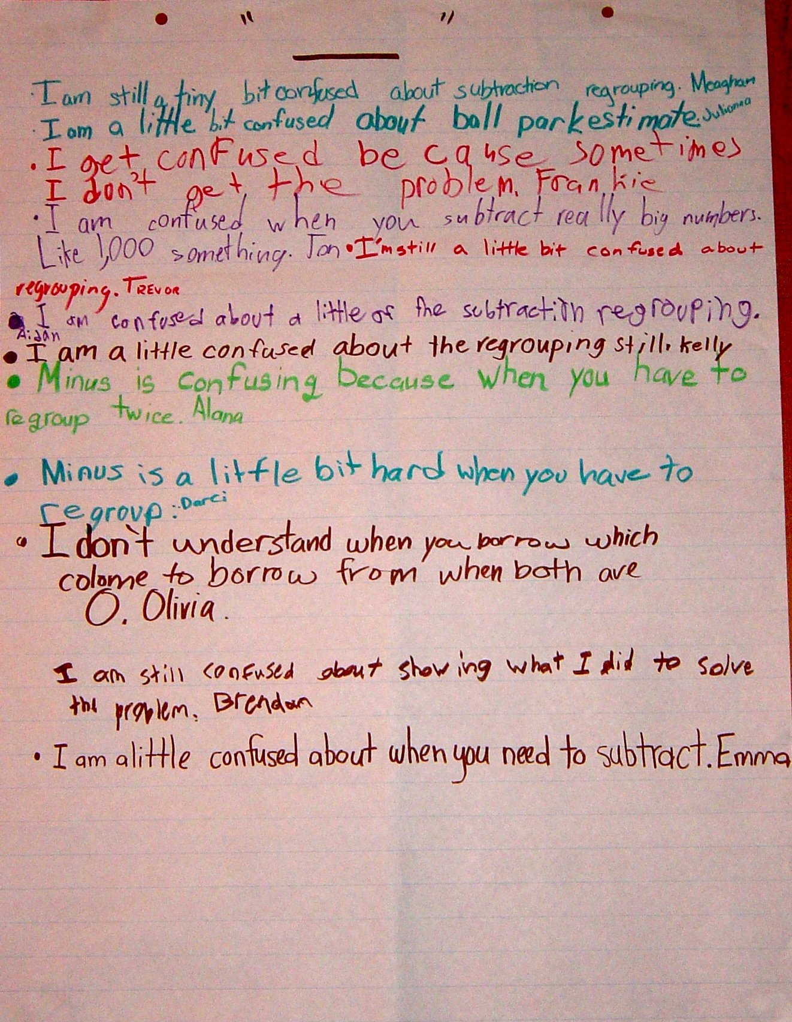

Slide 34
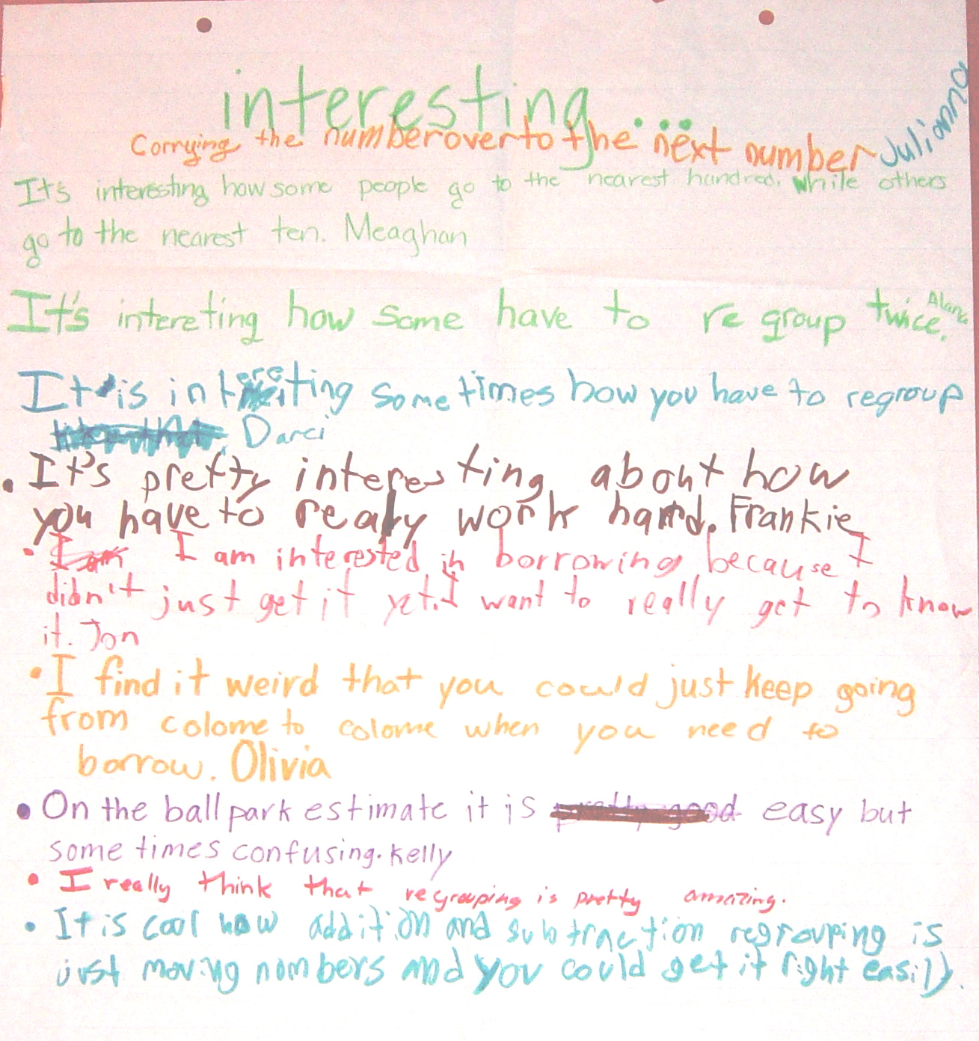

Slide 35
+/–/interesting: responses for “+”
I got that ball-park estimates are supposed to be simple
I know that you have to look at it and say “OK”
I know that when I am adding the number I end up with must be bigger than the one I started at
I get most of the problems
It was easy for me because on the first one it says 328 so I took the 2 and made it a 12
I know that we would have to regroup
I know how to do plus and minus because we have been doing it for a long time
I get it when you cross out a number and make it a new one
I know that when you can’t – from both colomes you go to the third colome and take that from it
I know that when my answer is right the ball park estimate is close to it

Slide 36
+/–/interesting: responses for “–”
I am still a tiny bit confused about subtraction regrouping
I am a little bit confused about ball park estimates
I get confused because sometimes I don’t get the problem
I am confused when you subtract really big numbers like 1,000 something
I’m still a little bit confused about regrouping
Minus is confusing when you have to regroup twice
Minus is a little bit hard when you have to regroup
I don’t understand when you borrow which colome you borrow from when both are 0
I am a little confused about when you need to subtract
I am still confused about showing what I did to solve the problem

Slide 37
+/–/interesting: responses for “interesting”
Carrying the number over to the next number
It’s interesting how some people go to the nearest hundred while some go to the nearest ten
It’s interesting how some have to regroup twice
It’s pretty interesting about how you have to work really hard
I am interested in borrowing because I didn’t just get it yet. I want to really get to know it
I find it weird that you could just keep going from colome to colome when you need to borrow
On the ball park estimate it is easy but sometimes hard
I really think that regrouping is pretty amazing
It is cool how addition and subtraction regrouping is just moving numbers and you could get it right easily

Slide 38
Self-assessment in the early years

Slide 40
All ready for action in third grade…

Slide 41
Tell me about you…

Slide 42
Technique review

Slide 43
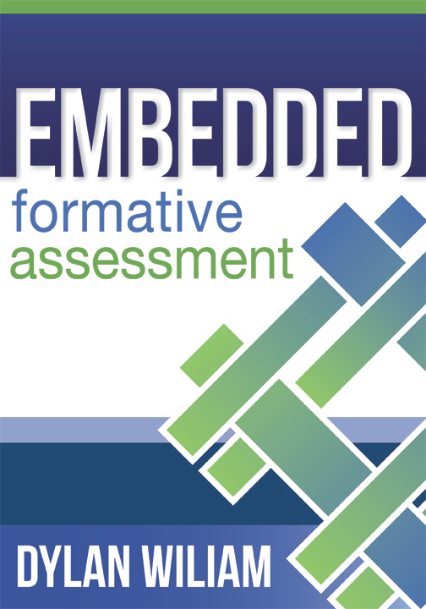
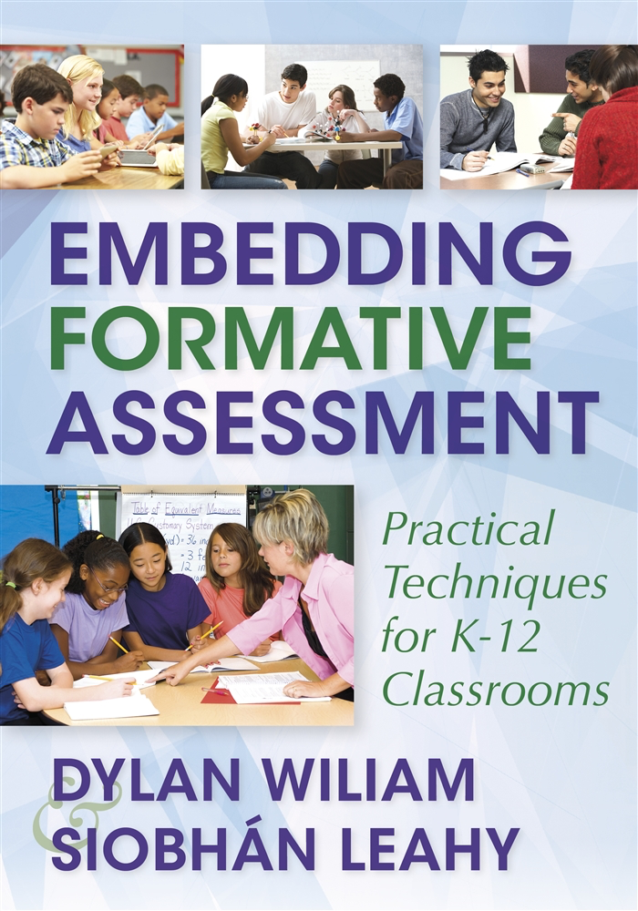
To find out more…
www.dylanwiliam.net
www.dylanwiliamcenter.com

Slide 44
…and even more...

