Slide 1
Cognitive Load Theory
Wisconsin Mathematics Council Ignite session: May 3rd, 2017
Dylan Wiliam (@dylanwiliam)
www.dylanwiliamcenter.com
www.dylanwiliam.net

Slide 2
Kinds of knowledge: an evolutionary approach
Biologically primary knowledge
Biologically secondary knowledge
Recognizing faces
Recognizing speech
General problem solving
Learnable
Reading
Writing
Mathematics
Learnable
Not teachable
Teachable
Geary (2007, 2008)

Slide 3
Countdown game
Target number: 127
25
3
1
9
4

Slide 4
A model of human memory
Long-term memory
Short-term memory
Environment
Limited
Limitless

Slide 5
The purpose of math instruction is to build domain-specific mathematical knowledge—i.e., long-term memory

Slide 6
Memory in chess
Studies of memory in chess
Djakow, Petrovskij, and Rudik (1927)
Adriaan De Groot (1946)
Chase and Simon (1973)

Slide 7
Memory in chess (1)
Mid-game | Player level | Number of pieces correctly placed
 | Novice | 5
 | Club player | 9
 | Expert | 16
Random | Player level | Number of pieces correctly placed
 | Novice | 2
 | Club player | 3
 | Expert | 3

Slide 8
Memory in chess (2)
End game | Player level | Number of pieces correctly placed
 | Novice | 4
 | Club player | 7
 | Expert | 8
Attempts to simulate the performance of the expert chess player with computers suggest that the expert can recognize at least 10,000, but less than 100,000, different arrangements of chess pieces or “chunks,” with a most likely value around 13,500 (Simon & Gilmartin, 1973)

Slide 9
What is learning?
Learning is “a change in long-term memory” (Kirschner, Sweller, & Clark, 2016 p. 77)
“The aim of all instruction is to alter long-term memory. If nothing has changed in long-term memory, nothing has been learned.” (ibid p. 77)
“Novices need to use thinking skills. Experts use knowledge” (Sweller et al., 2011 p. 21)

Slide 10
John Sweller

Slide 11
A mathematical problem
Transform a given number to a target number using just two mathematical operations:
subtract 29
multiply by 3
For example
Starting number: 27
Target number: 1027
Solution:
x 3, — 29, x 3, — 29, x 3, — 29, x 3, — 29

Slide 12
The origins of cognitive load theory
All the problems could be solved only in one way, which involved alternating the two available operations
Students solved the problems
But they did not notice the fact that all the problems had similar solution strategies
For novices, solving problems is not the best way to get better at solving problems

Slide 13
Cognitive load theory
Cognitive load
Intrinsic
“imposed by the basic structure of information being taught”
Extraneous
“imposed by the manner in which the information is presented or the activities in which learners must engage”
Levels of cognitive load are determined by element interactivity

Slide 14
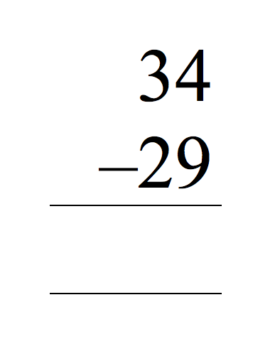
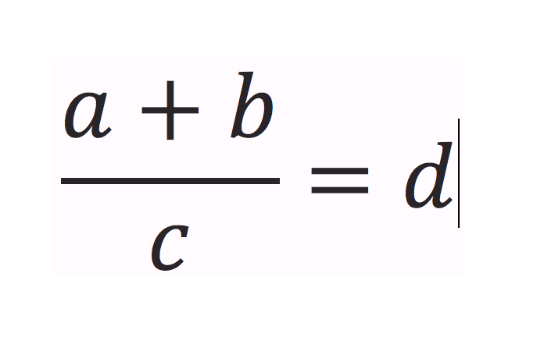
Element interactivity
“Interacting elements are defined as elements that must be processed simultaneously in working memory because they are logically related” (Sweller, Ayres, & Kalyuga, 2011 p. 58)
Low
Medium
High
Scalene
Isosceles
Equilateral

Slide 15
Instructional design
Good instruction minimizes both extraneous and intrinsic cognitive load
Extraneous cognitive load is reduced through good instructional design
Intrinsic cognitive load is reduced through good instructional sequencing

Slide 16
The goal-free effect
“When novices solve a conventional problem, they will frequently work backwards from the goal to the givens using a means–ends strategy.”
“In contrast, experts, using schemas held in long-term memory, know the solution and are more likely to work forward from the givens to the goal.”
“Working memory may be overwhelmed by a means–ends strategy, reducing or even preventing learning”

Slide 17
Worked-example/problem completion effects
“Studying worked examples provides one of the best, possibly the best, means of learning how to solve problems in a novel domain.” (p. 107)
Strategies
Present worked example and ask students to solve a similar problem
Increase engagement by using completion problems
Guidance fading: forwards is better than backwards

Slide 18
Split-attention effect
In the figure shown, find a value for ∠ DBE
Solution:
∠ ABC = 180° – ∠ BAC – ∠ BCA
= 180° – 45° – 55°
= 80°
∠ DBE = ∠ ABC (vertically opposite)
= 80°
A
45°
B
55°
D
C
Sweller, Merrienboer and Paas (1998)
E

Slide 19
Integrated example with no split attention
A
45°
1
B
180° – 55° – 45°
= 80°
55°
D
C
80°
2
E

Slide 20
Other important aspects
Redundancy
Modality effects
Transient information effects
Expertise reversal effect
Collective working memory effects

