Slide 1
Dylan Wiliam (@dylanwiliam)
Engineering effective tasks, activities, and discussions that elicit evidence of learning
www.dylanwiliamcenter.com

Slide 2
Unpacking Formative Assessment
 | Where the learner is going | Where the learner is now | How to get the learner there
Teacher
Peer
Student
Clarifying, sharing, and understanding learning intentions
Eliciting evidence of learning
Providing feedback that moves learners forward
Activating students as learning
resources for one another
Activating students as
owners of their own learning

Slide 3
Eliciting evidence
No hands up (except to ask a question)
Choose students at random
No opting out
Avoiding questions altogether
All-student response systems
Decision-driven data collection
Hinge-questions

Slide 4
Hands up

Slide 5
Surprising responses

Slide 6
Student responses to random questioning

Slide 7
What psychology tells us about learning
Review of the research on student self-study strategies
Focus on strategies that are relatively easy for students to use
Evaluation in terms of generalizability of findings across
different material to be learned
different learning conditions
different kinds of student
different measures of learning
Dunlosky, Rawson, Marsh, Nathan, and Willingham (2013)

Slide 8
1. Elaborative interrogation | Generating an explanation for why an explicitly stated fact or concept is true
2. Self-explanation | Explaining how new information is related to known information, or explaining steps taken during problem solving
3. Summarization | Writing summaries (of various lengths) of to-be-learned texts
4. Highlighting/underlining | Marking potentially important portions of to-be-learned materials while reading
5. Keyword mnemonic | Using keywords and mental imagery to associate verbal materials
6. Imagery for text | Attempting to form mental images of text materials while reading or listening
7. Rereading | Restudying text material again after an initial reading
8. Practice testing | Self-testing or taking practice tests over to-be-learned material
9. Distributed practice | Implementing a schedule of practice that spreads out study activities over time
10. Interleaved practice | Practice that mixes different kinds of problems, or study that mixes different kinds of material, within a single study session

Slide 9
Which of these consistently improves learning?
Elaborative interrogation
Self-explanation
Summarization
Highlighting/underlining
Keyword mnemonic
Imagery for text
Rereading
Practice testing
Distributed practice
Interleaved practice

Slide 10
“The new theory of disuse”
An item in memory is characterized by
Storage strength
how well learned an item is
can only increase
Retrieval strength
how easy an item is to retrieve at a particular time
goes up and down
Bjork (1992)

Slide 11
Storage strength and retrieval strength
 |  | Storage strength
 |  | Low | High
Retrieval strength | Low
 | High
Credit card number
First license plate number
Current parking space number
Social security number

Slide 12
How memory really works
Storage strength and retrieval strength are increased by
Re-studying an item
Retrieving it from memory
Retrieval has a greater impact than re-study
Retrieval and re-study increase:
storage strength more when retrieval strength is low
retrieval strength more when
retrieval strength is low
storage strength is high
Learners need “desirable difficulties” in learning
Bjork (1992)

Slide 13
Real-time test: Figurative language
He was like a bull in a china shop.
This backpack weighs a ton.
The sweetly smiling sunshine…
He honked his horn at the cyclist.
He was as tall as a house.
Alliteration
Hyperbole
Onomatopoeia
Personification
Simile

Slide 14
Eliciting evidence: Kinds of questions

Slide 15
Kinds of questions: Israel
Which fraction is the smallest?
Success rate 88%
Which fraction is the largest?
Success rate 46%; 39% chose (b)
Vinner (1997)

Slide 16
Questioning in science: Discussion
Ice-cubes are added to a glass of water. What happens to the level of the water as the ice-cubes melt?
The level of the water drops
The level of the water stays the same
The level of the water increases
You need more information to be sure

Slide 17
Questioning in science: Diagnosis
Version 1
Version 2
Which of these are living?
Rock
Cat
Table
Bird
Which of these are living?
Grass
Bus
Computer
Tree

Slide 18
Questioning in English: Diagnosis (1)
Where is the verb in this sentence?
The dog ran across the road
A
B
C
D

Slide 19
Questioning in English: Diagnosis (2)
Which of these is correct?
Its on its way.
It’s on its way.
Its on it’s way.
It’s on it’s way.

Slide 20
Principles of diagnostic questioning
A response from every student
ABCD cards, mini-white boards, exit passes
Quick checks on understanding, not extended discussions
Decision-driven data-collection
The right response means the right thinking
Distractor-driven multiple-choice questions
Multiple correct responses

Slide 21
Distractor-driven multiple choice questions
Janet was asked to do an experiment to find how long it takes for some sugar to dissolve in water. What advice would you give Janet to tell her how many repeated measurements to take?
Two or three measurements are always enough
She should take 5 measurements
If she is accurate she only needs to measure once
She should go on taking measurements until she knows how much they vary
She should go on taking measurements until she gets two or more the same
Osborne (2011)

Slide 22
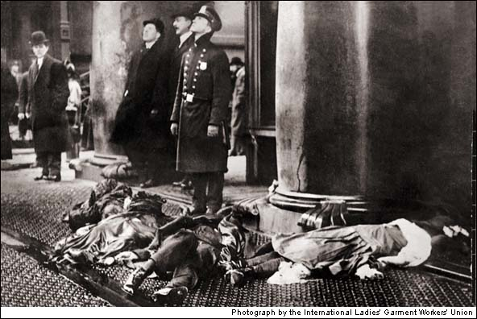
Triangle Shirtwaist Factory fire, March 25th, 1911

Slide 23
Triangle factory fire
Which of the following sources is biased?
Photograph of the event
New York Times story on Mar 26, 1911
Description of the fire in the textbook
Transcript of talk by Frances Perkins, Sep 30 1964

Slide 24
Multiple correct responses (2)
20 cm
What is the area of the semi-circle?
A. B. C. D. E.

Slide 25
Distractor-driven and multiple correct responses
Identify the adverbs in these sentences:
The boy ran across the street quickly. (A) (B) (C) (D) (E)
Jayne usually crossed the street in a leisurely fashion. (A) (B) (C) (D) (E)
Fred ran the race well but unsuccessfully. (A) (B) (C) (D) (E)

Slide 26
Developing good questions
Start by identifying a “hinge-point” in a lesson plan—a point where you need to collect evidence from students in order to decide what to do next
Identify any relevant misconceptions
by discussion with colleagues
by asking the question as an “exit-pass”
Develop the question
Ask colleagues to look for possible false-positives
Trial the question with students, asking them to explain their choices

Slide 27
Hinge-point questions
Working in groups of three or four, agree on a “hinge-point” in learning
Generate a “hinge-point question” that could be used to determine whether the student is ready to move on
Share your hinge-point question with another group
Their task is to find a way that a student with the wrong idea could give the right response
If they can, the question is returned to you for more work
If they can’t, your question is ready for trying out

Slide 28
Pros and cons of random questioning
 | + | —
Teachers
Students

Slide 29
Hot seat questioning

