Slide 1
Dylan Wiliam (@dylanwiliam)
Formative assessment:
The student’s role
www.dylanwiliamcenter.com

Slide 2
Unpacking Formative Assessment
 | Where the learner is going | Where the learner is now | How to get the learner there
Teacher
Peer
Student
Clarifying, sharing, and understanding learning intentions
Eliciting evidence of learning
Providing feedback that moves learners forward
Activating students as learning
resources for one another
Activating students as
owners of their own learning

Slide 3
Clarifying, sharing and understanding learning intentions

Slide 4
Learning intentions and success criteria
In general, it is a good idea that students know where they are going
But,
  It is not always possible
  It is not always advisable
  It is hard to do well

Slide 5
Goals and horizons
Sometimes, you want all students to learn the same thing
  Goal-directed teaching
  Key aim: all students reach the same understanding
Sometimes it is OK when students learn different things
  Horizon-directed teaching
  Key aim: all students learn something of value in the subject

Slide 6
A standard middle school math problem…
Two farmers have adjoining fields with a common boundary that is not straight.
This is inconvenient for ploughing.
How can they divide the two fields
so that the boundary is
straight, but the two
fields have the same
area as they had before?

Slide 9
How many rectangles?

Slide 10
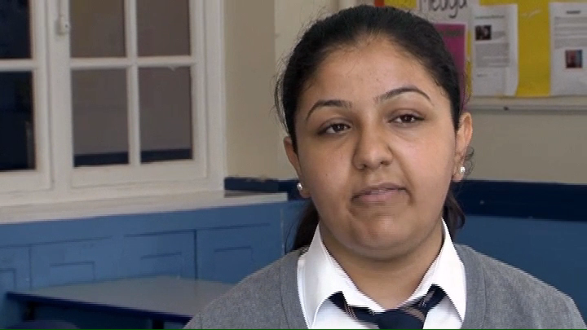
Sharing success criteria (English)

Slide 11
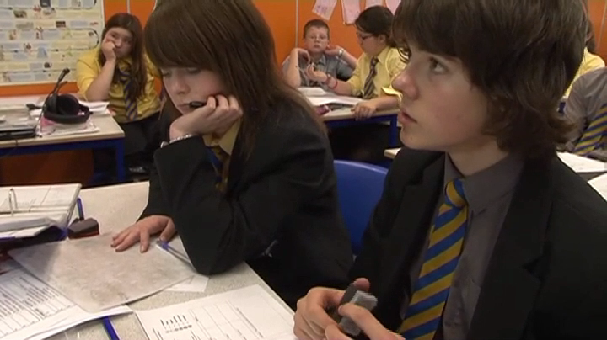
Sharing success criteria (German)

Slide 12
Activating students as owners of their own learning

Slide 13
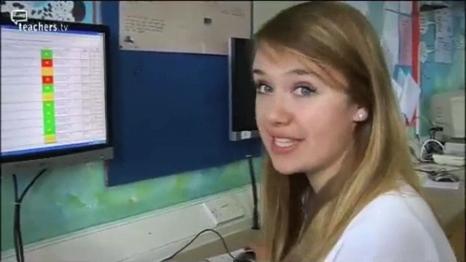
DEEP AfL

Slide 14
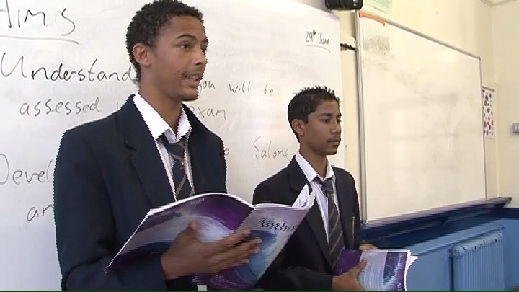
Students leading the lesson

Slide 15
Activating students as owners of their own learning

Slide 16
Benefits of structured interaction
15-yr-olds studying World History were tested on their understanding of material delivered in lectures
Half the students were trained to pose questions as they listened to the lectures
At the end of the lectures, students were given time to review their understanding of the material
 | Individual | Group
Unstructured | Independent review | Group discussion
Structured | Structured self-questioning | Structured peer-questioning

Slide 17
Impact on achievement
King (1991)

Slide 18
Help students own their own learning
Students assessing their own work:
  With rubrics
  With exemplars
Self-assessment of understanding:
  Learning portfolio
  Traffic lights
  Red/green discs
  Coloured cups
  Plus/minus/interesting

Slide 19
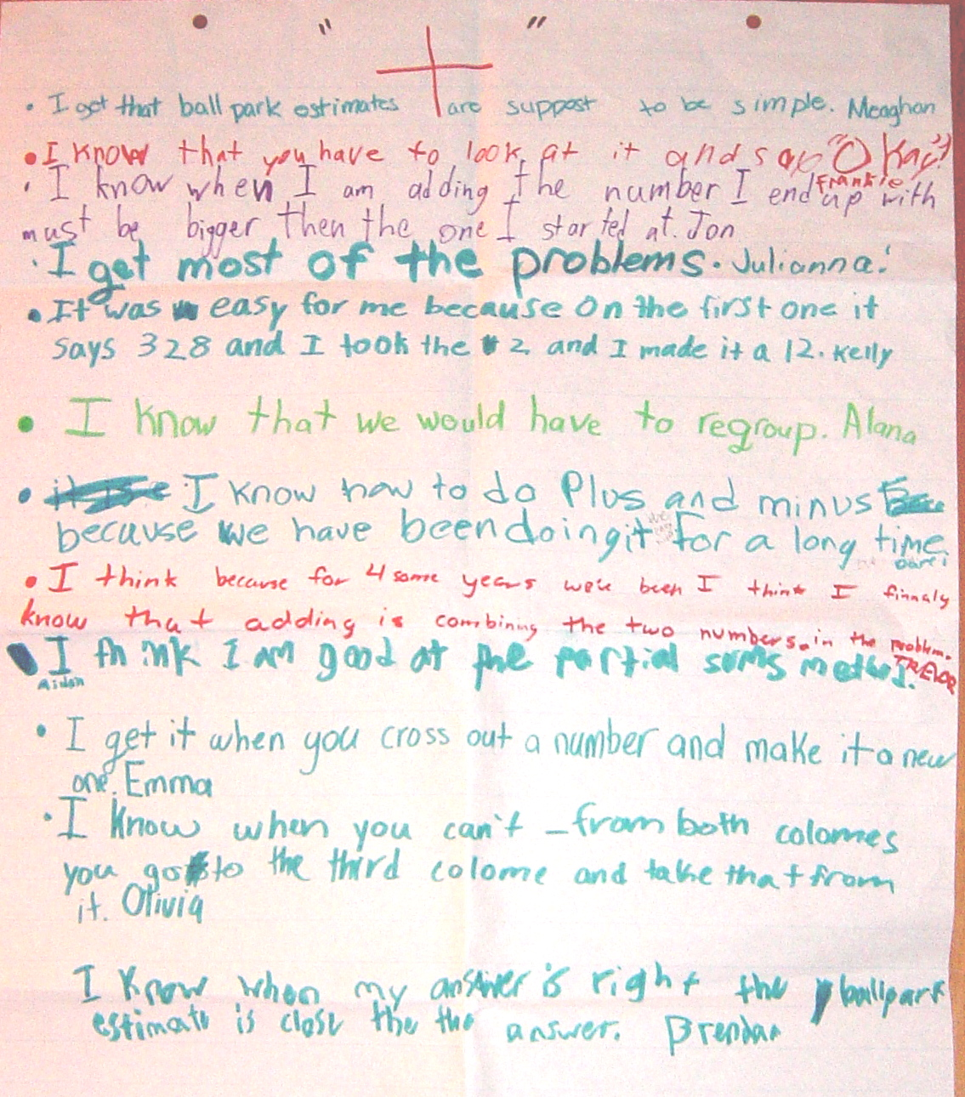

Slide 20
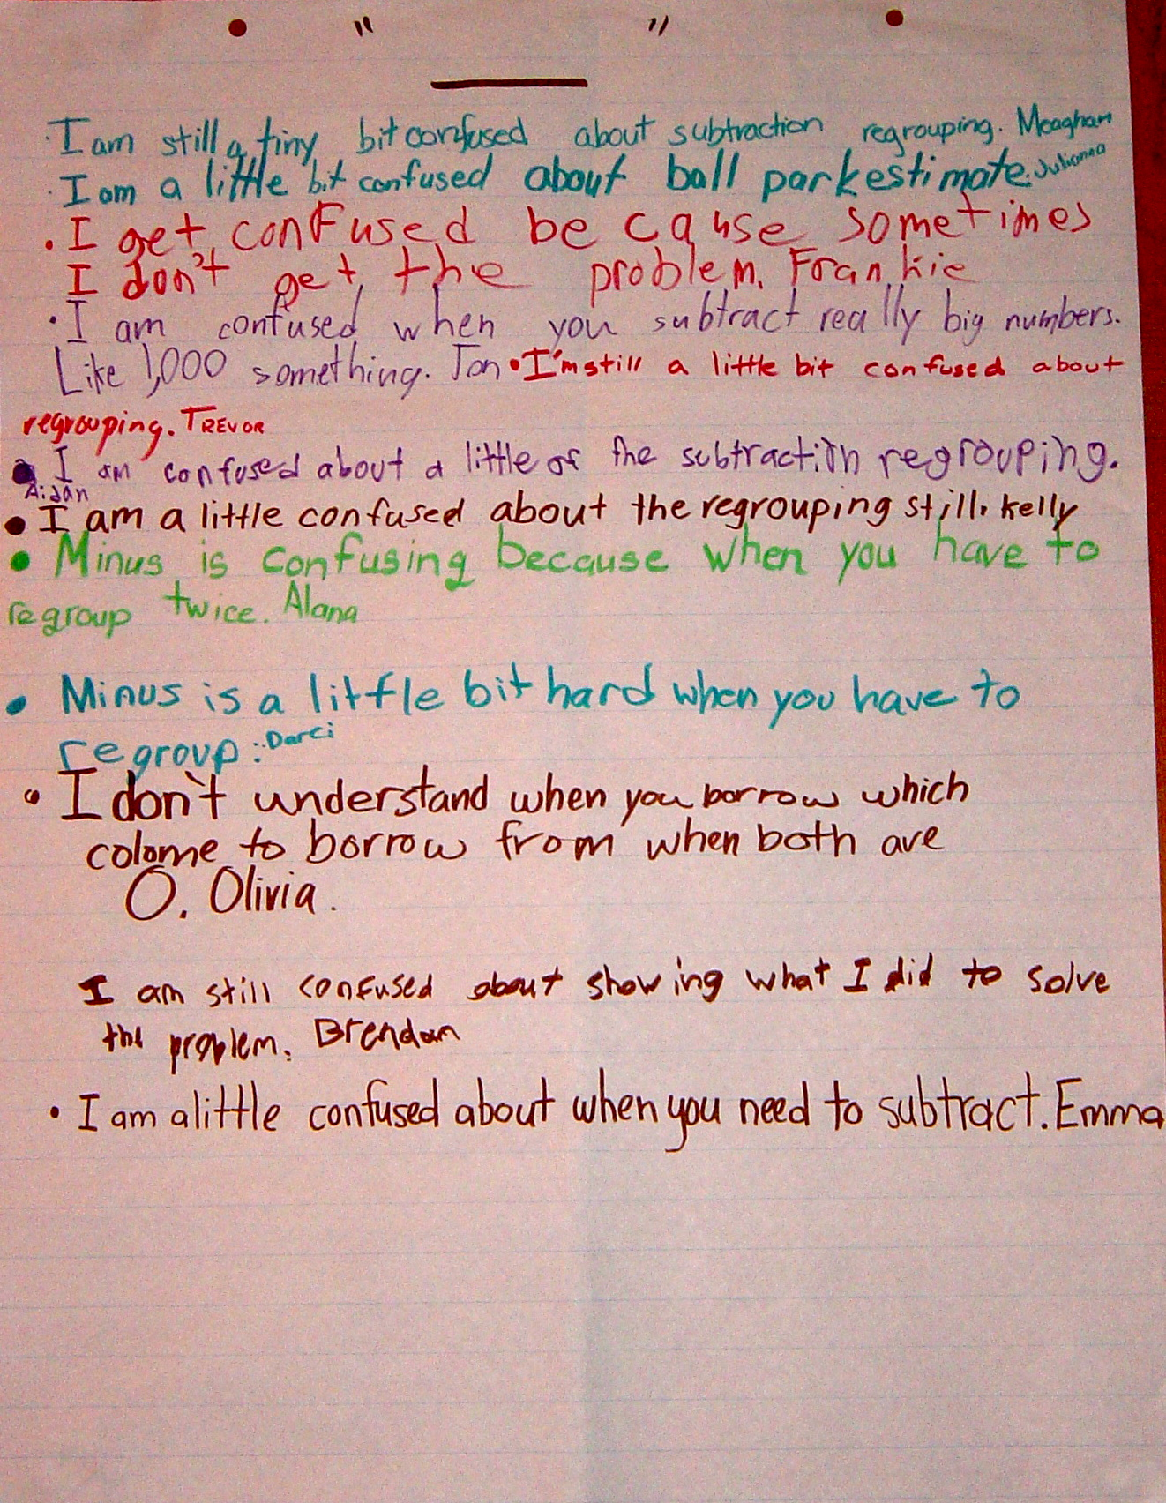

Slide 21
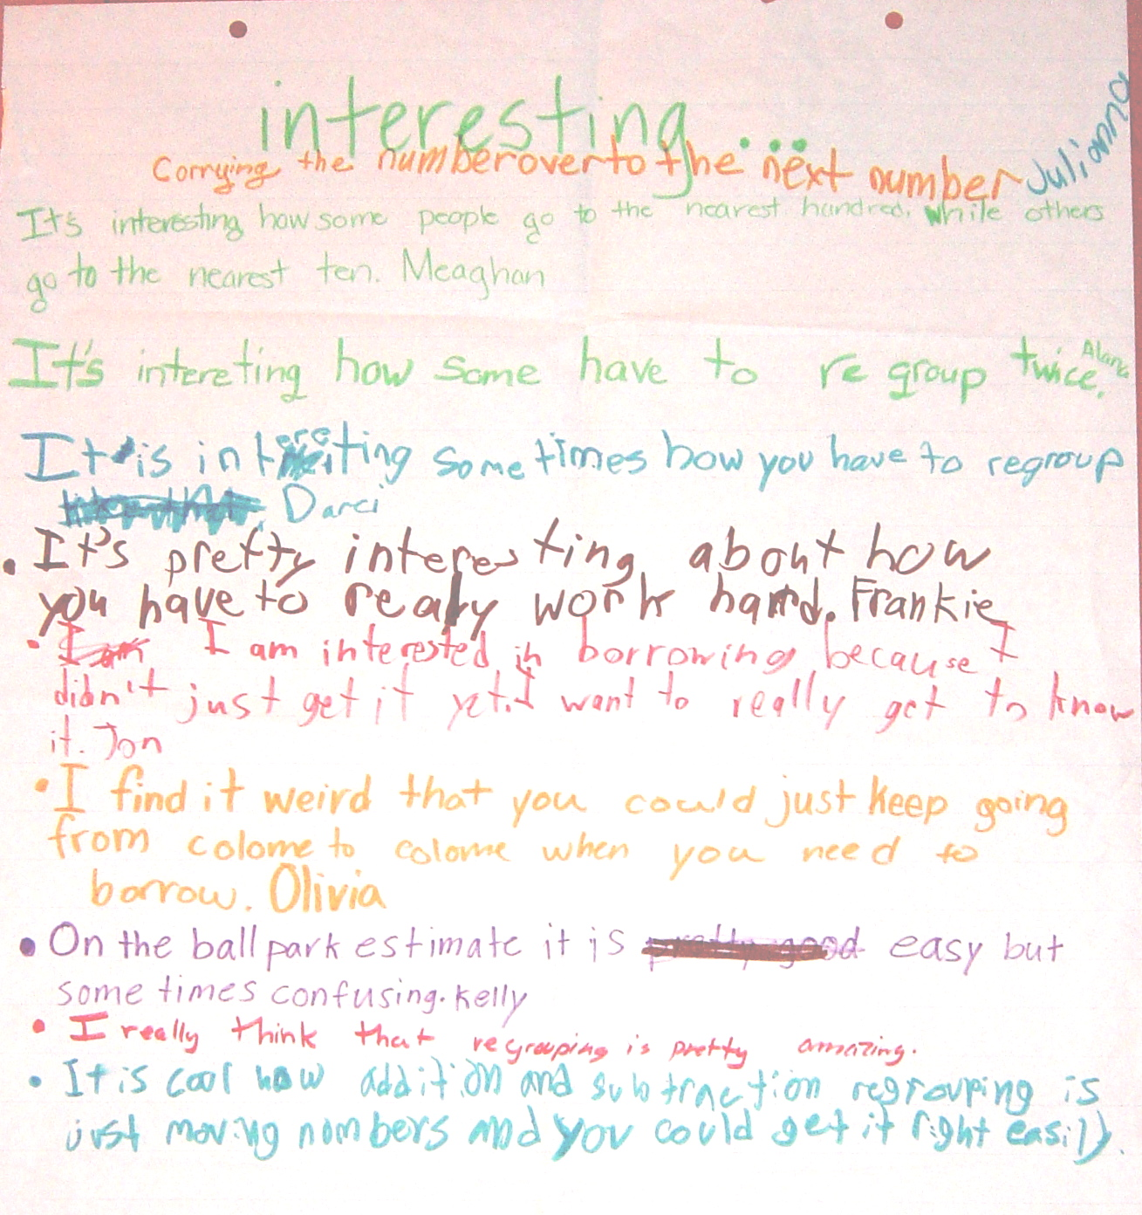

Slide 22
+/–/interesting: responses for “+”
I got that ball-park estimates are supposed to be simple
I know that you have to look at it and say “OK”
I know that when I am adding the number I end up with must be bigger than the one I started at
I get most of the problems
It was easy for me because on the first one it says 328 so I took the 2 and made it a 12
I know that we would have to regroup
I know how to do plus and minus because we have been doing it for a long time
I get it when you cross out a number and make it a new one
I know that when you can’t – from both colomes you go to the third colome and take that from it
I know that when my answer is right the ball park estimate is close to it

Slide 23
+/–/interesting: responses for “–”
I am still a tiny bit confused about subtraction regrouping
I am a little bit confused about ball park estimates
I get confused because sometimes I don’t get the problem
I am confused when you subtract really big numbers like 1,000 something
I’m still a little bit confused about regrouping
Minus is confusing when you have to regroup twice
Minus is a little bit hard when you have to regroup
I don’t understand when you borrow which colome you borrow from when both are 0
I am a little confused about when you need to subtract
I am still confused about showing what I did to solve the problem

Slide 24
+/–/interesting: responses for “interesting”
Carrying the number over to the next number
It’s interesting how some people go to the nearest hundred while some go to the nearest ten
It’s interesting how some have to regroup twice
It’s pretty interesting about how you have to work really hard
I am interested in borrowing because I didn’t just get it yet. I want to really get to know it
I find it weird that you could just keep going from colome to colome when you need to borrow
On the ball park estimate it is easy but sometimes hard
I really think that regrouping is pretty amazing
It is cool how addition and subtraction regrouping is just moving numbers and you could get it right easily

Slide 25
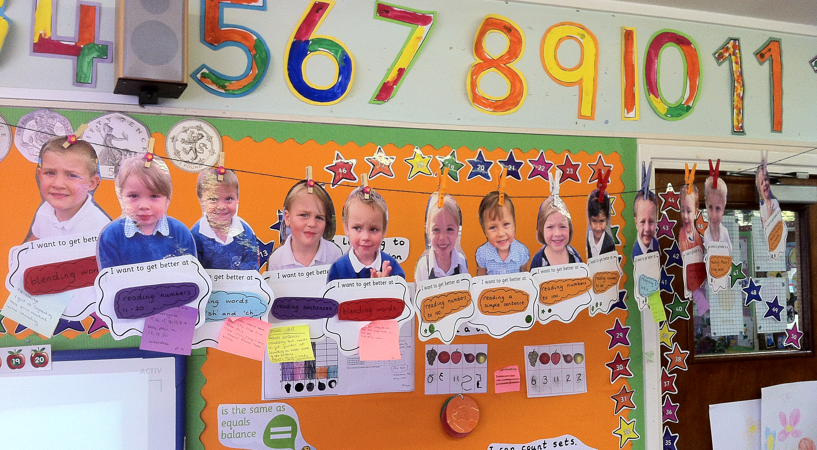
Self-assessment in the early years

Slide 26
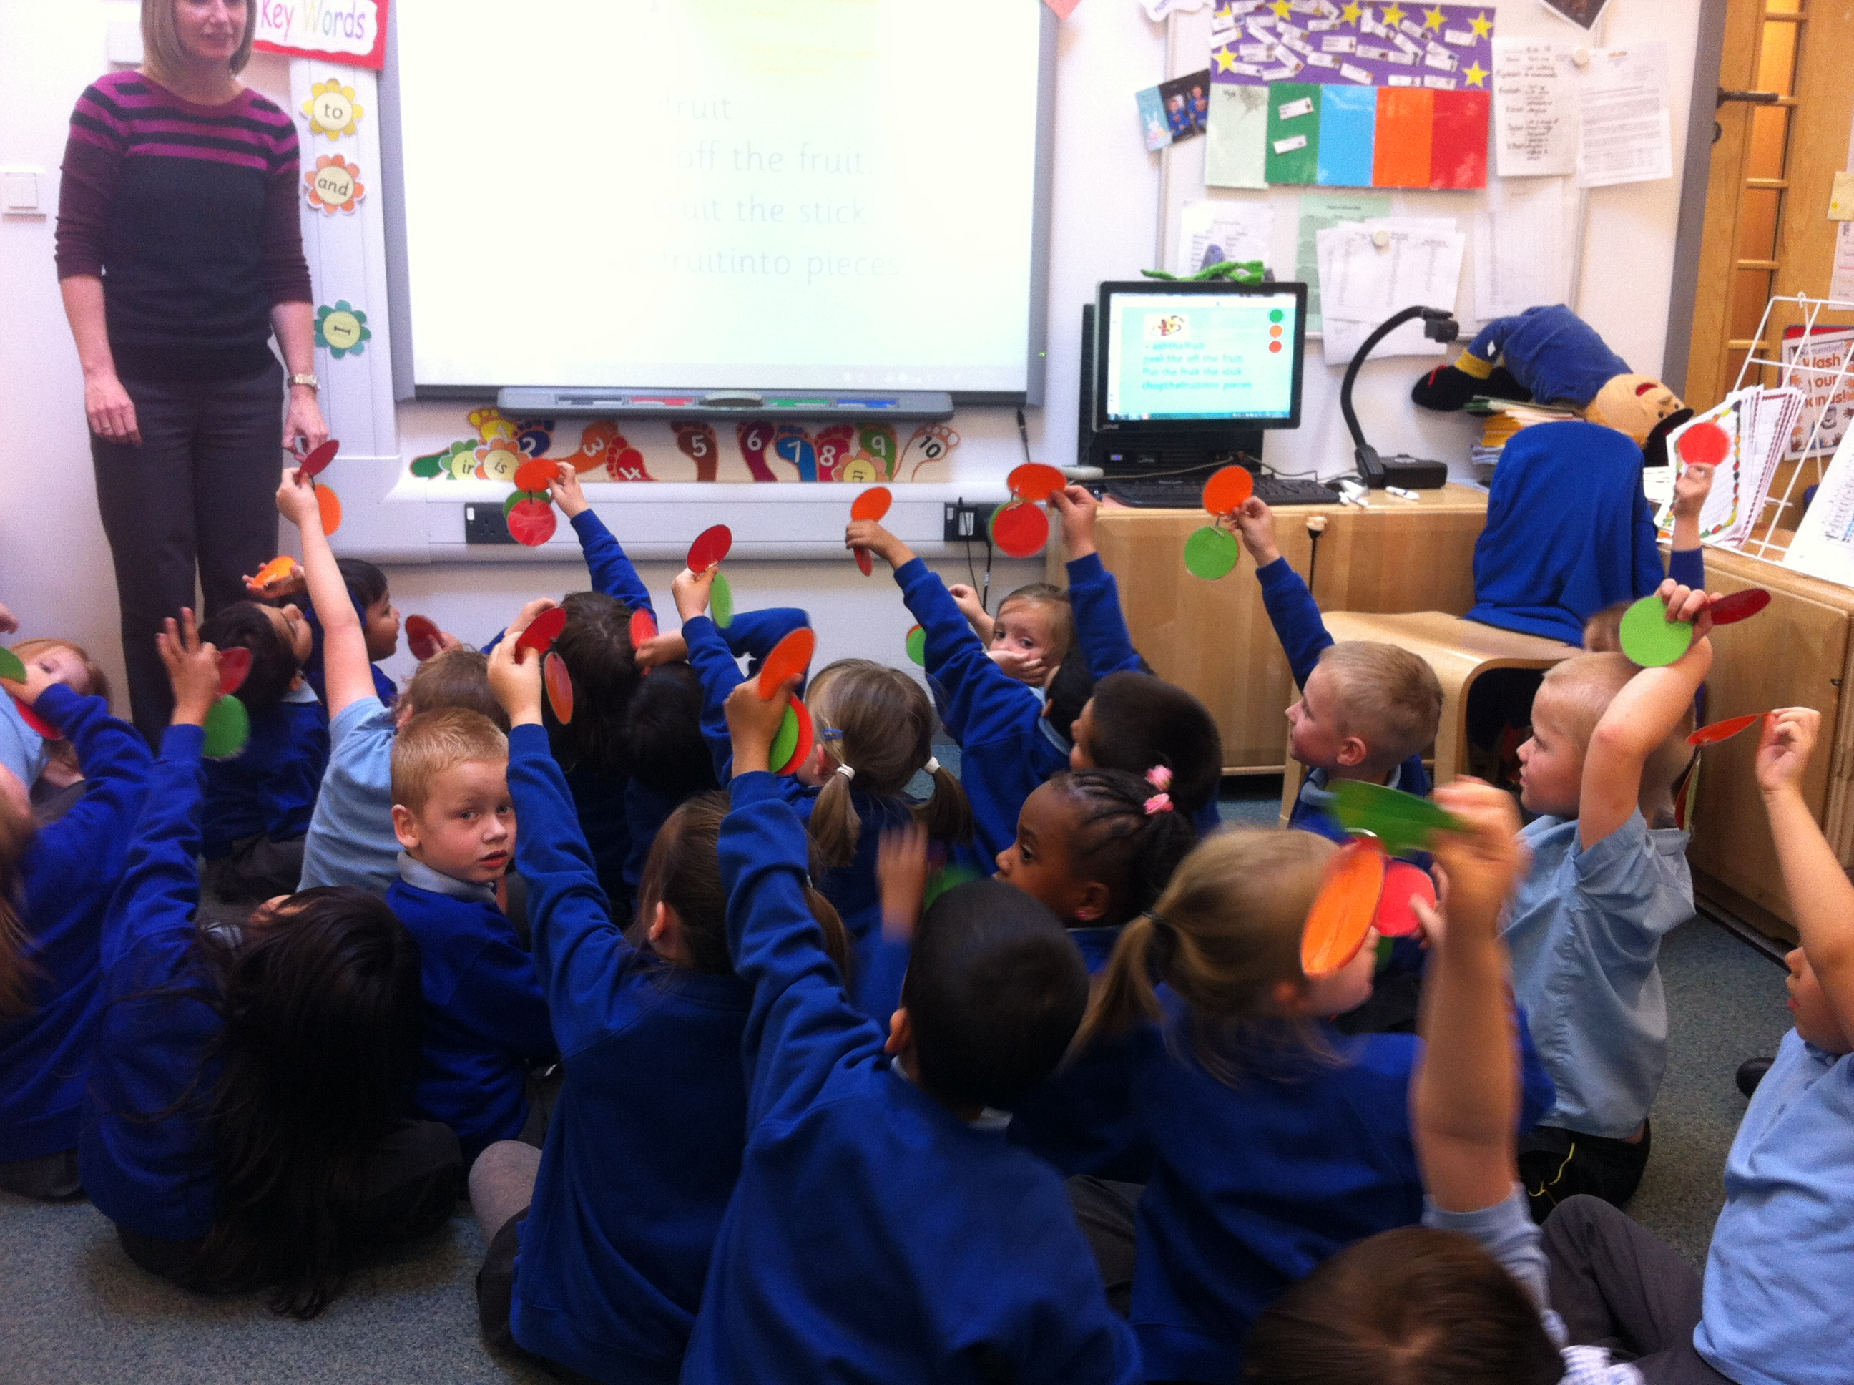

Slide 27
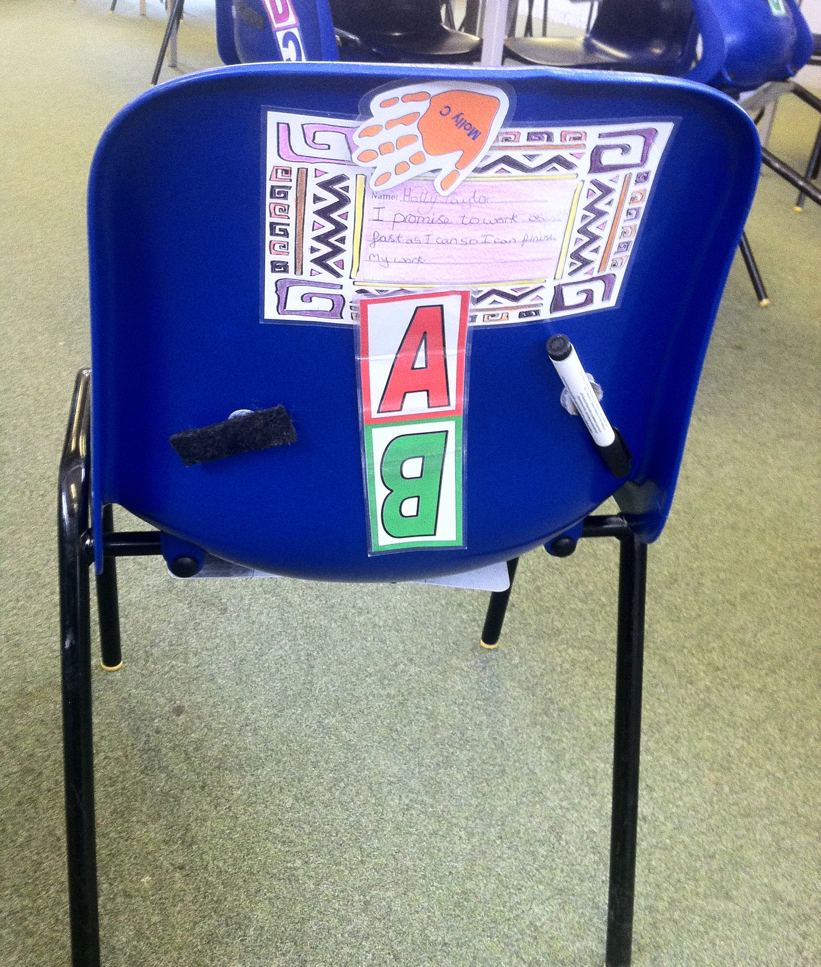
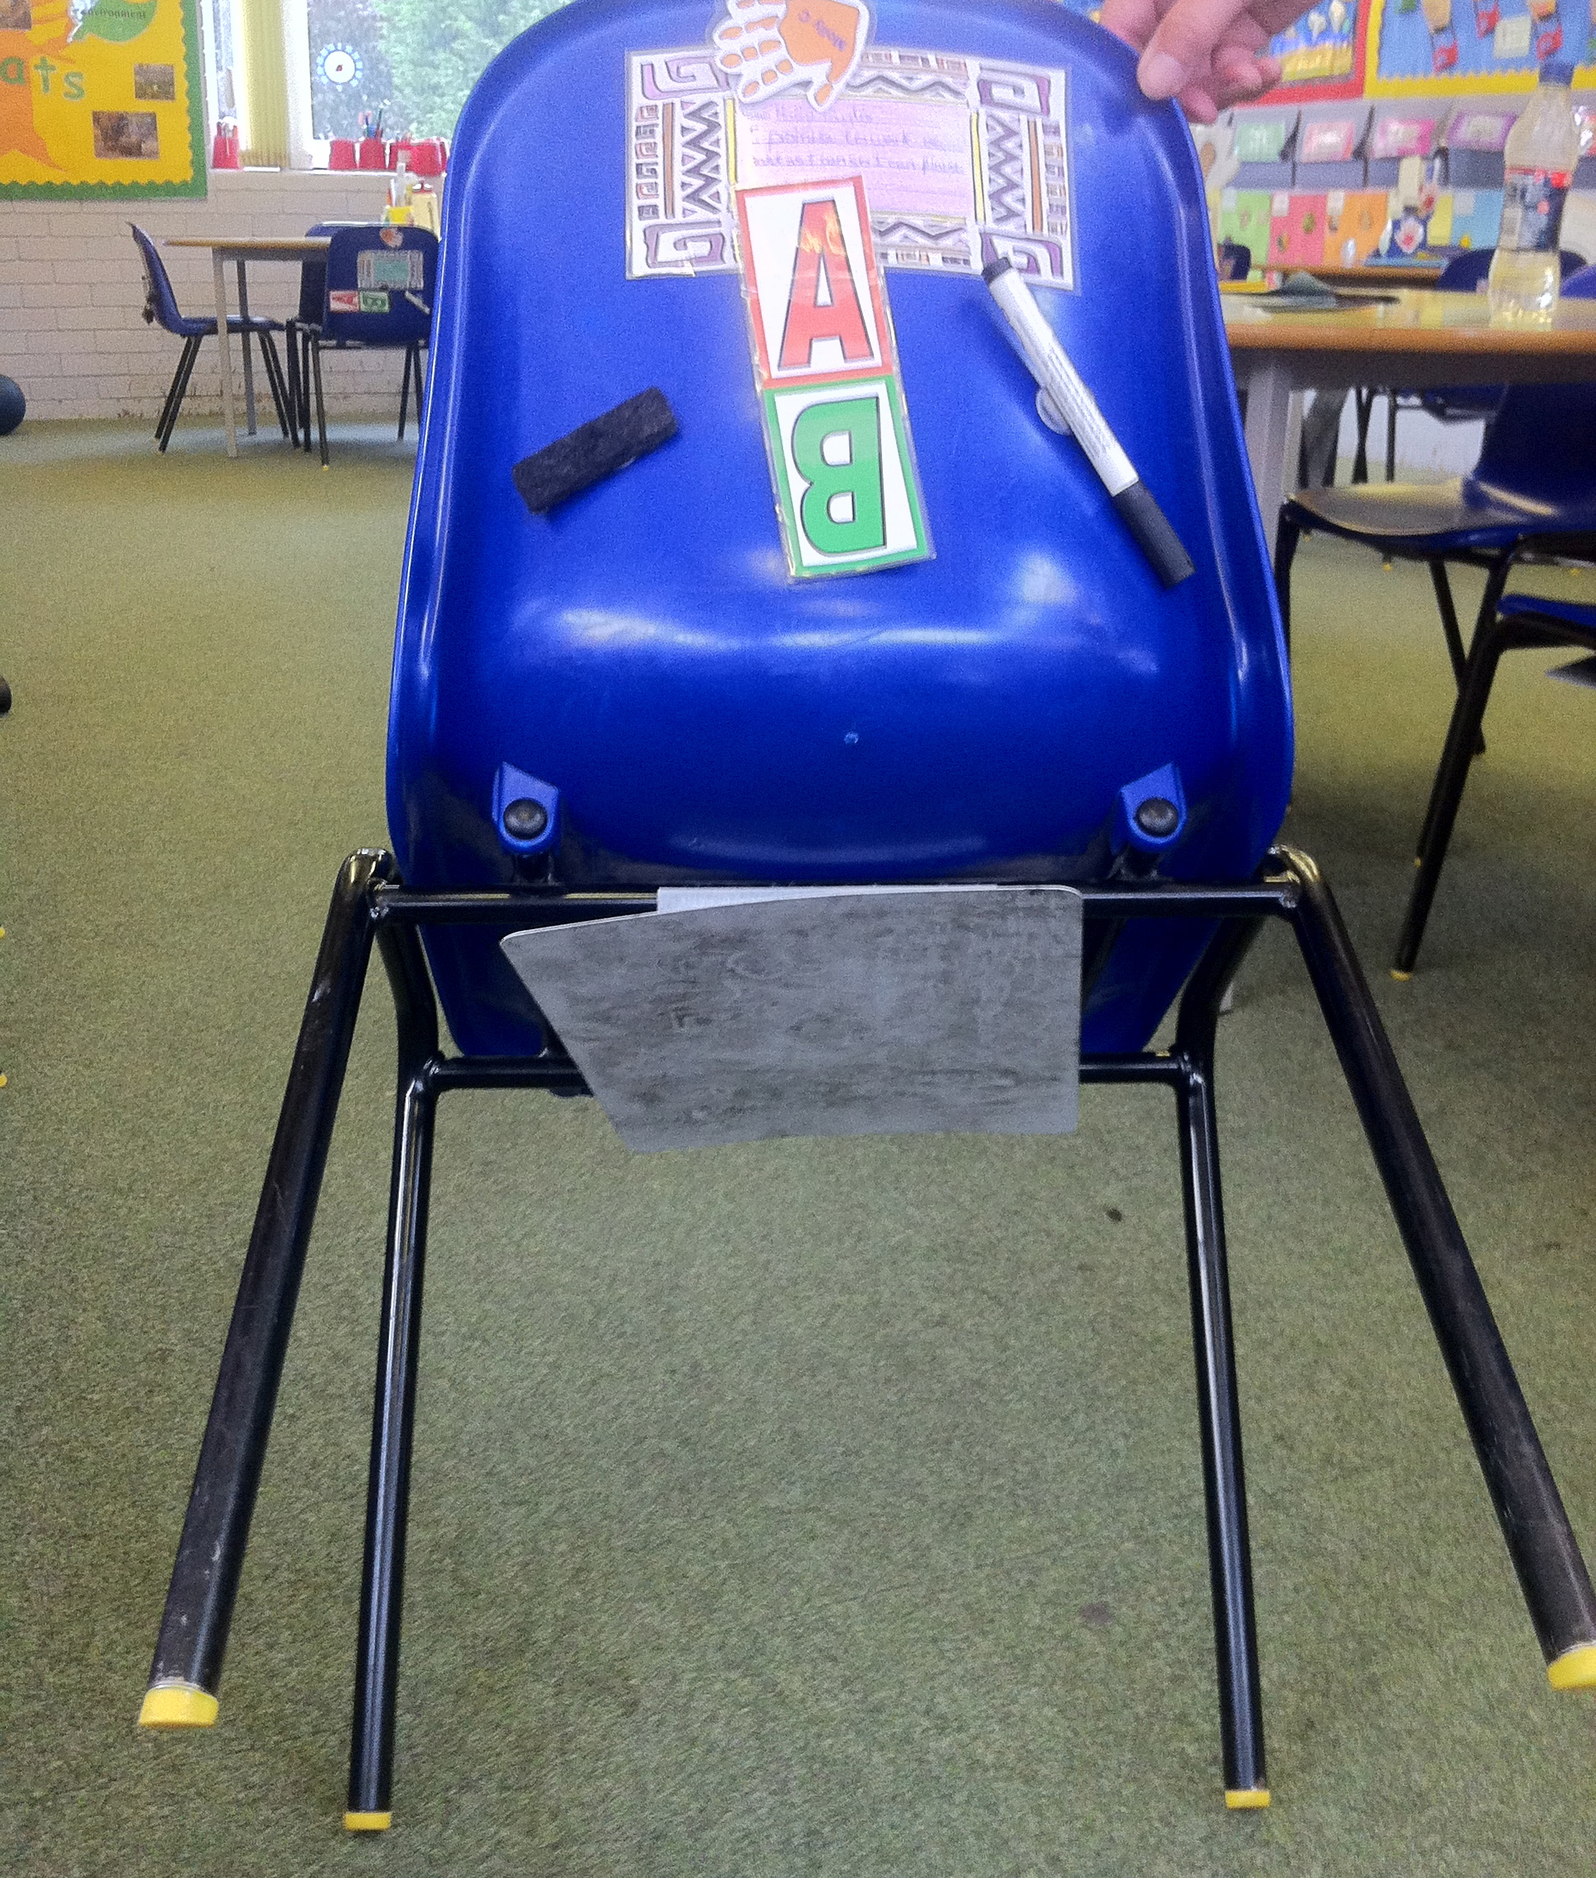
All ready for action in third grade…

Slide 28
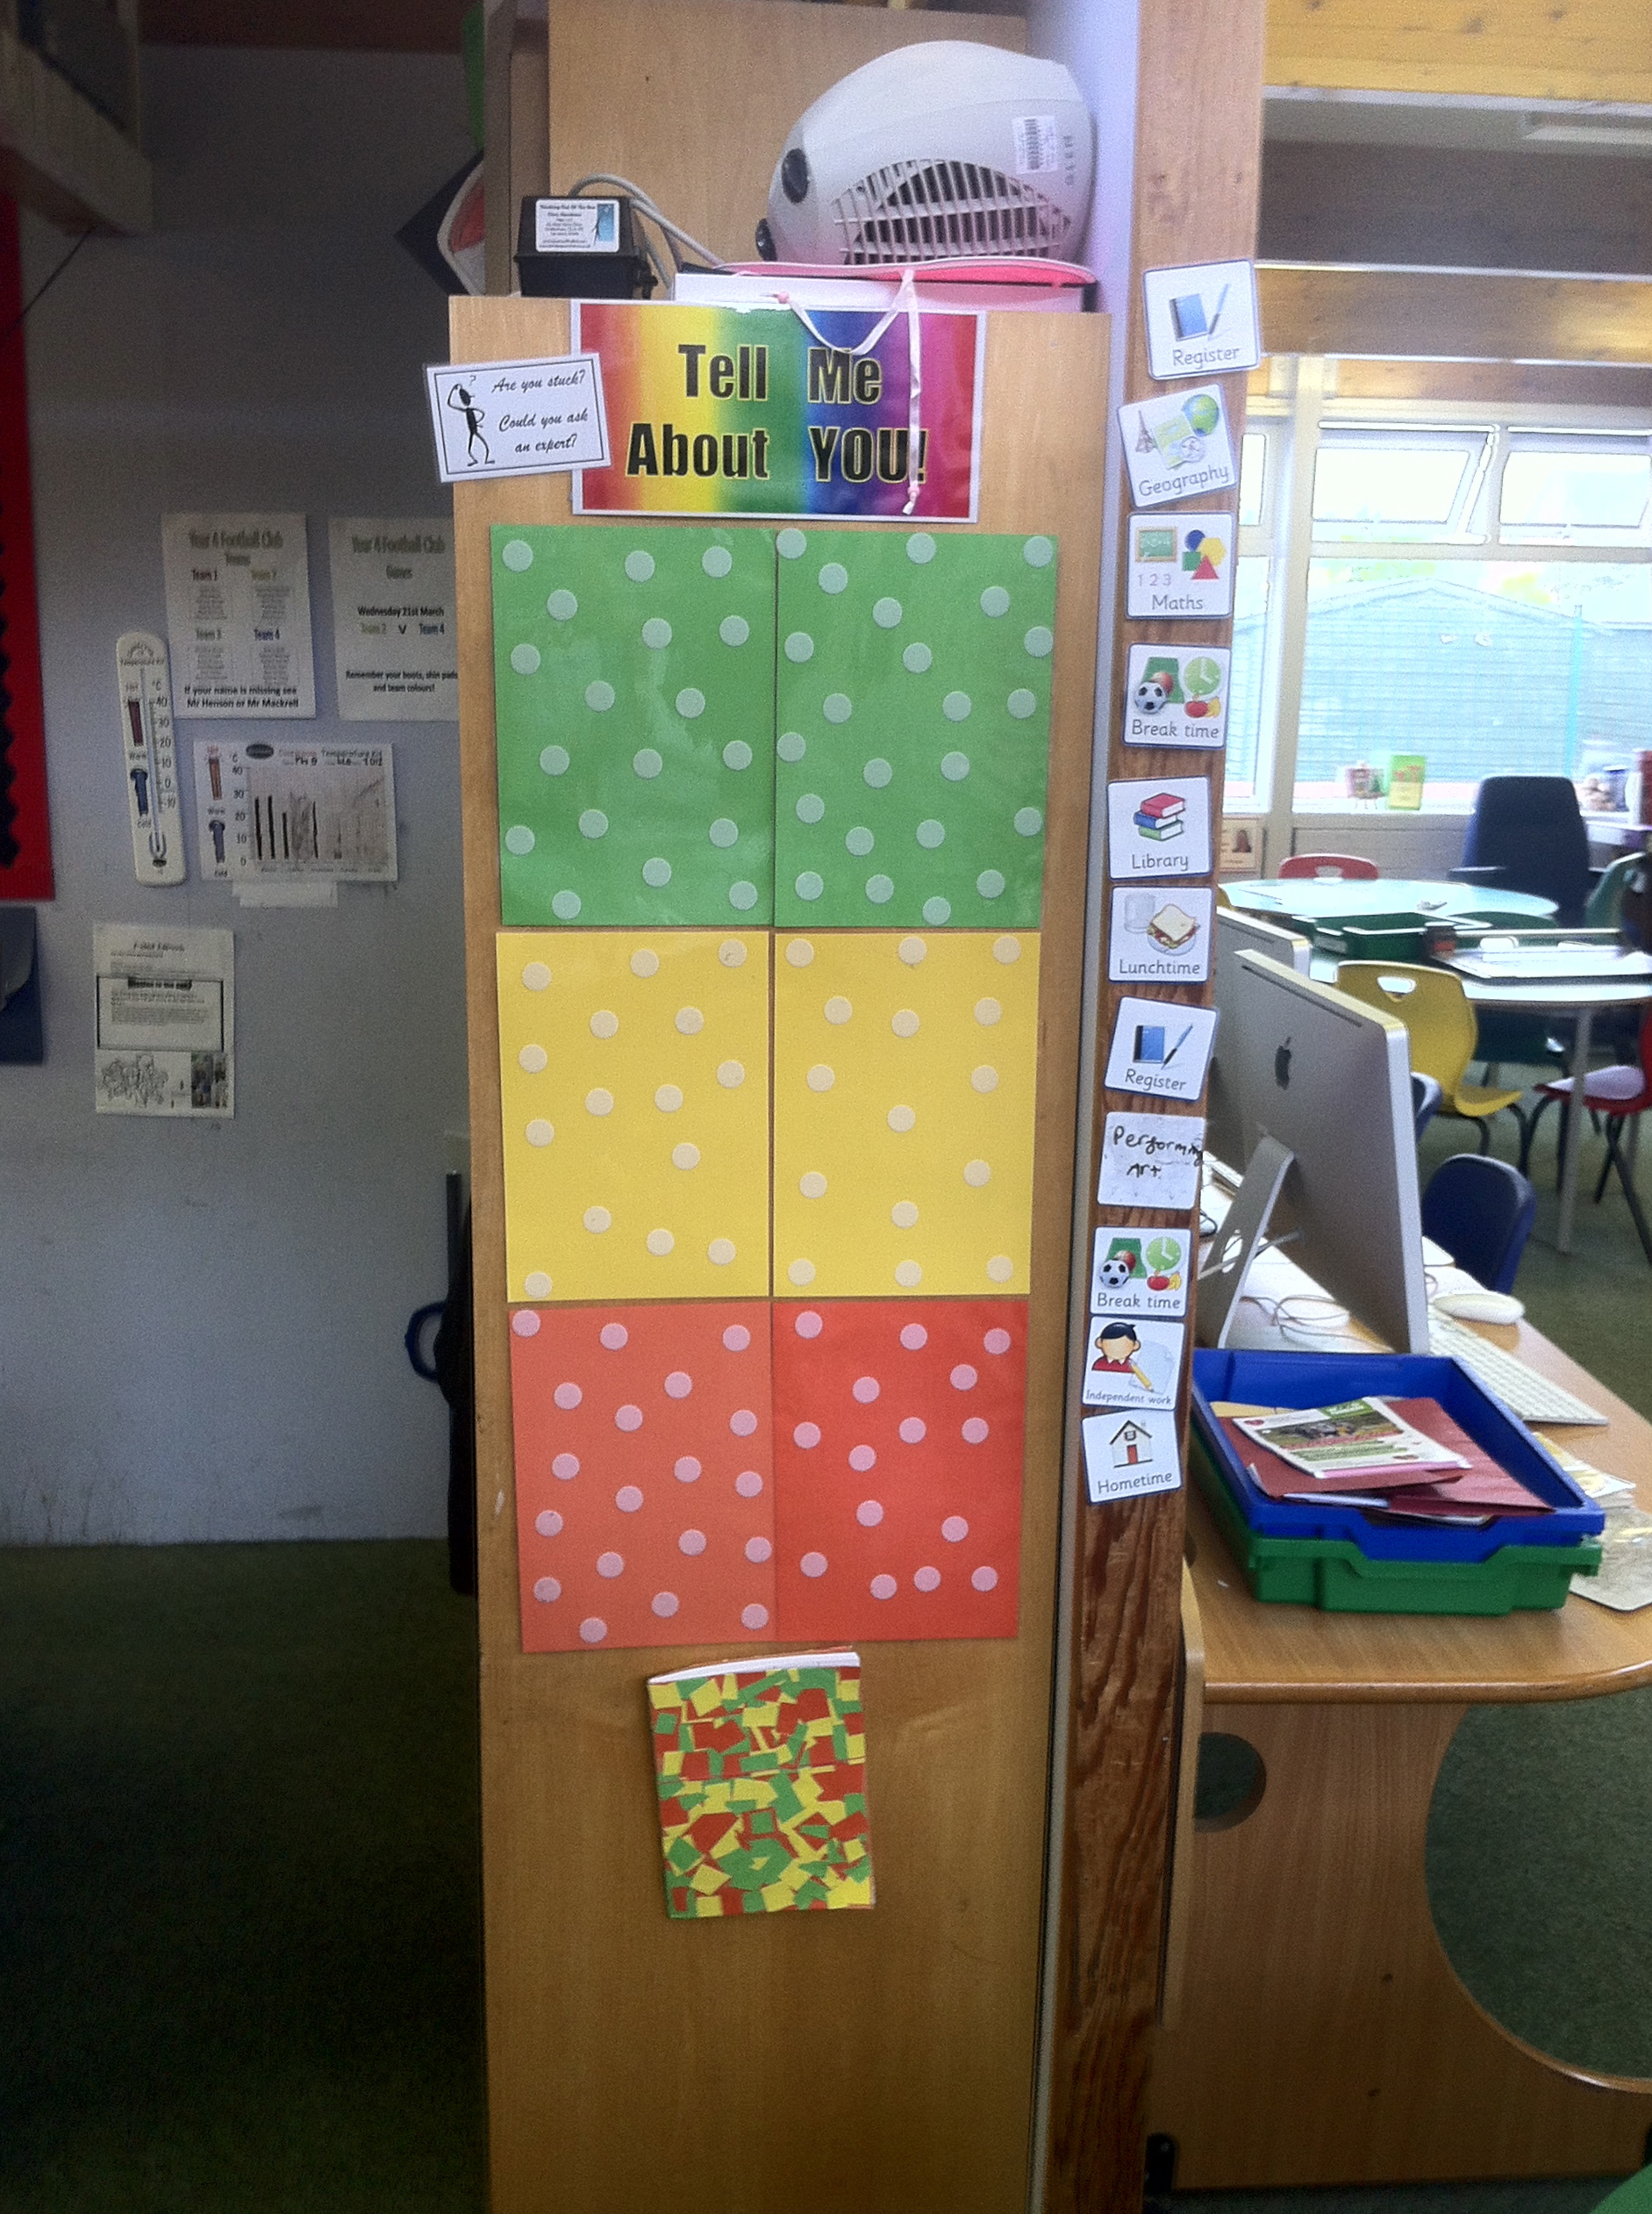
Tell me about you…

Slide 29
Self-assessment: Portugal
45 teachers studying for a Masters degree in Education, matched in age, qualifications and experience using the same curriculum scheme for the same amount of time
Control group (N=20) follow regular MA program | Experimental group (N=25) develop self-assessment with their students
117 students aged 8 years | 125 students aged 8 years
119 students aged 9 years | 121 students aged 9 years
77 students aged 10 - 14 years | 108 students aged 10 - 14 years
Fontana and Fernandes (1994)

Slide 30
Details of the intervention
Weeks | Intervention
1 to 2 | Individual choice from a range of work provided by the teacher. Student self-assessment using materials provided
3 to 6 | Children construct own problems like those in weeks 1 and 2 and select structured math apparatus to aid solutions
7 to 10 | Children presented with a new learning objectives, and make up their own problems, without exemplars by the teacher
11 to 14 | Children set their own learning objectives, construct appropriate problems, and use appropriate self-assessment
15 to 20 | As weeks 1 to 14, but with less monitoring from the teacher and increased freedom of choice and personal responsibility

Slide 31
Impact on student achievement
 | Pre-test | Post-test | Gain | Effect size
Control | 65.1 | 72.9 | 7.8 | 0.34
Experimental | 58.7 | 73.7 | 15.0 | 0.66

Slide 32
Motivation, self-regulation and learning
 |  | Value system
 |  | External | Internal
Locus of control | External | External: working hard because parents expect and insist on this | Identified: studying algebra in order to graduate high school
 | Internal | Introjected: studying in order to avoid feeling like a failure | Integrated: studying math is “part of the package” if you want to be an engineer
Deci and Ryan (1994)

Slide 33
Pros and cons of self/peer assessment
 | + | —
Teachers
Students

