Slide 1
Dylan Wiliam (@dylanwiliam)
Understanding Assessments:
What they Mean and What they Do
www.dylanwiliamcenter.com www.dylanwiliam.net

Slide 2
Initial assumptions
Any assessment system should be designed to assess the school’s curriculum rather than having to design the curriculum to fit the school’s assessment system.
Since each school’s curriculum should be designed to meet local needs, there cannot be a one-size-fits-all assessment system—each school’s assessment system will be different.
There are, however, a number of principles that should govern the design of assessment systems, and
There is some science here—knowledge that people need in order to avoid doing things that are just wrong.

Slide 3
Assessment: A cautionary tale
 | A | B | C | D | E | F | G | H | Total
Adams | 100 | 30 | 47 | 72 | 40 | 75 | 30 | 47 | 441
Brown | 90 | 38 | 43 | 60 | 20 | 65 | 48 | 70 | 434
Collins | 61 | 36 | 40 | 45 | 41 | 55 | 62 | 80 | 420
Dorkin | 63 | 32 | 51 | 90 | 30 | 70 | 47 | 35 | 418
Evans | 56 | 55 | 41 | 82 | 45 | 40 | 49 | 41 | 409
Fuller | 80 | 45 | 49 | 64 | 65 | 45 | 38 | 20 | 406
Grant | 23 | 47 | 45 | 55 | 60 | 80 | 32 | 60 | 402
Howell | 40 | 35 | 52 | 70 | 56 | 20 | 60 | 65 | 398
Iman | 85 | 40 | 60 | 40 | 28 | 51 | 55 | 30 | 389
Jones | 72 | 54 | 50 | 10 | 25 | 35 | 66 | 75 | 387
Keller | 48 | 57 | 55 | 34 | 70 | 60 | 36 | 10 | 370
Lant | 10 | 60 | 59 | 20 | 35 | 30 | 70 | 58 | 342
Mean | 61 | 44 | 49 | 54 | 43 | 52 | 49 | 49

Slide 4
Equalizing the range for each subject
 | A | B | C | D | E | F | G | H | Total
Adams | 100 | 0 | 35 | 77 | 40 | 92 | 0 | 53 | 397
Brown | 89 | 27 | 15 | 63 | 0 | 75 | 45 | 86 | 400
Collins | 57 | 20 | 0 | 44 | 42 | 58 | 80 | 100 | 401
Dorkin | 59 | 7 | 55 | 100 | 20 | 83 | 43 | 36 | 403
Evans | 51 | 83 | 5 | 90 | 50 | 33 | 48 | 44 | 404
Fuller | 78 | 50 | 45 | 68 | 90 | 42 | 20 | 14 | 407
Grant | 14 | 57 | 25 | 56 | 80 | 100 | 5 | 71 | 408
Howell | 33 | 17 | 60 | 75 | 72 | 0 | 75 | 79 | 411
Iman | 83 | 34 | 100 | 38 | 16 | 52 | 62 | 29 | 414
Jones | 69 | 80 | 50 | 0 | 10 | 25 | 90 | 93 | 417
Keller | 42 | 90 | 75 | 30 | 100 | 67 | 15 | 0 | 419
Lant | 0 | 100 | 95 | 12 | 30 | 17 | 100 | 69 | 423
Mean | 56 | 47 | 47 | 54 | 46 | 54 | 49 | 56

Slide 5
And using class ranks in each subject…
 | A | B | C | D | E | F | G | H | Total
Adams | 1 | 12 | 8 | 3 | 7 | 2 | 12 | 7 | 52
Brown | 2 | 8 | 10 | 6 | 12 | 4 | 7 | 3 | 52
Collins | 7 | 9 | 12 | 8 | 6 | 6 | 3 | 1 | 52
Dorkin | 6 | 11 | 5 | 1 | 9 | 3 | 8 | 9 | 52
Evans | 8 | 3 | 11 | 2 | 5 | 9 | 6 | 8 | 52
Fuller | 4 | 6 | 7 | 5 | 2 | 8 | 9 | 11 | 52
Grant | 11 | 5 | 9 | 7 | 3 | 1 | 11 | 5 | 52
Howell | 10 | 10 | 4 | 4 | 4 | 12 | 4 | 4 | 52
Iman | 3 | 7 | 1 | 9 | 10 | 7 | 5 | 10 | 52
Jones | 5 | 4 | 6 | 12 | 11 | 10 | 2 | 2 | 52
Keller | 9 | 2 | 3 | 10 | 1 | 5 | 10 | 12 | 52
Lant | 12 | 1 | 2 | 11 | 8 | 11 | 1 | 6 | 52

Slide 6
Before we can assess…
The ‘backward design’ of an education system
  Where do we want our students to get to?
    ‘Big ideas’
  What are the ways they can get there?
    Learning progressions
  When should we check on/report progress?
    Inherent and useful checkpoints

Slide 7
Big ideas

Slide 8
Big ideas
A “big idea”
  helps make sense of apparently unrelated phenomena
  is generative in that is can be applied in new areas

Slide 9
Big ideas in reading
Writing is an attempt to communicate meaning
Making sense of text often requires making connections between sentences
Writers often choose words for the effect they have on the listener/reader
The hero’s journey (Campbell, 1949)
…

Slide 10
Learning progressions
What is it that gets better when someone gets better at reading?

Slide 11
The “seductive allure” of neuroscience

Slide 12
Cortical language localization
117 individuals (aged 4 to 80) undergoing frontal or frontotemporoparietal craniotomies as a treatment for epilepsy
Subjects were shown line drawings of familiar objects and asked to name what they had seen while exposed regions of the cerebral cortex were stimulated with electric current
Naming errors were taken as indicating that the region in question was essential to language
Ojemann, Ojemann, Letitch, and Berger (1989)

Slide 13
Number of patients with a site in each zone (out of 117)
6
8
5
14
17
14
33
58
51
45
68
34
11
11
66
8
82
72
64
61
62
58
44
12
61
76
58
60
46
60
3
3
2
10
6
Ojemann, Ojemann, Letitch, and Berger (1989)

Slide 14
Percentage of patients with a site in each zone with significant naming errors in that zone
50
37
20
43
29
50
45
14
26
27
19
23
9
18
29
8
79
36
36
29
26
19
32
42
21
14
19
7
2
5
0
0
0
0
0
Ojemann, Ojemann, Letitch, and Berger (1989)

Slide 15
“All models are wrong; some are useful”
“Since all models are wrong the scientist cannot obtain a ‘correct’ one by excessive elaboration. On the contrary following William of Occam he should seek an economical description of natural phenomena. Just as the ability to devise simple but evocative models is the signature of the great scientist so overelaboration and overparameterization is often the mark of mediocrity.” (Box, 1976 p. 792)

Slide 16
Learning progressions
What gets better when students get better at reading?
  Phonemic awareness
  Phonics
  Fluency
  Vocabulary
  Text comprehension
National Reading Panel (2001)

Slide 17
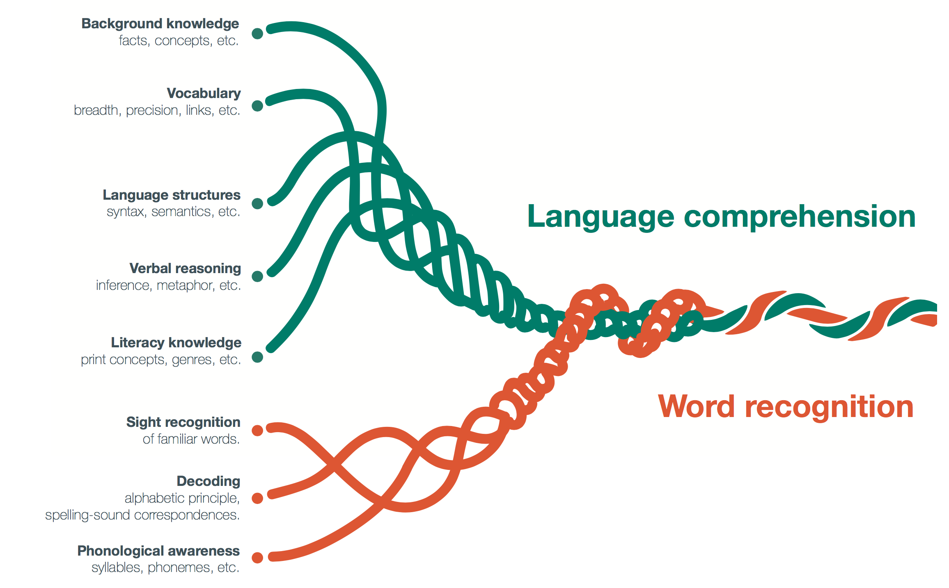
The “simple” view of reading
Background knowledge
Vocabulary
Language structures
Verbal reasoning
Literacy knowledge
Sight recognition
Decoding
Phonological awareness
Scarborough (2001)

Slide 18
Letters
Expanded model of reading (Willingham, 2017)
Translation rules
Word sounds
Spellings
Word meanings
Syntactic rules
Sentence representation
Idea web
Situation model

Slide 19
Copy this
ЖӘШІК

Slide 20
Reading skills: what are they really?
“A manifold, contained in an intuition which I call mine, is represented, by means of the synthesis of the understanding, as belonging to the necessary unity of self-consciousness; and this is effected by means of the category.”
What is the main idea of this passage?
  Without a manifold, one cannot call an intuition ‘mine.’
  Intuition must precede understanding.
  Intuition must occur through a category.
  Self-consciousness is necessary to understanding
Hirsch (2006)
Notes:
In the philosophy of Kant the manifold is the unorganized flux presented to the senses, but not experienced, since experience results from the mind structuring the manifold by means of concepts. The nature of the unstructured manifold is unknowable (transcendental).

Slide 21
Lost in translation?
“Comprehension depends on constructing a mental model that makes the elements fall into place and, equally important, enables the listener or reader to supply essential information that is not explicitly stated. In language use, there is always a great deal that is left unsaid and must be inferred. This means that communication depends on both sides, writer and reader, sharing a basis of unspoken knowledge. This large dimension of tacit knowledge is precisely what is not being taught adequately in our schools.”
Hirsch (2009 loc. 176)

Slide 22
Domain knowledge and memory
3rd (N=64), 5th (N=67) and 7th (N=54) grade students from Heidelberg, Germany, tested on reading expertise and soccer knowledge
  13-item questionnaire on soccer knowledge
  standardized reading comprehension test
Students heard (twice) and read a well-structured readable story on a young player’s experiences in a soccer game
Tested 15 minutes later with a cloze version of the test with 20 blanks

Slide 23
17.0
16.4
11.1
11.0
Schneider, Körkel, and Wiener (1989)

Slide 24
Assessment

Slide 25
Written examinations
“They have perverted the best efforts of teachers, and narrowed and grooved their instruction; they have occasioned and made well nigh imperative the use of mechanical and rote methods of teaching; they have occasioned cramming and the most vicious habits of study; they have caused much of the overpressure charged upon schools, some of which is real; they have tempted both teachers and pupils to dishonesty; and last but not least, they have permitted a mechanical method of school supervision.”
(White, 1888 pp. 517-518)

Slide 26
Campbell’s law
“The more any quantitative social indicator is used for social decision-making, the more subject it will be to corruption pressures and the more apt it will be to distort and corrupt the social processes it is intended to monitor.” (Campbell, 1976 p. 49)
  All performance indicators lose their meaning when adopted as policy targets
  The clearer you are about what you want, the more likely you are to get it, but the less likely it is to mean anything

Slide 27
The “Lake Wobegon” effect
Koretz, Linn, Dunbar and Shepard (1991)

Slide 28
Effects of narrow assessment
Incentives to teach to the test
  Focus on some subjects at the expense of others
  Focus on some aspects of a subject at the expense of others
  Focus on some students at the expense of others (“bubble” students)
Consequences
  Learning that is
    Narrow
    Shallow
    Transient

Slide 29
Getting assessment right

Slide 30
What is an assessment?
An assessment is a procedure for making inferences
  We give students things to do
  We collect the evidence
  We draw conclusions
Key question: “Once you know the assessment outcome, what do you know?”
For any test:
  some inferences are warranted (valid)
  some are not

Slide 31
Validity
Evolution of the idea of validity
  A property of a test
  A property of students’ scores on a test
  A property of inferences drawn on the basis of test results
“One validates not a test but an interpretation of data arising from a specified procedure”(Cronbach, 1971)
Consequences
  No such thing as a valid (or indeed invalid) assessment
  No such thing as a biased assessment
  Formative and summative are descriptions of inferences

Slide 32
Meanings and consequences of assessment
Evidential basis
  What does the assessment result mean?
Consequential basis
  What does the assessment result do?
Assessment literacy (Stiggins, 1991)
  Do you know what this assessment result means?
  Does it have utility for its intended use?
  What message does this assessment send to students (and other stakeholders) about the achievement outcomes we value?
  What is likely to be the effect of this assessment on students?

Slide 33
Validity revisited
“Validity is an integrative evaluative judgment of the degree to which empirical evidence and theoretical rationales support the adequacy and appropriateness of inferences and actions based on test scores or other modes of assessment.” (Messick, 1989 p. 13)
Social consequences:
  “Right concern, wrong concept” (Popham, 1997)

Slide 34
Quality in assessment
Threats to validity
  Construct-irrelevant variance
    Systematic: good performance on the assessment requires abilities not related to the construct of interest
    Random: good performance is related to chance factors, such as luck (effectively poor reliability)
  Construct under-representation
    Good performance on the assessment can be achieved without demonstrating all aspects of the construct of interest

Slide 35
Discussion
Working as a group, try to frame one validity issue as an issue of construct-irrelevant variance or of construct under-representation.

Slide 36
Understanding reliability

Slide 37
Understanding test scores
Consider a test of students’ ability to spell words drawn from a bank of 1000 words.
What we can conclude depends on:
  The size of the sample
  The way the sample was drawn
  Students’ knowledge of the sample
  The amount of notice given

Slide 38
Samples and reliability
Suppose we ask a student to spell 20 of the words drawn at random, at five different times of the day, with the following results
  15 17 14 15 14
  On average, the student scores 15 out of 20
  Our best guess is the student can spell 750 of the 1000 words
If the results were:
  20 12 17 10 16
  Our best guess is still that the student knows 750 of the 1000 spellings
  But now we are much less certain about this

Slide 39
Some examples
Example 1
Actual score | 15 | 17 | 14 | 15 | 14
Difference from average | 0 | +2 | -1 | 0 | -1
Average error | 0 (by definition!)
Standard deviation of errors | 1.2
Example 2
Actual score | 20 | 12 | 17 | 10 | 16
Difference from average | 5 | -3 | +2 | -5 | +1
Average error | 0 (by definition!)
Standard deviation of errors | 4.0

Slide 40
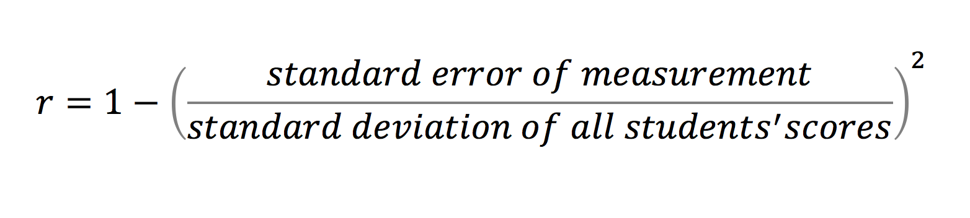
Quantifying reliability
The “standard error of measurement” or “SEM” is just the standard deviation of the errors averaged over all test takers
The reliability of the test is:

Slide 41
Relationship of reliability and error
For a test with an average score of 50, and a standard deviation of 15 (so that most scores range from 20 to 80), errors of measurement are as follows:
Reliability | Standard error of measurement
0.70 | 8.2
0.75 | 7.5
0.80 | 6.7
0.85 | 5.8
0.90 | 4.7
0.95 | 3.4

Slide 42
What does this mean?
Consider a class of 25 students taking a reading test
  with a reliability of 0.85
  an average score of 50
  a standard deviation of 15 (most scores range from 20 to 80)
Then
  17 students get a score within 6 points of their true score
  7 students get a score that is more than 6 points, but less than 12 points from their true score
  and one student gets a score that differs from their true score
  by more than 12 points
Unfortunately…
  you won’t know which student
  and you won’t know if their score was higher or lower than it should have been

Slide 43
Reliability: 0.75

Slide 44
Reliability: 0.80

Slide 45
Reliability: 0.85

Slide 46
Reliability: 0.90

Slide 47
Reliability: 0.95

Slide 48
Understanding what this means in practice

Slide 49
Grouping students by ability

Slide 50
Using tests for grouping students by ability
Using a test with a reliability of 0.9, and with a predictive validity of 0.7, to group 100 students into four ability groups:
 |  | should be in
 |  | group 1 | group 2 | group 3 | group 4
students placed in | group 1 | 23 | 9 | 3
 | group 2 | 9 | 12 | 6 | 3
 | group 3 | 3 | 6 | 7 | 4
 | group 4 |  | 3 | 4 | 8
Only 50% of the students are in the “right” group

Slide 51
Diagnostic testing

Slide 52
The limits of diagnostic testing
120-item multiple choice test for teacher licensure
  Four major subject areas
    language arts/reading
    mathematics
    social studies
    science
  30 items per subject area
  Sub-score reliabilities range from 0.71 to 0.83

Slide 53
How reliable are 10-item subtest scores?
Items for each subject area ranked in order of difficulty (i.e., 1 to 30)
Three parallel 10-item forms created in each subject area:
  Form A: items 1, 4, 7, … 28
  Form B: items 2, 5, 8, … 29
  Form C: items 3, 6, 9, … 30
Sub-score reliabilities in the range 0.40 to 0.60
On form A, 271 examinees scored 7 in mathematics and 3 in science

Slide 54
Scores of 271 students on form B
 |  | Science subscore
 |  | 1 | 2 | 3 | 4 | 5 | 6 | 7 | 8 | 9 | 10
Math subscore | 1 | 0 | 0 | 0 | 1 | 1 | 1 | 0 | 0 | 0 | 0
 | 2 | 0 | 0 | 0 | 1 | 3 | 1 | 2 | 0 | 0 | 0
 | 3 | 1 | 0 | 0 | 1 | 2 | 4 | 3 | 1 | 1 | 1
 | 4 | 0 | 0 | 2 | 7 | 7 | 6 | 4 | 0 | 1 | 0
 | 5 | 0 | 1 | 1 | 1 | 10 | 14 | 8 | 5 | 1 | 1
 | 6 | 2 | 0 | 1 | 5 | 10 | 11 | 15 | 8 | 1 | 1
 | 7 | 0 | 1 | 4 | 4 | 4 | 11 | 10 | 7 | 4 | 0
 | 8 | 0 | 1 | 1 | 5 | 12 | 13 | 7 | 5 | 4 | 0
 | 9 | 0 | 0 | 1 | 1 | 6 | 3 | 7 | 4 | 3 | 0
 | 10 | 0 | 0 | 0 | 1 | 1 | 2 | 1 | 1 | 0 | 0
110 out of 271 (41%) examinees got a better form B score in science than mathematics
Sinharay, Gautam and Halberman (2010)

Slide 55
What does this mean?
A student scoring 7 on mathematics and 3 on science would probably want to improve the latter
But 110 of the 271 examinees got a better score in science than mathematics on Form B
Correlation of science subscores on Forms A and B is 0.48
Correlation of science subscore on Form A with total score on Form B is 0.63
In other words, the total score on the total test is a better guide to the score on a sub-test than another score on the same sub-test

Slide 56
Measuring progress

Slide 57
Reliability, standard errors, and progress
Grade | Reliability | SEM as a percentage of annual progress
1 | 0.89 | 26%
2 | 0.85 | 56%
3 | 0.82 | 76%
4 | 0.83 | 39%
5 | 0.83 | 55%
6 | 0.89 | 46%
Average | 0.85 | 49%
In other words, the standard error of measurement of this reading test is equal to six months’ progress by a typical student

Slide 58
Errors of measurement and growth
Reading scores: 2015 norms (6th grade)
Northwest Evaluation Association (2015)

Slide 59
In other words…
In a class of 25 students, if they have all made exactly the expected progress, and they are tested with a typical reading test every six months:
  Four will appear to have made no progress or gone backwards
  Four will appear to have made at least twice as much progress as expected
  And again, you won’t know which students are which…

Slide 60
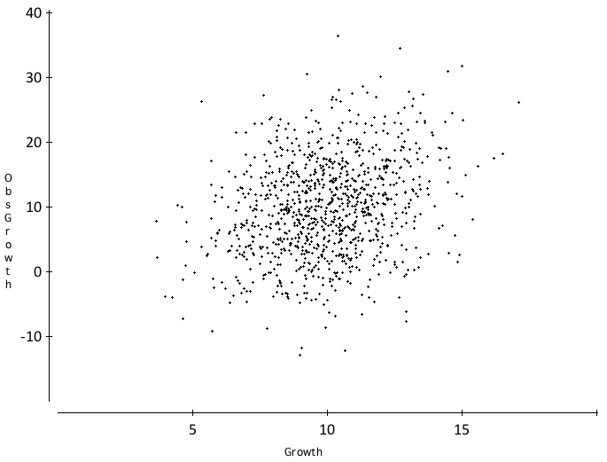
True and observed growth scores
Observed progress
Pre-test average: 50
Post-test average: 60
Pre-test SD: 15
Change SD: 2
Test reliability: 0.85
Progress reliability: 0.04
True progress

Slide 61
Fortunately…
While progress measures for individuals are rather unreliable, progress measures for groups are much more reliable.
As rules of thumb:
  For individual students, progress measures are meaningful only if the progress is more than twice the standard error of measurement of the test being used to measure progress
  For a class of 25 students, progress measures are meaningful if the progress is more than half the standard error of measurement of the test being used to measure progress

Slide 62
Curriculum-based measurement

Slide 63
Curriculum-based measurement
Used for a variety of purposes including screening, benchmarking, and progress monitoring
Avoids the problems of measuring change scores because it focuses on multiple assessments of status.
Depends on a clear view of what will be learned by the end of the instructional sequence.
However, it is not a panacea

Slide 64
Review of studies of CBM-R
“Such studies suggest that even under the best conditions (i.e., high-quality probe sets and tightly controlled conditions), (a) a minimum of 5 or 6 weeks of data with multiple data points collected per week are needed to inform routine instructional decisions and (b) a minimum of 12 weeks of data with multiple data points collected per week are needed to make special education eligibility decisions ” (p. 12)
Ardoin, Christ, Morena, Cormier, and Klingbeil (2013)

Slide 65
“… at this point, there are no studies to suggest that an individual student's progress can be accurately determined using CBM-R progress monitoring data” (p. 14)
“Furthermore, trainers and publishers of CBM-R materials should neither suggest to school teachers and other educators that CBM-R progress monitoring data can be used as a primary outcome measure to evaluate individual student growth over short periods of time nor train them in current CBM-R decision rules.” (pp. 14-15)
Ardoin, Christ, Morena, Cormier, and Klingbeil (2013)

Slide 66
Discussion question
Discussion
From what you have heard so far, what are the key challenges regarding the design of reading assessment for your school/district?

Slide 67
Evidence-centered design

Slide 68
Evidence-centered design
Conceptual assessment framework
  Student model: what are we assessing?
    “Degree of difficulty” model
    “Marks for style” model
    “Support” model
  Evidence model: what evidence do we want?
  Task model: where will the evidence come from?
  Four-process architecture
    Task selection
    Task presentation
    Evidence identification
    Evidence accumulation
Mislevy, Almond and Lukas (2003);
Almond, Steinberg and Mislevy (2003)

Slide 69
Task selection

Slide 70
Kinther Layticks
Skondo has often been described as one of the fantem growing plaidos in the UK during the last 10 years, but the lure of chemicks about in tabsel has continued to attract the attention of moorick numbers of Britons.
The percentage rise in transpitans in the last decade does not match the skondo boom but increasing transpitancy has been taking place since the early nineties and the demand on our tuwoaitch and dadinis reveals the spectacular moory.
Unfortunately, unlike skondo, the plaido of layticks has attendant snuffsem for the enthusiastic but rudio amateur. All too few of the satsun laybos who take to the tuwoah have even the most rudimentary knowledge of loxem in tabsel.
Name two popular plaidos.
Have there been many deaths from Skondo?
Which country has a lot of kinther layticks?
Write down two precautions to take for layticks
What is snuffsem about skondo?
What would you find in dadinis?

Slide 71
Task presentation

Slide 72
Item formats
“No assessment technique has been rubbished quite like multiple choice, unless it be graphology” Wood, 1991, p. 32)
Myths about multiple-choice items
  They are biased against females
  They assess only candidates’ ability to spot or guess
  They test only lower-order skills

Slide 73
Diagnostic questions in English
In a piece of persuasive writing, which of these would be the best thesis statement?
  The typical TV show has 9 violent incidents
  There is a lot of violence on TV
  The amount of violence on TV should be reduced
  Some programs are more violent than others
  Violence is included in programs to boost ratings
  Violence on TV is interesting
  I don’t like the violence on TV
  The essay I am going to write is about violence on TV

Slide 74
Evidence identification

Slide 75
Referents in assessment
Norm-referenced
  a group who were assessed previously
Cohort-referenced
  the group assessed at the same time
Criterion-referenced
  explicit and precise performance criteria
Ipsative
  defined only within an individual
Construct-referenced
  a shared construct in a community of practice

Slide 76
Quality
“Maxims cannot be understood, still less applied by anyone not already possessing a good practical knowledge of the art. They derive their interest from our appreciation of the art and cannot themselves either replace or establish that appreciation”.
(Polanyi, 1958 p. 50).
“Quality doesn’t have to be defined. You understand it without definition. Quality is a direct experience independent of and prior to intellectual abstractions”.
(Pirsig, 1991 p. 64).

Slide 77
Evidence accumulation

Slide 78
Memory on land and underwater
18 (5f, 13m) student members of a university diving club were tested on their recall of two- and three-syllable words from four 36-word lists taken from the Toronto Word Bank spoken to them twice.
Students learned, and were tested on, the words while underwater, and while on the shore, resulting in four conditions:
  DD (learn dry, recall dry)
  DW (learn dry, recall wet)
  WD (learn wet, recall dry)
  WW (learn wet, recall wet)

Slide 79
Memory is context-dependent
 |  | Recall environment
 |  | Dry | Wet
Learning environment | Dry | 13.5 | 8.6
 | Wet | 8.4
11.4
No significant main effects; interaction effect: F=22.0; df = 1, 12; p= <0.001
Godden and Baddeley (1975)

Slide 80
Alcohol and memory
32 adults (aged 22 to 43) asked to memorize a map and a 19-item set of instructions for a journey
Half did so sober and half at the legal limit for intoxication
The following day, half of them were tested sober and half at the legal limit for intoxication.
 | Number of items correct
 | Day 1 | Day 2
Day 1: sober; day 2: sober | 17 | 17
Day 1: sober; day 2: intoxicated | 17 | 11
Day 1: intoxicated; day 2: sober | 18 | 13
Day 1: intoxicated; day 2: intoxicated | 16
16
Lowe (1981)

Slide 81
Discussion question
Discussion
How will you decide how much evidence is needed to decide whether a student has reached learned something?

Slide 82
Recording

Slide 83
Sylvie and Bruno concluded (Carroll, 1893)
“That’s another thing we’ve learned from your Nation,” said Mein Herr, “map-making. But we’ve carried it much further than you. What do you consider the largest map that would be really useful?”
“About six inches to the mile.”
“Only six inches!” exclaimed Mein Herr. “We very soon got to six yards to the mile. Then we tried a hundred yards to the mile. And then came the grandest idea of all! We actually made a map of the country, on the scale of a mile to the mile!”
“Have you used it much?” I enquired.
“It has never been spread out, yet,” said Mein Herr: “the farmers objected: they said it would cover the whole country, and shut out the sunlight! So we now use the country itself, as its own map, and I assure you it does nearly as well.

Slide 84
What is a grade?
“…an inadequate report of an inaccurate judgment by a biased and variable judge of the extent to which a student has attained an undefined level of mastery of an unknown proportion of an indefinite material.” (Dressel, quoted in Chickering, 1983 p. 12)

Slide 85
Reporting

Slide 86
Effects of feedback
Kluger & DeNisi (1996)
Review of 3000 research reports
Excluding those:
  without adequate controls
  with poor design
  with fewer than 10 participants
  where performance was not measured
  without details of effect sizes
left 131 reports, 607 effect sizes, involving 12652 individuals
On average feedback does improve performance, but
  Effect sizes very different in different studies
  In 38% (50 out of 131) of studies, effect sizes were negative

Slide 87
Getting feedback right is hard
Response type | Feedback indicates performance…
 | exceeds goal | falls short of goal
Change behavior | Exert less effort | Increase effort
Change goal | Increase aspiration | Reduce aspiration
Abandon goal | Decide goal is too easy | Decide goal is too hard
Reject feedback | Feedback is ignored | Feedback is ignored

Slide 88
Meanings and consequences of school grades
Two rationales for grading
  Meanings
    Assessment as evidentiary reasoning
    Assessment outcomes as supports for making inferences
      (e.g., about student achievement)
  Consequences
    Assessment outcomes as rewards and punishments
    Assessments create incentives for students to do what we want them to do
  These two rationales interact, and conflict
    achievement grades for completion of homework
    achievement grades for effort
    penalties for late submission
    zeroes for missing work

Slide 89
Dual-pathway theory (Boekaerts, 2006)
Long-term learning goals are translated into short-term learning intentions
Dynamic comparisons of task and situational demands with personal resources, taking into account:
  Current perceptions of the task
  Beliefs about the subject or task
  Beliefs about “ability” and the role of effort in the subject
  Interest in the subject (personal vs. situational)
  Previous experiences on similar tasks
  Costs and benefits

Slide 90
And then it comes down to…
Resulting activation of energy along one of two pathways
  Wellbeing
  Growth
We need assessment systems that push our students towards a focus on growth, rather than wellbeing

Slide 91
Summary
Before we can assess, we need clear models of progression
Validity is not a property of tests or assessments, but of inferences, which are weakened by
  construct underrepresentation
  construct-irrelevant variance
Reliability is a key requirement for validity
Limited test reliability has particularly severe consequences for changes scores and diagnosis
Assessments are important for what they do as well as what they mean

