Slide 1
Dylan Wiliam (@dylanwiliam)
Formative assessment amid uncertainty
www.dylanwiliamcenter.com www.dylanwiliam.org

Slide 2
Effective learning environments
A prevalent, mistaken, view
Teachers create learning
The teacher’s job is to do the learning for the learner
A not so prevalent, not quite so mistaken, but equally dangerous view
Only learners can create learning
The teacher’s job is to “facilitate” learning
A difficult to negotiate, middle path
Teaching as engineering effective learning environments that:
Create student engagement (pedagogies of engagement)
Are well-regulated (pedagogies of contingency)
Develop disciplinary habits of mind (pedagogies of formation)

Slide 3
Why formative assessment?
A principle and an uncomfortable fact about the world
The principle:
"If I had to reduce all of educational psychology to just one principle, I would say this: The most important single factor influencing learning is what the learner already knows. Ascertain this and teach him [or her] accordingly” (Ausubel, 1968 p. vi)
The uncomfortable fact:
Students do not learn what we teach.

Slide 4
Learners do not (always) learn what we teach…
Denvir and Brown (1986)

Slide 5
Why formative assessment?
A principle and an uncomfortable fact about the world
The principle:
"If I had to reduce all of educational psychology to just one principle, I would say this: The most important single factor influencing learning is what the learner already knows. Ascertain this and teach him [or her] accordingly” (Ausubel, 1968 p. vi)
The uncomfortable fact:
Students do not learn what we teach.
What is learning?
Learning is a change in long-term memory (Kirschner et al., 2006)
The fact that someone can do something now does not mean they will be able to do it in six weeks, but
If they cannot do something now, it is highly unlikely they will be able to do it in six weeks

Slide 6
How memory works

Slide 7
Why teaching is really hard
Performance (how well a learner completes a learning task) and learning (the changes in long-term memory that result) are different
Learning and performance are negatively correlated
Students do not reliably know when they are learning
Students do not reliably know whether they know something

Slide 8
The psychology of learning (Thorndike, 1913)
“The Law of Exercise comprises the laws of Use and Disuse.” (p. 2)
“The Law of Use is : When a modifiable connection is made between a situation and a response, that connection's strength is, other things being equal, increased.” (p. 2)
“The Law of Disuse is : When a modifiable connection is not made between a situation and a response during a length of time, that connection's strength is decreased.” (p. 4)

Slide 9
“The new theory of disuse”
An item in memory is characterized by
Storage strength
how well learned an item is
can only increase
Retrieval strength
how easy an item is to retrieve at a particular time
goes up and down
Bjork (1992)

Slide 10
How memory really works
Storage strength and retrieval strength are increased by
Re-studying an item
Retrieving it from memory
Retrieval has a greater impact than re-study
Bjork (1992)

Slide 11
Studying and testing
180 students read one of two TOEFL passages: “The Sun” (256 words) or “Sea Otters” (275 words)
Each passage contained 30 idea units
Phase 1: four 7-minute periods, interspersed with 2 minute multiplications problems
Students randomly allocated to one of three patterns of study (S) and testing (T)
SSSS
SSST
STTT
Students then tested on their recall of the passages immediately (i.e., after 5 minutes) and after 1 week

Slide 12
Studying and testing
Roediger and Karpicke (2006)

Slide 13
How memory really works
Storage strength and retrieval strength are increased by
Re-studying an item
Retrieving it from memory
Retrieval has a greater impact than re-study
Retrieval and re-study increase:
storage strength more when retrieval strength is low
retrieval strength more when
retrieval strength is low
storage strength is high
Bjork (1992)

Slide 14
Interleaved mathematics practice
54 7th grade classes taught by 15 teachers in 5 middle schools in a large school district in Florida
Classes described as “advanced honors mathematics”
All recruited teachers taught at least two sections
Students completed a total of 9 worksheets over a four month period, followed by a test one month later
Each worksheet covered two sides of a sheet of paper and contained 8 problems
Rohrer, Dedrick, Hartwig, and Cheung (2019)

Slide 15
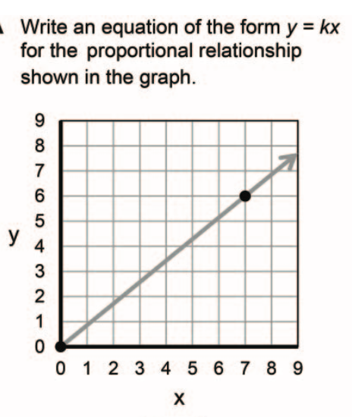
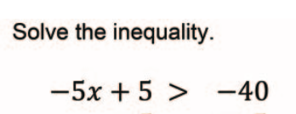
Four kinds of problem
A. Graphs
B. Inequalities
C. Expressions
D. Circles

Slide 16
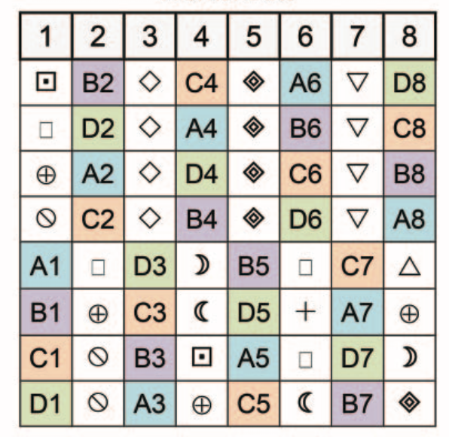
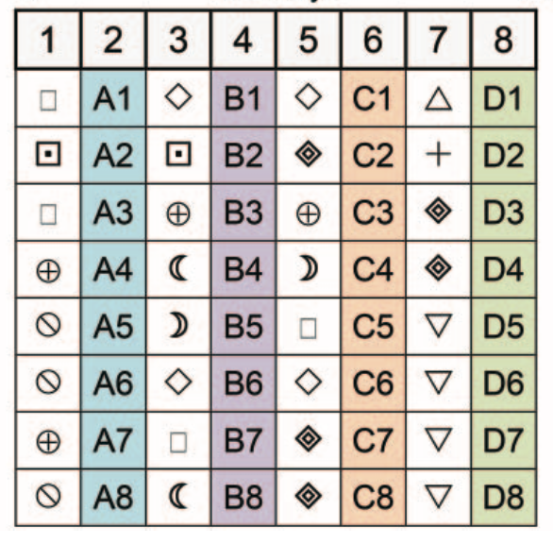
Experimental design
Worksheet
Review
Test
Interleaved practice
10 days
35 days
Blocked practice
103 days

Slide 17
Participants
School | Teacher | Interleaved classes | Blocked classes
A | 1 | 2 | 2
 | 2 | 2 | 2
 | 3 | 2 | 2
B | 4 | 1 | 1
 | 5 | 1 | 1
 | 6 | 1 | 1
C | 7 | 2 | 2
 | 8 | 2 | 2
D | 9 | 3 | 2
 | 10 | 2 | 1
 | 11 | 2 | 2
 | 12 | 1 | 1
E | 13 | 2 | 2
 | 14 | 3 | 3
 | 15 | 2 | 2

Slide 18
Test results
 | Blocked | Interleaved
Mean | 38 | 61
Standard deviation | 27 | 29
Effect size (Cohen’s d) | 0.83
Percentile increase | 30
 | Blocked | Interleaved
Mean | 38 | 61
Standard deviation | 27 | 29
 | Blocked
Mean | 38
Standard deviation | 27
 | Blocked | Interleaved
Mean | 38 | 61
Standard deviation | 27 | 29
Effect size (Cohen’s d) | 0.83
Rohrer, Dedrick, Hartwig, and Cheung (2019)

Slide 19
What does all this mean?
Use assessment at the beginning of a lesson/topic
Provide retrieval practice
Activate prior knowledge
Design instruction that minimizes cognitive load
Extrinsic load: minimized through good instructional design (avoid distractions)
Intrinsic load: minimized through good curriculum sequencing (distributed practice)
Don’t assume that performance equals learning
Zero-stakes testing
Question generation

Slide 20
Thank You
www.dylanwiliam.net

