Slide 1
Stopping people doing good things: the essence of effective leadership
Alberta Assessment Consortium Fall Conference
Edmonton, AB: October 2011
Dylan Wiliam
www.dylanwiliam.net

Slide 2
Improving schools: where’s the solution?
Structure
Smaller/larger high schools
K-8 schools/”All-through” schools
Alignment
Curriculum reform
Textbook replacement
Governance
Charter Schools
Vouchers
Technology
Computers
Interactive white-boards
Workforce reforms

Slide 3
School effectiveness
Three generations of school effectiveness research
Raw results approaches
Different schools get different results
Conclusion: Schools make a difference
Demographic-based approaches
Demographic factors account for most of the variation
Conclusion: Schools don’t make a difference
Value-added approaches
School-level differences in value-added are relatively small
Classroom-level differences in value-added are large
Conclusion: An effective school is a school full of effective classrooms

Slide 4
Canada
Within schools
Between schools
OECD PISA data from McGaw, 2008

Slide 5
We need to focus on classrooms, not schools
In Canada, variability at the classroom level is at least 4 times that at school level
As long as you go to school, it doesn’t matter very much which school you go to
But it matters very much which classrooms you are in…
It’s not class size
It’s not the between-class grouping strategy
It’s not the within-class grouping strategy

Slide 6
…and most of all, on teachers
Take a group of 50 teachers
Students taught by the most effective teacher in that group of 50 teachers learn in six months what those taught by the average teacher learn in a year
Students taught by the least effective teacher in that group of 50 teachers will take two years to achieve the same learning (Hanushek, 2006)
And furthermore:
In the classrooms of the most effective teachers, students from disadvantaged backgrounds learn at the same rate as those from advantaged backgrounds (Hamre & Pianta, 2005)

Slide 7
Improving teacher quality takes time…
A classic labor force issue with 2 (non-exclusive) solutions
Replace existing teachers with better ones
Help existing teachers become even more effective
Replace existing teachers with better ones?
Increasing the quality of entrants to exclude the lowest performing 30% of teachers would in 30 years, increase average teacher quality by 0.5 standard deviations.
Cumulatively, one extra student passing a test per class every three years…

Slide 8
…so we have to help the teachers we have improve…
Improve the effectiveness of existing teachers
The “love the one you’re with” strategy
It can be done
Provided we focus rigorously on the things that matter
Even when they’re hard to do

Slide 9
Teachers do improve, but slowly…
Leigh, A. (2007). Estimating teacher effectiveness from two-year changes in student test scores.

Slide 10
People like neuroscience
Descriptions of 18 psychological phenomena
Example: curse of knowledge
Designed to be comprehensible without scientific training
Each phenomenon was given four possible explanations
Basic (without neuroscience)
Good explanation (provided by the researchers)
Bad explanation (e.g., circular reasoning)
Enhanced (with neuroscience explanation)
Good explanation
Bad explanation
Added neuroscience did not change the logic of the explanation
Participants randomly given one of the four explanations
Asked to rate this on a 7-point scale (-3 to +3).

Slide 11
Sample explanations
 | Good explanation | Bad explanation
Without neuroscience | The researchers claim that this ‘curse’ happens because subjects have trouble switching their point of view to consider what someone else might know, mistakenly projecting their own knowledge onto others. | The researchers claim that this ‘curse’ happens because subjects make more mistakes when they have to judge the knowledge of others. People are much better at judging what they themselves know.
With neuroscience | Brain scans indicate that this ‘curse’ happens because of the frontal lobe brain circuitry known to be involved in self-knowledge. Subjects have trouble switching their point of view to consider what someone else might know, mistakenly projecting their own knowledge onto others. | Brain scans indicate that this ‘curse’ happens because of the frontal lobe brain circuitry known to be involved in self-knowledge. Subjects make more mistakes when they have to judge the knowledge of others. People are much better at judging what they themselves know.

Slide 12
Seductive allure
 | Without neuroscience |  | With neuroscience
Explanation | Good | Bad | Good | Bad
Novices (n=81) | +0.9 | –0.7 | +0.9 | +0.2
Students (n=22) | +0.1 | –1.1 | +0.7 | +0.2
Experts (n=48) | +0.5 | –1.1 | –0.2 | –0.8
(Weisberg et al., 2008)

Slide 13
Brains recognizing words
Group-level activations for recognition of words versus a baseline condition (Miller, et al., 2002)

Slide 15
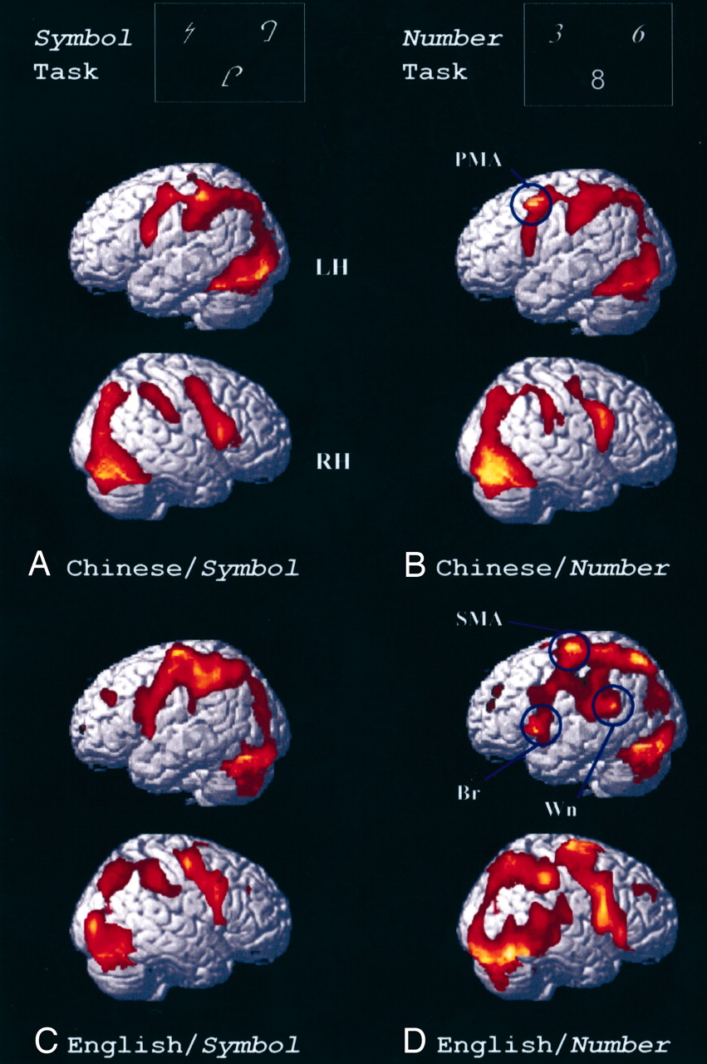
Dissociation in the brain representation of Arabic numbers between native Chinese speakers and native English speakers (Tang et al., 2008)

Slide 16
A case study in one district
Cannington
Urban school district serving ~20,000 students
Approximately 20% of the population non-white
No schools under threat of re-constitution, but all under pressure to improve test scores
Funding for a project on “better learning through smarter teaching”
Focus on mathematics, science and modern foreign languages (MFL)
Commitment from Principals in November 2007
Initial workshops in July 2008

Slide 17
Progress of TLCs in Cannington
 | Maths |  | Science |  | MFL
Ash | 1 | — | 1 | — | 0 | —
Cedar | 5 | ▮ | 1 | ▮ | 3 | ▮ ▮
Hawthorne | 4 | ▮ ▮ | 10 | ▮ ▮ | 5 | ▮ ▮ ▮ ▮
Hazel | 7 | — | 12 | — | 2 | —
Larch | 1 | ▮ ▮ ▮ ▮ | 0 | ▮ | 0 | ▮
Mallow | 6 | ▮ ▮ ▮ | 7 | ▮ | 3 | ▮ ▮
Poplar | 11 | ▮ | 3 | ▮ ▮ ▮ | 1 | ▮ ▮ ▮
Spruce | 7 | ▮ ▮ ▮ ▮ | 8 | ▮ ▮ ▮ | 5 | ▮ ▮ ▮
Willow | 2 | ▮ | 5 | ▮ | 2 | ▮ ▮ ▮ ▮
Totals | 44 |  | 47 |  | 21
Black nos. show teachers attending launch event; blue bars show progress of TLC

Slide 18
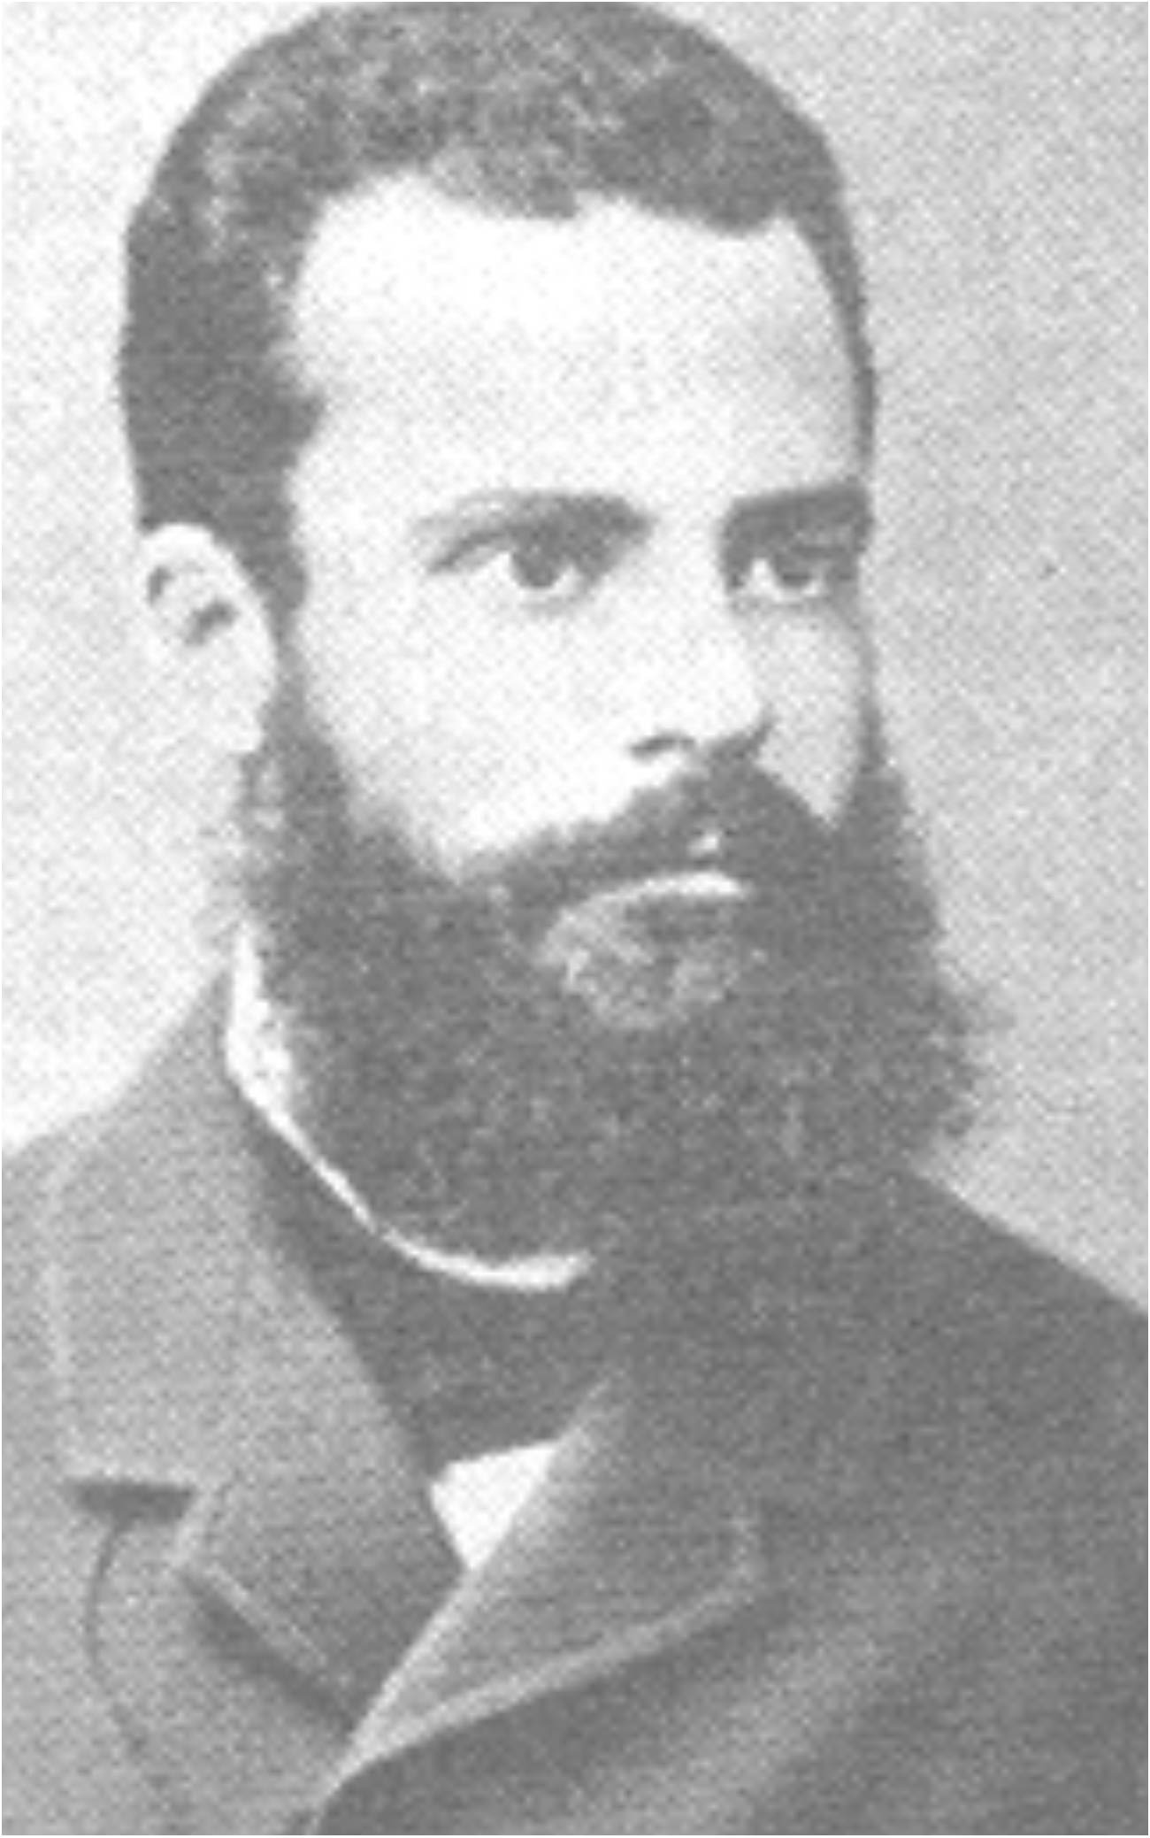
Pareto analysis
Vilfredo Pareto (1848-1923)
Economist and philosopher
Pareto improvement
A change that makes at least one person better off without making anyone else worse off.
Pareto efficiency/Pareto optimality
An allocation of resource is Pareto optimal when there are no more Pareto improvements
Obstacles to Pareto improvements
The political economy of reform
It is very hard to stop people doing valuable things in order to give them time to do even more valuable things

Slide 19
Cake or death?

Slide 20
Cost/effect comparisons
Intervention | Extra months of learning per year | Cost/class-room/yr
Class-size reduction (by 30%) | 4 | $30k
Increase teacher content knowledge from weak to strong | 2 | ?
Formative assessment/ Assessment for learning | 8 | $3k

Slide 21
Teacher learning
Teacher learning is just like any other learning in a highly complex area
In the same way that teachers cannot do the learning for their learners
Leaders cannot do the learning for their teachers
Two extreme responses
“It’s hopeless”
Let a thousand flowers bloom..
Neither will work
What leaders can do is engineer effective learning environments for teachers
‘Servant’ leadership

Slide 22
The knowing-doing gap
Statement | We know we should do this | We are doing this
Getting good ideas from other units in the chain | 4.9 | 4.0
Instituting an active suggestions program | 4.8 | 3.9
Using a detailed assessment process for new hires | 5.0 | 4.2
Posting all jobs internally | 4.2 | 3.5
Talking openly about learning from mistakes | 4.9 | 4.3
Providing employees with frequent feedback | 5.7 | 5.2
Sharing information about financial performance | 4.3 | 3.8
Pfeffer, J. (2000). The knowing-doing gap. Cambridge, MA: Harvard Business School Press.

Slide 23
Control and impact
 |  | Control
 |  | Inside | Outside
Impact | Low
 | High

Slide 24
Why people shouldn’t work on their own
Strangers predict your IQ better than you do (Borkenau & Liebler, 1993)
Most of us think we are above average drivers (Svenson, 1981)
Only 2% of high school seniors believe their leadership skills are below average (College Board, 1976/1977)
…and 25% of them believe they are in the top 1% in their ability to get along with others (College Board, 1976/1977)
94% of college professors report doing above average work (Cross, 1997)
People think they are at lower risk than their peers for heart attacks, cancer, food poisoning, etc. (Weinstein, 1980)
And, most surprisingly…
People believe they are better than their peers at providing accurate self assessment (Pronin, Lin, & Ross, 2002)

Slide 25
What is a Professional Learning Community?
“…an inclusive group of people, motivated by a shared learning vision, who support and work with each other, finding ways, inside and outside their immediate community, to enquire on their practice and together learn new and better approaches that will enhance all pupils’ learning.” (Stoll et al., 2006)

Slide 26
Professional learning communities
Professional
Decision-making under uncertainty
Accountable to a community of peers
Learning
Focused on improvement in student outcomes
Communities
Joint enterprise
Mutual engagement
Shared repertoire

Slide 27
Professions in comparative perspective
 | Medical education | Teacher education
People-centred profession? | ✔ | ✔
Agreed body of knowledge? | ✔ | ✘
Shared language of description? | ✔ | ✘
Cumulating research? | ✔ | ✘
Practitioners involved in research | ✔ | ✘
‘Keeping up with research’ regarded as a professional duty | ✔ | ✘

Slide 28
Context matters

Slide 31
Tight, but loose
Two opposing factors in any school reform
Need for flexibility to adapt to local constraints and affordances
Implies there is appropriate flexibility built into the reform
Need to maintain fidelity to the theory of action of the reform, to minimise “lethal mutations”
So you have to have a clearly articulated theory of action
Different innovations have different approaches to flexibility
Some reforms are too loose (e.g., ‘Effective schools’ movement)
Others are too tight (e.g., Montessori Schools)
The “tight but loose” formulation:
… combines an obsessive adherence to central design principles (the “tight” part) with accommodations to the needs, resources, constraints, and affordances that occur in any school or district (the “loose” part), but only where these do not conflict with the theory of action of the intervention.

Slide 32
Design and intervention
Our design process
cognitive/affective
insights
synergy/
comprehensiveness
set of components
Teachers’ implementation process
set of
components
synergy/
comprehensiveness
cognitive/affective
insights

Slide 33
The happiness hypothesis (Haidt, 2005)
 | + | –
The rider | Rational Good at complex analysis Focused on the long-term Thinks about the future | Weak Easily distracted Gets bogged down in detail Tires quickly
The elephant | Instinctive Compassionate Sympathetic Loyal Protective Powerful | Emotional Skittish Focused on the short-term Thinks about the present

Slide 34
Strategies for change (Heath & Heath, 2010)
Direct the rider
Follow the bright spots
Script the critical moves
Point to the destination
Motivate the elephant
Find the feeling
Shrink the change
Grow your people
Shape the path
Tweak the environment
Build habits
Rally the herd
Notes:
Direct the rider
Follow the bright spots (malnutrition in Vietnam)
Script the critical moves (1% milk; 25 points)
Point to the destination (No dry holes)
Motivate the elephant
Find the feeling (Gloves on the table)
Shrink the change (5-minute room makeover)
Grow your people (Dweck’s mindset)
Shape the path
Tweak the environment (popcorn study, one-click ordering)
Build habits (action triggers: don’t tax the rider; checklists)
Rally the herd (free spaces in hospitals)

Slide 35
TLC case study 1: Edmonton County School

Slide 36
TLC case study 2: St. Wilfrid’s RC High School

Slide 37
Teacher Quotes
“I have been the most impressed with how much more involved my students have been in their own learning…their confidence in their efforts has been wonderful.”
Here [school based TLC] we had techniques sort of embedded in this group where, you know, we are talking about problems. And our group really actually talked about problems, and we were all GUYS, and older guys too. We actually talked and that doesn’t happen. That doesn’t happen, so I enjoyed the group a lot and thought it was very useful.”
“This work, has really changed what I do – more than most things. When you stop grading papers with numbers, that’s a big deal!”

Slide 38
Impact: on teachers

Slide 39
Impact: on students

Slide 40
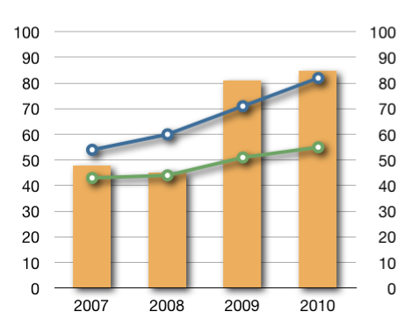
Impact at Edmonton County School

Slide 41
Teacher Quotes
“We don’t have to have ‘cookie cutter’ classrooms, where we’re all on the same page. There’s an atmosphere here that supports innovation. We can individualize…we’re encouraged to try new things and we’re given time to share with our colleagues.”

Slide 42
Membership of PLCs
 | Benefits | Risks
Volunteers | Culture deepens quickly Appealing to ‘keen’ teachers | Non-volunteers left behind
Conscripts | Oppositional sub-culture less likely Differences in approach can be used to deepen conversations | ‘Project mentality’ disconnected from practice Tokenistic adoption

Slide 43
When is change sustainable?
Understanding what it means to scale (Coburn, 2003)
Depth
Sustainability
Spread
Shift in reform ownership
Consideration of the diversity of contexts of application
Clarity about components, and the theory of action

Slide 44
Key stakeholders’ reactions
Departmental sub-cultures
Unions
Professional associations
Teaching assistants
Ofsted
Parents
Governors
Community leaders

Slide 45
Cost profile of innovations
“Big bang”
“Steady-state”
Annual Cost
Annual
Cost
Time
Time
“Focused expansion”
“Inflationary”
Annual Cost
Annual Cost
Time
Time

Slide 46
Managing disappointments
Failure: opportunity for learning or blame
Falling down: failing or learning?
High-reliability organizations embrace failure
$1m dollar club
“A complaint is a gift”
Group-work is hard for teachers, … and for teachers of teachers…

Slide 47
A case study in risk
Transposition of the great arteries (TGA)
A rare, but extremely serious, congenital condition in newborn babies (~25 per 100,000 live births) in which
the aorta emerges from the right ventricle and so receives oxygen-poor blood, which is carried back to the body without receiving more oxygen
the pulmonary artery emerges from the left ventricle and so receives the oxygen-rich blood, which is carried back to the lungs
Traditional treatment: the ‘Senning’ procedure which involves:
the creation of a ‘tunnel’ between the ventricles, and
the insertion of a ‘baffle’ to divert oxygen-rich blood from the left ventricle (where it shouldn’t be) to the right ventricle (where it should)
Prognosis
Early death rate (first 30 days): 12%
Life expectancy: 46.6 years

Slide 48
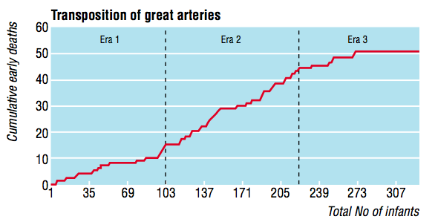
The introduction of the ‘switch’ procedure
Senning
Transitional
Switch
Early death rate
Senning 12%
Transitional 25%
Bull, et al (2000). BMJ, 320, 1168-1173.

Slide 49
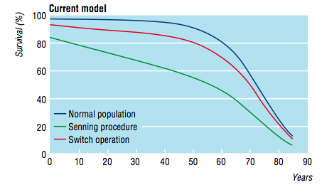
Impact on life expectancy
Life expectancy:
Senning: 46.6 years
Switch: 62.6 years

Slide 50
Force-field analysis (Lewin, 1954)
What are the forces that will support or drive the adoption of teacher learning communities in your school/district/province?
What are the forces that will constrain or prevent the adoption of teacher learning communities in your school/district/province?
+
—

