Slide 1
Embedding formative assessment with teacher learning communities
Dylan Wiliam
Alberta Assessment Fall Conference
Edmonton, AB: October 2011
www.dylanwiliam.net

Slide 2
“Teachers will not take up attractive sounding ideas, albeit based on extensive research, if these are presented as general principles which leave entirely to them the task of translating them into everyday practice – their lives are too busy and too fragile for this to be possible for all but an outstanding few. What they need is a variety of living examples of implementation, by teachers with whom they can identify and from whom they can both derive conviction and confidence that they can do better, and see concrete examples of what doing better means in practice.” (Black & Wiliam, 1998)

Slide 3
How flat is the world?
Percentage crossing national boundaries
  Physical mail:
  Telephone minutes:
  Internet traffic:
  First generation immigrants:
  University students:
  People, ever in their lives:
  Goods and services:

Slide 4
Percentage crossing national boundaries
Responses
1%
5%
10%
20%
50%
  Physical mail:
  Telephone minutes:
  Internet traffic:
  First generation immigrants:
  University students:
  People, ever in their lives:
  Goods and services:

Slide 5
Mostly round; some flat bits (Ghemawat, 2011)
Percentage crossing national boundaries
  Physical mail: 1
  Telephone minutes: 2
  Internet traffic: 17
  First generation immigrants: 3
  University students: 2
  People, ever in their lives: 10
  Goods and services: 10

Slide 6
There is only one 21st century skill
So the model that says learn while you’re at school, while you’re young, the skills that you will apply during your lifetime is no longer tenable. The skills that you can learn when you’re at school will not be applicable. They will be obsolete by the time you get into the workplace and need them, except for one skill. The one really competitive skill is the skill of being able to learn. It is the skill of being able not to give the right answer to questions about what you were taught in school, but to make the right response to situations that are outside the scope of what you were taught in school. We need to produce people who know how to act when they’re faced with situations for which they were not specifically prepared. (Papert, 1998)

Slide 7
What kinds of schools do we need?
School model | Ethos | Key process
Talent refineries | School must provide opportunities for students to show what they can do | Ensuring good teaching and syllabus coverage
Talent incubators | All students students can learn, but not all students can achieve at high levels | Drawing out what is within the student
Talent factories | All students can achieve at high levels | Whatever it takes

Slide 8
Be the change you want to see in the world
“Educators create a results orientation in their schools when they stop looking out the window for solutions to their problems and start looking in the mirror” (DuFour, Eaker & Du Four, 2005 p. 246)
“You control everything you need to control to make a difference in your students’ lives” (Lemov, 2010)

Slide 9
What kind of school is yours?
Metaphors for schools’ approaches to change
  Lighthouse
    “We’ve done things this way for years, and it has worked very well”
  Christmas tree
    “Never knowingly left behind, on anything”
Where does your school fit on the continuum between these two?
I

Slide 10
What kinds of changes could we make?
Changes in structure
Changes in management
Changes in teachers’ subject knowledge
Changes in teachers’ classroom practice

Slide 11
Knowledge transfer?

Slide 12
A model for teacher learning
Content, then process
  Content (what we want teachers to change)
    Evidence
    Ideas (strategies and techniques)
  Process (how to go about change)
    Choice
    Flexibility
    Small steps
    Accountability
    Support

Slide 13
Choice
Belbin inventory (Management teams: why they succeed or fail)
  Eight team roles (defined as “A tendency to behave, contribute and interrelate with others in a particular way.”)
    Company worker; Innovator; Shaper; Chairperson; Resource investigator; Monitor/evaluator; Completer/finisher; Team worker
  Key ideas
    Each role has strengths and allowable weaknesses
    People rarely sustain “out of role” behavior, especially under stress
Each teacher’s personal approach to teaching is similar
  Some teachers’ weaknesses require immediate attention
  For most, however, students benefit more by developing teachers’ strengths

Slide 14
Flexibility
Two opposing factors in any school reform
  Need for flexibility to adapt to local circumstances
    Implies there is appropriate flexibility built into the reform
  Need to maintain fidelity to the theory of action
    So you have to have a clearly articulated theory of action
Different reforms have different approaches to flexibility
  Some are too loose (e.g., ‘Effective schools’ movement)
  Others are too tight (e.g., Montessori Schools)
The “tight but loose” formulation:
  … combines an obsessive adherence to central design principles (the “tight” part) with accommodations to the needs, resources, constraints, and affordances that occur in any school or district (the “loose” part), but only where these do not conflict with the theory of action of the intervention.

Slide 15
Strategies and techniques
Distinction between strategies and techniques
  Strategies define the territory of formative assessment (no brainers)
  Teachers are responsible for choice of techniques
    Allows for customization/caters for local context
    Creates ownership
    Shares responsibility
Key requirements of techniques
  embodiment of deep cognitive/affective principles
  relevance
  feasibility
  acceptability

Slide 16
Small steps
According to Berliner (1994), experts
  excel mainly in their own domain.
  often develop automaticity for the repetitive operations that are needed to accomplish their goals.
  are more sensitive to the task demands and social situation when solving problems.
  are more opportunistic and flexible in their teaching than novices.
  represent problems in qualitatively different ways than novices.
  have fast and accurate pattern recognition capabilities. Novices cannot always make sense of what they experience.
  perceive meaningful patterns in the domain in which they are experienced.
  begin to solve problems slower but bring richer and more personal sources of information to bear on the problem that they are trying to solve.

Slide 17
Example: CPR (Klein & Klein, 1981)
Six video extracts of a person delivering cardio-pulmonary resuscitation (CPR)
  5 of the video extracts are students
  1 of the video extracts is an expert
Videos shown to three groups: students, experts, instructors
Success rate in identifying the expert:
  Experts: 90%
  Students: 50%
  Instructors: 30%

Slide 18
Looking at the wrong knowledge…
The most powerful teacher knowledge is not explicit
  That’s why telling teachers what to do doesn’t work
  What we know is more than we can say
  And that is why most professional development has been relatively ineffective
Improving practice involves changing habits, not adding knowledge
  That’s why it’s hard
    And the hardest bit is not getting new ideas into people’s heads
    It’s getting the old ones out
  That’s why it takes time
But it doesn’t happen naturally
  If it did, the most experienced teachers would be the most productive, and that’s not true (Hanushek, 2005)

Slide 19
Changing, not sharing, practice
The knowing-doing gap
Teachers don’t need new ideas
Teachers need support in implementing the ideas they already have

Slide 20

Changing, not sharing, practice

Slide 21
We need to create time and space for teachers to reflect on their practice in a structured way, and to learn from mistakes
(Bransford, Brown & Cocking, 1999)
“Always make new mistakes”
(Esther Dyson)
“Ever tried. Ever failed. No matter. Try again. Fail again. Fail better.”
(Samuel Beckett, Worstward Ho)

Slide 22
Sensory capacity (Nørretranders, 1998)
Sensory system | Total bandwidth (in bits/second) | Conscious bandwidth (in bits/second)
Eyes | 10,000,000 | 40
Ears | 100,000 | 30
Skin | 1,000,000 | 5
Taste | 1,000 | 1
Smell | 100,000 | 1

Slide 23
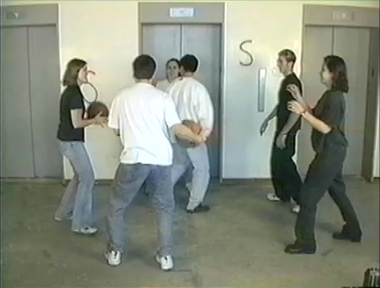

Slide 24
Hand hygiene in hospitals (Pittet, 2001)
Study | Focus | Compliance rate
Preston, Larson & Stamm (1981) | Open ward | 16%
 | ICU | 30%
Albert & Condie (1981) | ICU | 28% to 41%
Larson (1983) | All wards | 45%
Donowitz (1987) | Pediatric ICU | 30%
Graham (1990) | ICU | 32%
Dubbert (1990) | ICU | 81%
Pettinger & Nettleman (1991) | Surgical ICU | 51%
Larson et al. (1992) | Neonatal ICU | 29%
Doebbeling et al. (1992) | ICU | 40%
Zimakoff et al. (1992) | ICU | 40%
Meengs et al. (1994) | ER (Casualty) | 32%
Pittet, Mourouga & Perneger (1999) | All wards | 48%
 | ICU | 36%

Slide 25
Supportive accountability
What is needed from teachers
  A commitment to:
    the continuous improvement of practice
    focus on those things that make a difference to student outcomes
What is needed from leaders
  A commitment to:
    creating expectations for the continuous improvement of practice
    ensuring that the the focus stays on those things that make a difference to student outcomes
    providing the time, space, dispensation and support for innovation
    supporting risk-taking

Slide 26
Making a commitment…
Action planning
  Forces teachers to make their ideas concrete and creates a record
  Makes the teacher accountable for doing what they promised
  Requires each teacher to focus on a small number of changes
  Requires the teacher to identify what they will give up or reduce
A good action plan
  Does not try to change everything at once
  Spells out specific changes in teaching practice
  Relates to the five “key strategies” of AfL
  Is achievable within a reasonable period of time
  Identifies something that the teacher will no longer do or will do less of

Slide 27
…and being held to it
I think specifically what was helpful was the ridiculous NCR [No Carbon Required] forms. I thought that was the dumbest thing, but I’m sitting with my friends and on the NCR form I write down what I am going to do next month.
Well, it turns out to be a sort of “I’m telling my friends I’m going to do this” and I really actually did it and it was because of that. It was because I wrote it down
I was surprised at how strong an incentive that was to do actually do something different … that idea of writing down what you are going to do and then because when they come by the next month you better take out that piece of paper and say “Did I do that?” … Just the idea of sitting in a group, working out something, and making a commitment… I was impressed about how that actually made me do stuff. (Tim, Spruce Central High School)

Slide 28
Teacher Learning Communities

Slide 29
Teacher learning communities
Plan that the TLC will run for two years
Identify 10 to 12 interested colleagues
  Composition
    Similar assignments (e.g. early years, math/sci)
    Mixed-subject/mixed-phase
    Hybrid
Secure institutional support for:
  Monthly meetings (75 - 120 minutes each, inside or outside school time)
  Time between meetings (2 hrs per month in school time)
    Collaborative planning
    Peer observation
  Any necessary waivers from school policies

Slide 30
Signature pedagogies

Slide 31
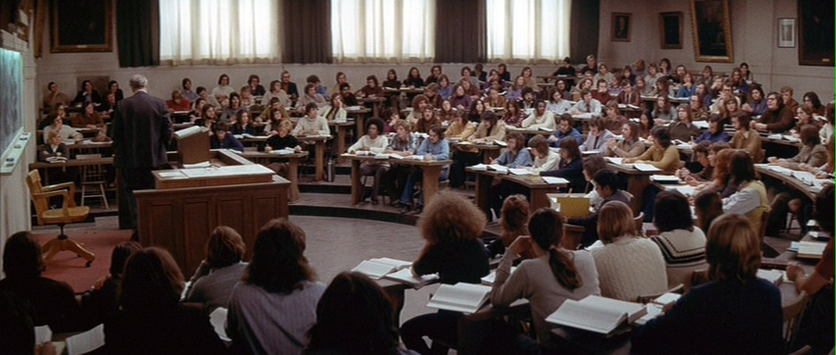
In Law

Slide 32
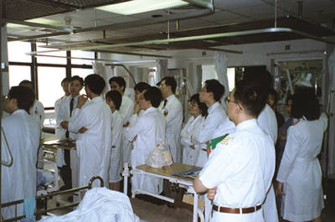
In Medicine

Slide 33
A ‘signature pedagogy’ for teacher learning
Every monthly TLC meeting should follows the same structure and sequence of activities
  Activity 1: Introduction (5 minutes)
  Activity 2: Starter activity (5 minutes)
  Activity 3: Feedback (25-50 minutes)
  Activity 4: New learning about formative assessment (20-40 minutes)
  Activity 5: Personal action planning (15 minutes)
  Activity 6: Review of learning (5 minutes)

Slide 34
Activities 1, 2, 3, 5, 6: “Bookends”
For each of these five activities, the process is exactly the same at each TLC meeting
This provides a familiar structure for teachers to get better together
  As the structure fades into the background,
  The learning comes into the foreground
Teachers come to the meeting knowing what is expected of them

Slide 35
Ground-rules for TLCs
Norms of collaboration (Garmston & Wellman, 1999)
Seven powerful Ps
  Pausing
  Paraphrasing
  Probing
  Putting ideas on the table (and pulling them off!)
  Paying attention to self and others
  Presuming positive intentions
  Pursuing a balance between advocacy and inquiry

Slide 36
Activity 1: Introduction
Sharing learning intentions for the meeting

Slide 37
Activity 2: Starter
A variety of warm-up activities to get participants’ minds to the meeting:
  Think of something you are looking forward to this year
  30-seconds to get “things off your chest” about what infuriates you about your job
  30 seconds to tell the group about something that happened within the last month and made you feel good
  Think of something that happened in a lesson this year that made you smile
  Think of something that one of your colleagues did last term that supported you
  Go back to the TLC ‘ground rules’

Slide 38
Activity 3: Feedback
Routines need to be established, expectations shared, and structure maintained.
Similar expectations regarding preparation and engagement.
  Come to the meeting knowing you will be sharing your own AfL experiences.
  Be prepared to offer constructive, thoughtfully conceived feedback to colleagues.
  Be prepared to challenge ideas that may be good classroom practice but are not necessarily tightly related to formative assessment.

Slide 39
Activity 4: New learning about AfL
Drip-feed’ of new ideas, to increase knowledge, and to produce variety
  Watch videos of classroom practice
  Book study (one chapter each month)
  New AfL techniques

Slide 40
Activity 5: Personal action planning
Each teacher updates his or her personal action plan
Makes a specific commitment about what they will do over the coming month
Arranges any support needed from colleagues
  Specific date and time for peer observation

Slide 41
Activity 6: Wrap
Did the meeting meet its intended objectives
  If yes, great
  If no, time to plan what to do about it

Slide 42
Every TLC needs a leader
The job of the TLC leader(s)
  To remind participants about the next meeting
  To book a room for the meeting
  To ensure that all necessary resources (including refreshments!) are available at meetings
  To ensure that the agenda is followed
  To maintain a collegial and supportive environment
But most important of all…
  not to be the formative assessment “expert”

Slide 43
Peer observation
Run to the agenda of the observed, not the observer
  Observed teacher specifies focus of observation
    e.g., teacher wants to increase wait-time
  Observed teacher specifies what counts as evidence
    provides observer with a stop-watch to log wait-times
  Observed teacher owns any notes made during the observation

Slide 44
A hinge-point question about TLC leaders
What is the most important role of the TLC leader?
  Becoming the most knowledgeable about AfL in your school
  Reserving the room, making the handouts, and organizing refreshments
  Making sure the TLC meeting occurs and has good attendance
  Recruiting as many new teachers as possible to join the TLC
  Making sure the meeting keeps a strong AfL focus and that everyone shares/gets support

Slide 45
A hinge-point question about TLC meetings
What is the most important purpose of a TLC meeting?
  Giving teachers who may not know each other well a chance to work together
  Learning new AfL techniques that can be used in your classroom
  Learning new AfL techniques in order to keep the meetings fresh
  Reporting what AfL technique(s) you have tried and getting help where you are stumped
  Planning what AfL technique(s) you are going to try next in your classroom

Slide 46
Comments?
Questions?

Slide 47
Force-field analysis (Lewin, 1954)
What are the forces that will support or drive the adoption of teacher learning communities in your school/state/territory?
What are the forces that will constrain or prevent the adoption of teacher learning communities in your school/state/territory?
+
—

