Slide 1
Formative Assessment: what it is and what it isn’t; when it works and when it doesn’t.
Alberta Assessment Consortium Fall Conference
Edmonton, AB: October 2011
Dylan Wiliam
www.dylanwiliam.net

Slide 2
Overview: science and design
We need to improve student achievement
This requires improving teacher quality
Improving the quality of entrants takes too long
So we have to make the teachers we have better
We can change teachers in a range of ways
Some will benefit students, and some will not.
Those that do involve changes in teacher practice
Changing practice requires new kinds of teacher learning
And new models of professional development.
Science
Design

Slide 3
Raising achievement matters
For individuals
Increased lifetime salary
Improved health
Longer life
For society
Lower criminal justice costs
Lower health-care costs
Increased economic growth
Net present value to Canada of a 25 point increase on PISA: $4 trn (Hanushek & Woessman, 2010)

Slide 4
Which of the following categories of skill is disappearing from the work-place most rapidly?
Routine manual
Non-routine manual
Routine cognitive
Complex communication
Expert thinking/problem-solving

Slide 5
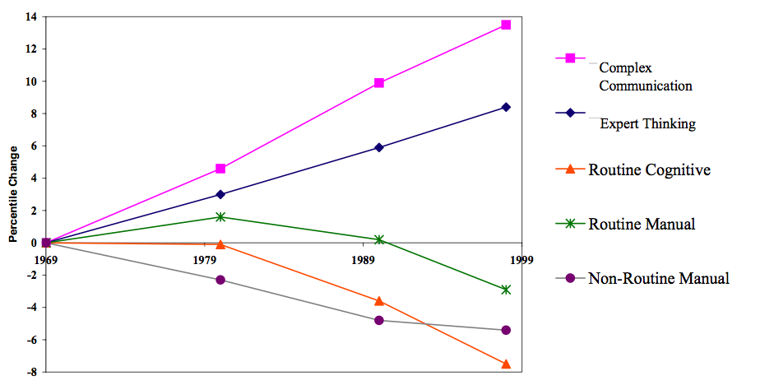
…but what is learned matters too…
Autor, Levy & Murnane, 2003

Slide 6
…now more than ever…
Source: Economic Policy Institute

Slide 7
Relevant studies
Fuchs & Fuchs (1986)
Natriello (1987)
Crooks (1988)
Banger-Drowns, et al. (1991)
Kluger & DeNisi (1996)
Black & Wiliam (1998)
Nyquist (2003)
Dempster (1991, 1992)
Elshout-Mohr (1994)
Brookhart (2004)
Allal & Lopez (2005)
Köller (2005)
Brookhart (2007)
Wiliam (2007)
Hattie & Timperley (2007)
Shute (2008)

Slide 8
The formative assessment hi-jack…
Long-cycle
Span: across units, terms
Length: four weeks to one year
Impact: Student monitoring; curriculum alignment
Medium-cycle
Span: within and between teaching units
Length: one to four weeks
Impact: Improved, student-involved, assessment; teacher cognition about learning
Short-cycle
Span: within and between lessons
Length:
day-by-day: 24 to 48 hours
minute-by-minute: 5 seconds to 2 hours
Impact: classroom practice; student engagement

Slide 9
Which of these are formative?
District science supervisor uses test results to plan professional development workshops for teachers
Teachers doing item-by-item analysis of 5th grade math tests to review their 5th grade curriculum
A school tests students every 10 weeks to predict which students are “on course” to pass the state test in March
Three-fourths of the way through a unit test
Students who fail a test on Friday have to come back on Saturday
Exit pass question: “What is the difference between mass and weight?”
“Sketch the graph of y equals one over one plus x squared on your mini-white boards.”

Slide 10
Unpacking formative assessment
Key processes
Establishing where the learners are in their learning
Establishing where they are going
Working out how to get there
Participants
Teachers
Peers
Learners

Slide 11
Aspects of formative assessment
 | Where the learner is going | Where the learner is | How to get there
Teacher | Clarify and share learning intentions | Engineering effective discussions, tasks and activities that elicit evidence of learning | Providing feedback that moves learners forward
Peer | Understand and share learning intentions | Activating students as learning resources for one another
Learner | Understand learning intentions | Activating students as owners of their own learning

Slide 12
Five “key strategies”…
Clarifying, understanding, and sharing learning intentions
curriculum philosophy
Engineering effective classroom discussions, tasks and activities that elicit evidence of learning
classroom discourse, interactive whole-class teaching
Providing feedback that moves learners forward
feedback
Activating students as learning resources for one another
collaborative learning, reciprocal teaching, peer-assessment
Activating students as owners of their own learning
metacognition, motivation, interest, attribution, self-assessment
(Wiliam & Thompson, 2007)

Slide 13
…and one big idea
Use evidence about learning to adapt instruction to meet student needs

Slide 14
An educational positioning system
A good teacher
Establishes where the students are in their learning
Identifies the learning destination
Carefully plans a route
Begins the learning journey
Makes regular checks on progress on the way
Makes adjustments to the course as conditions dictate

Slide 15
Strategies and practical techniques for classroom formative assessment

Slide 16
Eliciting evidence
Key idea: questioning should
cause thinking
provide data that informs teaching
Improving teacher questioning
generating questions with colleagues
closed v open
low-order v high-order
appropriate wait-time
Getting away from I-R-E
basketball rather than serial table-tennis
‘No hands up’ (except to ask a question)
‘Hot Seat’ questioning
All-student response systems
Class polls, ABCD cards, Mini white-boards, Exit passes

Slide 17
Questioning in maths: discussion
Look at the following sequence:
3, 7, 11, 15, 19, ….
Which is the best rule to describe the sequence?
n + 4
3 + n
4n - 1
4n + 3

Slide 18
Questioning in maths: diagnosis
In which of these right-angled triangles is a² + b² = c² ?
A
b
B
c
a
a
c
b
C
a
D
c
b
b
c
a
E
a
F
b
c
c
b
a

Slide 19
Questioning in science: discussion
Ice-cubes are added to a glass of water. What happens to the level of the water as the ice-cubes melt?
The level of the water drops
The level of the water stays the same
The level of the water increases
You need more information to be sure

Slide 20
Questioning in science: diagnosis
The ball sitting on the table is not moving. It is not moving because:
no forces are pushing or pulling on the ball.
gravity is pulling down, but the table is in the way.
the table pushes up with the same force that gravity pulls down
gravity is holding it onto the table.
there is a force inside the ball keeping it from rolling off the table
Wilson & Draney, 2004

Slide 21
Questioning in English: discussion
Macbeth: mad or bad?

Slide 22
Questioning in English: diagnosis
Where is the verb in this sentence?
The dog ran across the road
A
B
C
D

Slide 23
Questioning in English: diagnosis
Which of these is correct?
Its on its way.
It’s on its way.
Its on it’s way.
It’s on it’s way.

Slide 24
Differentiation (2)
Identify the adverbs in these sentences:
The boy ran across the street quickly. (A) (B) (C) (D) (E)
Jayne usually crossed the street in a leisurely fashion. (A) (B) (C) (D) (E)
Fred ran the race well but unsuccessfully. (A) (B) (C) (D) (E)

Slide 25
Questioning in English: diagnosis
Which of these is the best thesis statement?
The typical TV show has 9 violent incidents
The essay I am going to write is about violence on TV
There is a lot of violence on TV
The amount of violence on TV should be reduced
Some programs are more violent than others
Violence is included in programs to boost ratings
Violence on TV is interesting
I don’t like the violence on TV

Slide 26
Questioning in history: discussion
In which year did World War II begin?
1919
1938
1939
1940
1941

Slide 27
Questioning in history: diagnosis
Why are historians concerned with bias when analyzing sources?
People can never be trusted to tell the truth
People deliberately leave out important details
People are only able to provide meaningful information if they experienced an event firsthand
People interpret the same event in different ways, according to their experience
People are unaware of the motivations for their actions
People get confused about sequences of events

Slide 28
Questioning in MFL: discussion
Is the verb “être” regular in French?

Slide 29
Questioning in MFL: diagnosis
Which of the following is the correct translation for ”I give the book to him”?
Yo lo doy el libro.
Yo doy le el libro.
Yo le doy el libro.
Yo doy lo el libro.
Yo doy el libro le.
Yo doy el libro lo.
Notes:
This item is diagnostic because it has been designed so that if pupils answer incorrectly, it is easy to work out why. Response A indicates a pronoun error, responses B and E indicate placement errors, and responses D and F indicate both pronoun and placement errors

Slide 30
Hinge Questions
A hinge question is based on the important concept in a lesson that is critical for students to understand before you move on in the lesson.
The question should fall about midway during the lesson.
Every student must respond to the question within two minutes.
You must be able to collect and interpret the responses from all students in 30 seconds

Slide 31
Real-time test: Figurative language
He was like a bull in a china shop.
This backpack weighs a ton.
The sweetly smiling sunshine…
He honked his horn at the cyclist.
He was as tall as a house.
Alliteration
Hyperbole
Onomatopoeia
Personification
Simile

Slide 32
Providing feedback that moves learners forward

Slide 33
Kinds of feedback: Israel
264 low and high ability grade 6 students in 12 classes in 4 schools; analysis of 132 students at top and bottom of each class
Same teaching, same aims, same teachers, same classwork
Three kinds of feedback: scores, comments, scores+comments
 | Achievement | Attitude
Scores | no gain | High scorers : positive Low scorers: negative
Comments | 30% gain | High scorers : positive Low scorers : positive
[Butler(1988) Br. J. Educ. Psychol., 58 1-14]

Slide 34
Responses
 | Achievement | Attitude
Scores | no gain | High scorers : positive Low scorers: negative
Comments | 30% gain | High scorers : positive Low scorers : positive
What do you think happened for the students given both scores and comments?
Gain: 30%; Attitude: all positive
Gain: 30%; Attitude: high scorers positive, low scorers negative
Gain: 0%; Attitude: all positive
Gain: 0%; Attitude: high scorers positive, low scorers negative
Something else
[Butler(1988) Br. J. Educ. Psychol., 58 1-14]

Slide 35
Kinds of feedback: Israel (2)
200 grade 5 and 6 Israeli students
Divergent thinking tasks
4 matched groups
experimental group 1 (EG1); comments
experimental group 2 (EG2); grades
experimental group 3 (EG3); praise
control group (CG); no feedback
Achievement
EG1>(EG2≈EG3≈CG)
Ego-involvement
(EG2≈EG3)>(EG1≈CG)
[Butler (1987) J. Educ. Psychol. 79 474-482]

Slide 36
Effects of feedback
Kluger & DeNisi (1996) review of 3000 research reports
Excluding those:
without adequate controls
with poor design
with fewer than 10 participants
where performance was not measured
without details of effect sizes
left 131 reports, 607 effect sizes, involving 12652 individuals
On average, feedback increases achievement
Effect sizes highly variable
38% (50 out of 131) of effect sizes were negative

Slide 37
Provide feedback that moves learning on
Key idea: feedback should
cause thinking
provide guidance on how to improve
Comment-only grading
Focused grading
Explicit reference to rubrics
Suggestions on how to improve
Not giving complete solutions
Re-timing assessment
(eg three-fourths-of-the-way-through-a-unit test)

Slide 38
Share learning intentions
Explain learning intentions at start of lesson/unit
Learning intentions
Success criteria
Consider providing learning intentions and success criteria in students’ language
Use posters of key words to talk about learning
e.g., describe, explain, evaluate
Use planning and writing frames
Use annotated examples of different standards to ‘flesh out’ assessment rubrics (e.g. lab reports)
Provide opportunities for students to design their own tests

Slide 39
Help students be learning resources
Students assessing their peers’ work
“pre-flight checklist”
“two stars and a wish”
“choose-swap-choose”
Training students to pose questions/identifying group weaknesses
End-of-lesson students’ review

Slide 40
Help students own their own learning
Students assessing their own work
with scoring rubrics
with exemplars
“learning portfolios”
Self-assessment of understanding
Traffic lights
Red/green discs
Coloured cups

Slide 41
Thank you
www.dylanwiliam.net

