Slide 1
Confessions of an accidental psychologist
Dylan Wiliam
www.dylanwiliam.net

Slide 2
Not so much a career as careering…
I never wanted to be a psychologist…
I wanted to be (in chronological order)
  Scrum-half for Wales (actually, Gareth Edwards)
  A chemist
  A pure mathematician
  A rock musician
I actually became…
  A secondary school teacher
  An educational researcher
  A teacher trainer
  A psychometrician

Slide 3
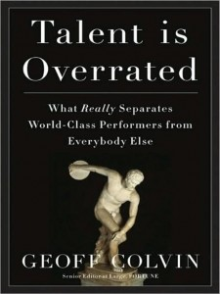
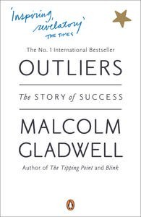
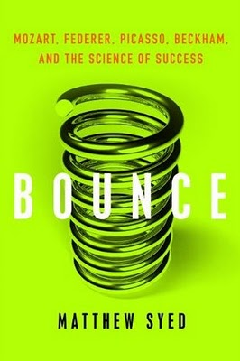
Talent is over-rated…

Slide 4
Just write…
“If I had to write a book in order to communicate what I already think, before starting to write it, I would never have the courage to undertake it. I only write because I don’t know yet exactly what to think of this thing I would so much like to think through. Thus the book transforms me and what I think. I write in order to change myself, and not to think the same thing as before.” Michel Foucault, Dits et ecrits 1954-88 v4.
And as for the PhD…
  It’s not having it that matters; it’s not having it that matters.

Slide 5
Reviewing
The rejection of my own manuscript has a sordid aftermath:
  one day of depression;
  one day of utter contempt for the editor and his accomplices;
  one day of decrying the conspiracy against letting Truth be published;
  one day of fretful ideas about changing my profession;
  one day of re-evaluating the manuscript in view of the editor’s comments followed by the conclusion that I was lucky it wasn’t accepted!
Underwood, B. J. (1957). Psychological research. New York: Appleton-Century-Crofts Inc.

Slide 6
Formative assessment research

Slide 7
Kinds of feedback: Israel
264 low and high ability grade 6 students in 12 classes in 4 schools; analysis of 132 students at top and bottom of each class
Same teaching, same aims, same teachers, same classwork
Three kinds of feedback: scores, comments, scores+comments
 | Achievement | Attitude
Scores | no gain | High scorers : positive Low scorers: negative
Comments | 30% gain | High scorers : positive Low scorers : positive
Butler(1988)

Slide 8
Responses
8
 | Achievement | Attitude
Scores | no gain | High scorers : positive Low scorers: negative
Comments | 30% gain | High scorers : positive Low scorers : positive
What do you think happened for the students given both scores and comments?
  Gain: 30%; Attitude: all positive
  Gain: 30%; Attitude: high scorers positive, low scorers negative
  Gain: 0%; Attitude: all positive
  Gain: 0%; Attitude: high scorers positive, low scorers negative
  Something else

Slide 9
Kinds of feedback: Israel (2)
200 grade 5 and 6 Israeli students in 8 classrooms
Divergent thinking tasks
4 matched groups (2 classrooms in each group)
  experimental group 1 (EG1); comments
  experimental group 2 (EG2); grades
  experimental group 3 (EG3); praise
  control group (CG); no feedback
In terms of achievement:
  which group did best?
  which group did worst?
Butler (1987) J. Educ. Psychol. 79 474-482

Slide 10
Kinds of feedback: Israel (2)
200 grade 5 and 6 Israeli students
Divergent thinking tasks
4 matched groups
  experimental group 1 (EG1); comments
  experimental group 2 (EG2); grades
  experimental group 3 (EG3); praise
  control group (CG); no feedback
Achievement
  EG1>(EG2≈EG3≈CG)
Ego-involvement
  (EG2≈EG3)>(EG1≈CG)
Butler (1987) J. Educ. Psychol. 79 474-482

Slide 11

Students and grades

Slide 12
Effects of feedback
Kluger & DeNisi (1996) review of 3000 research reports
Excluding those:
  without adequate controls
  with poor design
  with fewer than 10 participants
  where performance was not measured
  without details of effect sizes
left 131 reports, 607 effect sizes, involving 12652 individuals
On average, feedback increases achievement
  Effect sizes highly variable
  38% (50 out of 131) of effect sizes were negative

Slide 13


A research review…and something else…

Slide 14
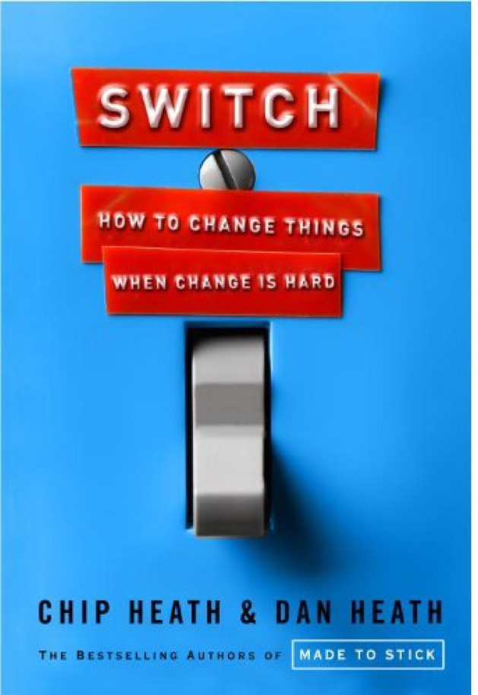
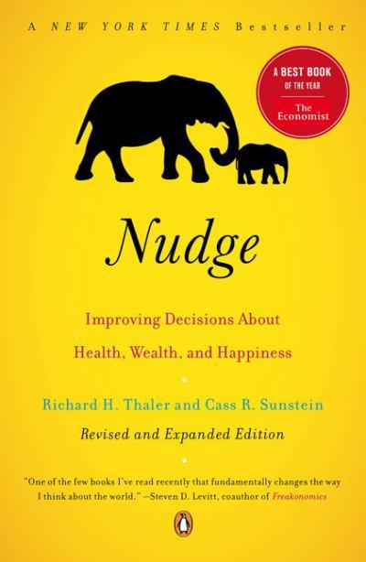




Slide 15
The hedgehog and the fox
Archilochus (c. 680 BCE — c. 645 BCE)
  “The fox knows many tricks; the hedgehog one big one.”
Telling the story
  Sustained engagement with practitioners
  400 presentations, to 20,000 people in five years
  100,000 copies of Inside the black box sold
  At least as many copies downloaded
  Phi Delta Kappan’s most downloaded article ever

Slide 16
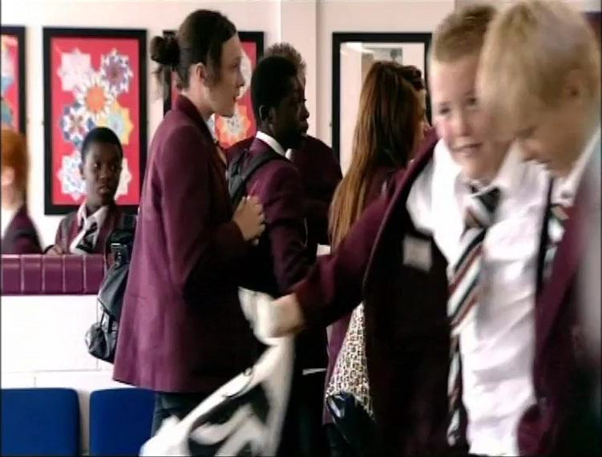
The Classroom Experiment

Slide 17
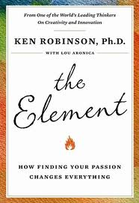

Slide 18
So much for the easy bit…
Theorization
Ideas
Products
Evidence of impact
Advocacy

Slide 19



Going beyond the evidence given…
www.dylanwiliam.net

