Slide 2
Teaching with Passion to Drive Up Standards for Every Child
Professor Dylan Wiliam
www.dylanwiliam.net

Slide 3
Outline
The challenge ahead
Teaching as a moral activity
It’s teacher quality, stupid
Supporting teacher learning

Slide 4
Benefits of education
More educated people
live longer, are healthier, and have less disability
are less likely to be teenage parents
are less likely to be incarcerated
are less likely to commit suicide
are more likely to vote and contribute more to society
earn more
More educated societies
are richer
are fairer
(Source: www.learningbenefits.net & www.equalitytrust.org)

Slide 5
The world of work is changing
Skill category | Percentage change 1969-1999
Complex communication | +14%
Expert thinking/problem solving | +8%
Routine manual | –3%
Non-routine manual | –5%
Routine cognitive | –8%
Autor, Levy & Murnane (2003)

Slide 6
How flat is the world?
Percentage crossing national boundaries:
1%
5%
10%
20%
50%
Physical mail:
Telephone minutes:
Internet traffic:
First generation immigrants:
University students:
People, ever in their lives
Goods and services:

Slide 7
Mostly round; some flat bits (Ghemawat, 2011)
Percentage crossing national boundaries
Physical mail: 1
Telephone minutes: 2
Internet traffic: 17
First generation immigrants: 3
University students: 2
People, ever in their lives: 10
Goods and services: 10

Slide 8
There is only one 21st century skill
So the model that says learn while you’re at school, while you’re young, the skills that you will apply during your lifetime is no longer tenable. The skills that you can learn when you’re at school will not be applicable. They will be obsolete by the time you get into the workplace and need them, except for one skill. The one really competitive skill is the skill of being able to learn. It is the skill of being able not to give the right answer to questions about what you were taught in school, but to make the right response to situations that are outside the scope of what you were taught in school. We need to produce people who know how to act when they’re faced with situations for which they were not specifically prepared. (Papert, 1998)

Slide 9
What is the goal?
Some unhelpful ways of thinking about the goal
Every child reaching her or his potential
Why be limited by your potential?
Can’t deduce an “ought” from an “is”
Closing achievement gaps
Getting rid of “gifted and talented” programmes?
An alternative aspiration:
All students proficient
Many students excellent; all sub-groups of students proportionately represented in the excellent

Slide 10
What kinds of schools do we need?
School model | Ethos | Key process
Talent refineries | School must provide opportunities for students to show what they can do | Ensuring good teaching and syllabus coverage
Talent incubators | All students students can learn, but not all students can achieve at high levels | Drawing out what is within the student
Talent factories | All students can achieve at high levels | Whatever it takes

Slide 11
How do we get there?
 |  | Control
 |  | Inside | Outside
Impact | Low | Curriculum Governance Staffing arrangements Organization Buildings | Teacher status Class size
 | High | Teacher quality | Poverty Home language use

Slide 12
The ‘dark matter’ of teacher quality
We know that teachers make a difference
But what makes the difference in teachers?
Components of teacher quality | %
What teachers know | 10-30%
What teachers do | 10-15%
Total (given overlaps) | 30-40%

Slide 13
“In a completely rational society, the best of us would aspire to be teachers and the rest of us would have to settle for less, because passing civilization along from one generation to the next ought to be the highest honor and highest responsibility anyone could have.”
—Lee Iacocca

Slide 14
A daunting target
Programme for International Student Assessment (PISA)
United Kingdom 500
Canada 527
Finland 544
Shanghai 579

Slide 15
Replace existing teachers with better ones?
Firing ineffective teachers?
De-selecting least effective 10% and replace them with average teachers
2 points on PISA (right away, if it can be done)
Raising the bar for entry into the profession?
Stop people with IIIrd class degrees from getting in
0 points on PISA (ever)
Exclude the lowest performing 30% from getting in
5 points on PISA (in 30 years time)
So we have to improve the teachers we have
The “love the one you’re with” strategy

Slide 16
How do we speed up teacher improvement?
Merit pay for effective teachers?
Can’t be done fairly, and doesn’t work
Create a culture of continuous improvement
Responsibilities of teachers
To continue to improve classroom skill for the whole career
To focus the improvement on ideas supported by evidence
Responsibilities of leaders
Create the expectation for continuous improvement
Keep the focus on what is likely to improve achievement
Provide support
Encourage risk taking

Slide 17
Teacher expertise
Experts:
excel mainly in their own domain
develop automaticity for the repetitive operations that are needed to accomplish their goals
In comparison to novices, experts
are more sensitive to social situation when solving problems
are more opportunistic and flexible in their teaching
represent problems in qualitatively different ways
have faster and more accurate pattern recognition capabilities
begin to solve problems slower but bring richer and more personal sources of information to bear

Slide 18
Hand hygiene in hospitals
Study | Focus | Compliance rate
Preston, Larson, & Stamm (1981) | Open ward | 16%
 | ICU | 30%
Albert & Condie (1981) | ICU | 28% to 41%
Larson (1983) | All wards | 45%
Donowitz (1987) | Pediatric ICU | 30%
Graham (1990) | ICU | 32%
Dubbert (1990) | ICU | 81%
Pettinger & Nettleman (1991) | Surgical ICU | 51%
Larson, et al. (1992) | Neonatal ICU | 29%
Doebbeling, et al. (1992) | ICU | 40%
Zimakoff, et al. (1992) | ICU | 40%
Meengs, et al. (1994) | ER (Casualty) | 32%
Pittet, Mourouga, & Perneger (1999) | All wards | 48%
 | ICU | 36%
Pittet, 2001

Slide 19
The happiness hypothesis (Haidt, 2005)
 | + | –
The rider | Rational Good at complex analysis Focused on the long-term Thinks about the future | Weak Easily distracted Gets bogged down in detail Tires quickly
The elephant | Instinctive Compassionate Sympathetic Loyal Protective Powerful | Emotional Skittish Focused on the short-term Thinks about the present

Slide 20
Strategies for change (Heath & Heath, 2010)
Direct the rider
Follow the bright spots
Script the critical moves
Point to the destination
Motivate the elephant
Find the feeling
Shrink the change
Grow your people
Shape the path
Tweak the environment
Build habits
Rally the herd
Notes:
Direct the rider
Follow the bright spots (malnutrition in Vietnam)
Script the critical moves (1% milk; 25 points)
Point to the destination (No dry holes)
Motivate the elephant
Find the feeling (Gloves on the table)
Shrink the change (5-minute room makeover)
Grow your people (Dweck’s mindset)
Shape the path
Tweak the environment (popcorn study, one-click ordering)
Build habits (action triggers: don’t tax the rider; checklists)
Rally the herd (free spaces in hospitals)

Slide 21
Professional learning communities
Professional
Decision-making under uncertainty
Accountable to a community of peers
Learning
Focused on improvement in student outcomes
Communities
Joint enterprise
Mutual engagement
Shared repertoire

Slide 22
A case study in risk
Transposition of the great arteries (TGA)
A rare (1 in 4000 live births) but serious condition in which
the aorta emerges from the right ventricle and so receives oxygen-poor blood, which is carried back to the body
the pulmonary artery emerges from the left ventricle and so receives the oxygen-rich blood, which is carried back to the lungs
Traditional treatment: the ‘Senning’ procedure:
creating a small ‘tunnel’ between the ventricles, and
inserting a ‘baffle’ to divert oxygen-rich blood from the left ventricle (where it shouldn’t be) to the right ventricle (where it should)
Prognosis
Early death rate (first 30 days): 12%
Life expectancy: 46.6 years

Slide 23
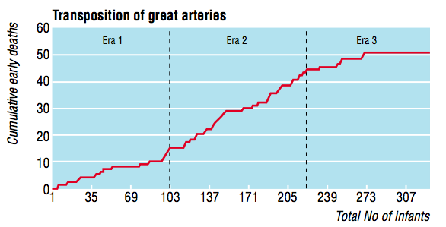
The introduction of the ‘switch’ procedure
Senning
Transitional
Switch
Early death rate
Senning 12%
Transitional 25%
Bull, et al (2000). BMJ, 320, 1168-1173.

Slide 24
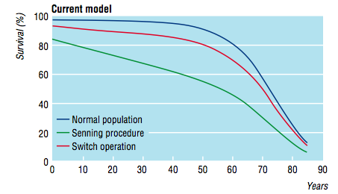
Impact on life expectancy
Life expectancy:
Senning: 46.6 years
Switch: 62.6 years

