Slide 1
Embedding formative assessment with teacher learning communities
Dylan Wiliam
Learning Forward Summer Conference
July 2011
www.dylanwiliam.net

Slide 2
Feedback has complex effects
264 low and high ability grade 6 students in 12 classes in 4 schools; analysis of 132 students at top and bottom of each class
Same teaching, same aims, same teachers, same classwork
Three kinds of feedback: scores, comments, scores+comments
 | Achievement | Attitude
Scores | no gain | High scorers : positive Low scorers: negative
Comments | 30% gain | High scorers : positive Low scorers : positive
[Butler(1988) Br. J. Educ. Psychol., 58 1-14]

Slide 3
Responses
 | Achievement | Attitude
Scores | no gain | High scorers : positive Low scorers: negative
Comments | 30% gain | High scorers : positive Low scorers : positive
What do you think happened for the students given both scores and comments?
Gain: 30%; Attitude: all positive
Gain: 30%; Attitude: high scorers positive, low scorers negative
Gain: 0%; Attitude: all positive
Gain: 0%; Attitude: high scorers positive, low scorers negative
Something else
[Butler(1988) Br. J. Educ. Psychol., 58 1-14]

Slide 4
Effects of feedback
Kluger & DeNisi (1996) review of 3000 research reports
Excluding those:
without adequate controls
with poor design
with fewer than 10 participants
where performance was not measured
without details of effect sizes
left 131 reports, 607 effect sizes, involving 12652 individuals
On average, feedback increases achievement
Effect sizes highly variable
38% (50 out of 131) of effect sizes were negative

Slide 5
Getting feedback right is hard
Response type | Feedback indicates performance…
 | exceeds goal | falls short of goal
Change behavior | Exert less effort | Increase effort
Change goal | Increase aspiration | Reduce aspiration
Abandon goal | Decide goal is too easy | Decide goal is too hard
Reject feedback | Feedback is ignored | Feedback is ignored

Slide 6
Cost/effect comparisons
Intervention | Extra months of learning per year | Cost/class-room/yr
Class-size reduction (by 30%) | 4 | $30k
Increase teacher content knowledge from weak to strong | 2 | ?
Formative assessment/ Assessment for learning | 8 | $3k

Slide 7
Relevant studies
Fuchs & Fuchs (1986)
Natriello (1987)
Crooks (1988)
Banger-Drowns, et al. (1991)
Kluger & DeNisi (1996)
Black & Wiliam (1998)
Nyquist (2003)
Dempster (1991, 1992)
Elshout-Mohr (1994)
Brookhart (2004)
Allal & Lopez (2005)
Köller (2005)
Brookhart (2007)
Wiliam (2007)
Hattie & Timperley (2007)
Shute (2008)

Slide 8
The formative assessment hi-jack…
Long-cycle
Span: across units, terms
Length: four weeks to one year
Impact: Student monitoring; curriculum alignment
Medium-cycle
Span: within and between teaching units
Length: one to four weeks
Impact: Improved, student-involved, assessment; teacher cognition about learning
Short-cycle
Span: within and between lessons
Length:
day-by-day: 24 to 48 hours
minute-by-minute: 5 seconds to 2 hours
Impact: classroom practice; student engagement

Slide 9
Formative assessment: a new definition
“An assessment functions formatively to the extent that evidence about student achievement elicited by the assessment is interpreted and used to make decisions about the next steps in instruction that are likely to be better, or better founded, than the decisions that would have been taken in the absence of that evidence.” (Wiliam, 2009)

Slide 10
Unpacking formative assessment
Key processes
Establishing where the learners are in their learning
Establishing where they are going
Working out how to get there
Participants
Teachers
Peers
Learners

Slide 11
Aspects of formative assessment
 | Where the learner is going | Where the learner is | How to get there
Teacher | Clarify and share learning intentions | Engineering effective discussions, tasks and activities that elicit evidence of learning | Providing feedback that moves learners forward
Peer | Understand and share learning intentions | Activating students as learning resources for one another
Learner | Understand learning intentions | Activating students as owners of their own learning

Slide 12
Five “key strategies”…
Clarifying, understanding, and sharing learning intentions
curriculum philosophy
Engineering effective classroom discussions, tasks and activities that elicit evidence of learning
classroom discourse, interactive whole-class teaching
Providing feedback that moves learners forward
feedback
Activating students as learning resources for one another
collaborative learning, reciprocal teaching, peer-assessment
Activating students as owners of their own learning
metacognition, motivation, interest, attribution, self-assessment
(Wiliam & Thompson, 2007)

Slide 13
…and one big idea
Use evidence about learning to adapt instruction to meet student needs

Slide 14
Effective learning environments
A prevalent, mistaken, view
Teachers create learning
The teacher’s job is to do the learning for the learner
A not so prevalent, not quite so mistaken, but equally dangerous view
Only learners can create learning
The teacher’s job is to “facilitate” learning
A difficult to negotiate, middle path
Teaching as the engineering of effective learning environments
Key features:
Create student engagement (pedagogies of engagement)
Well-regulated (pedagogies of contingency)
Develop habits of mind (pedagogies of formation)

Slide 15
An educational positioning system
A good teacher
Establishes where the students are in their learning
Identifies the learning destination
Carefully plans a route
Begins the learning journey
Makes regular checks on progress on the way
Makes adjustments to the course as conditions dictate

Slide 16
Which of these are formative?
District science supervisor uses test results to plan professional development workshops for teachers
Teachers doing item-by-item analysis of 5th grade math tests to review their 5th grade curriculum
A school tests students every 10 weeks to predict which students are “on course” to pass the state test in March
Three-fourths of the way through a unit test
Students who fail a test on Friday have to come back on Saturday
Exit pass question: “What is the difference between mass and weight?”
“Sketch the graph of y equals one over one plus x squared on your mini-white boards.”

Slide 17
Practical techniques: sharing learning intentions
Explaining learning intentions at start of lesson/unit
Learning intentions
Success criteria
Intentions/criteria in students’ language
Posters of key words to talk about learning
eg describe, explain, evaluate
Planning/writing frames
Annotated examples of different standards to ‘flesh out’ scoring rubrics (e.g. lab reports)
Opportunities for students to design their own tests

Slide 18
Practical techniques: eliciting evidence
Key idea: questioning should
cause thinking
provide data that informs teaching
Improving teacher questioning
generating questions with colleagues
closed v open
low-order v high-order
appropriate wait-time
Getting away from I-R-E
basketball rather than serial table-tennis
‘No hands up’ (except to ask a question)
‘Hot Seat’ questioning
All-student response systems
Class polls, ABCD cards, Mini white-boards, Exit passes

Slide 19
Practical techniques: feedback
Key idea: feedback should
cause thinking
provide guidance on how to improve
Comment-only grading
Focused grading
Explicit reference to rubrics
Suggestions on how to improve
Not giving complete solutions
Re-timing assessment
(eg three-fourths-of-the-way-through-a-unit test)

Slide 20
Students owning their learning and as learning resources
Students assessing their own/peers’ work
With rubrics
With exemplars
“Two stars and a wish”
Training students to pose questions/identifying group weaknesses
Self-assessment of understanding
Traffic lights
Red/green discs
Colored cups
End-of-lesson students’ review

Slide 21
Technique review

Slide 22
Supporting change with teacher learning communities

Slide 23
Knowledge transfer…or creation?
(Nonaka & Takeuchi, 1995)

Slide 24
A model for teacher learning
Content, then process
Content (what we want teachers to change)
Evidence
Ideas (strategies and techniques)
Process (how to go about change)
Choice
Flexibility
Small steps
Accountability
Support

Slide 25
Choice
Belbin inventory (Management teams: why they succeed or fail)
Eight team roles (defined as “A tendency to behave, contribute and interrelate with others in a particular way.”)
Company worker; Innovator; Shaper; Chairperson; Resource investigator; Monitor/evaluator; Completer/finisher; Team worker
Key ideas
Each role has strengths and allowable weaknesses
People rarely sustain “out of role” behavior, especially under stress
Each teacher’s personal approach to teaching is similar
Some teachers’ weaknesses require immediate attention
For most, however, students benefit more by developing teachers’ strengths

Slide 26
Flexibility
Two opposing factors in any school reform
Need for flexibility to adapt to local constraints and affordances
Implies there is appropriate flexibility built into the reform
Need to maintain fidelity to the theory of action of the reform, to minimise “lethal mutations”
So you have to have a clearly articulated theory of action
Different innovations have different approaches to flexibility
Some reforms are too loose (e.g., the ‘Effective schools’ movement)
Others are too tight (e.g., Montessori Schools)
The “tight but loose” formulation
… combines an obsessive adherence to central design principles (the “tight” part) with accommodations to the needs, resources, constraints, and affordances that occur in any school or district (the “loose” part), but only where these do not conflict with the theory of action of the intervention.

Slide 27
Small steps
According to Berliner (1994), experts
excel mainly in their own domain.
often develop automaticity for the repetitive operations that are needed to accomplish their goals.
are more sensitive to the task demands and social situation when solving problems.
are more opportunistic and flexible in their teaching than novices.
represent problems in qualitatively different ways than novices.
have fast and accurate pattern recognition capabilities. Novices cannot always make sense of what they experience.
perceive meaningful patterns in the domain in which they are experienced.
begin to solve problems slower but bring richer and more personal sources of information to bear on the problem that they are trying to solve.

Slide 28
Example: CPR (Klein & Klein, 1981)
Six video extracts of a person delivering cardio-pulmonary resuscitation (CPR)
5 of the video extracts are students
1 of the video extracts is an expert
Videos shown to three groups: students, experts, instructors
Success rate in identifying the expert:
Experts: 90%
Students: 50%
Instructors: 30%

Slide 29
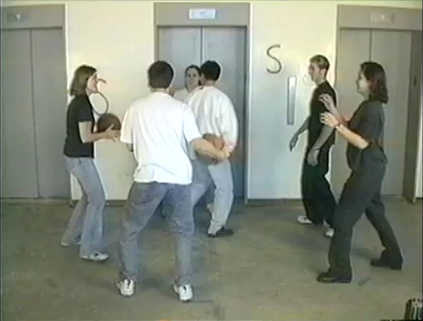
Visual attention

Slide 30
Sensory capacity (Nørretranders, 1998)
Sensory system | Total bandwidth (in bits/second) | Conscious bandwidth (in bits/second)
Eyes | 10,000,000 | 40
Ears | 100,000 | 30
Skin | 1,000,000 | 5
Taste | 1,000 | 1
Smell | 100,000 | 1

Slide 31
Looking at the wrong knowledge…
The most powerful teacher knowledge is not explicit
That’s why telling teachers what to do doesn’t work
What we know is more than we can say
And that is why most professional development has been relatively ineffective
Improving practice involves changing habits, not adding knowledge
That’s why it’s hard
And the hardest bit is not getting new ideas into people’s heads
It’s getting the old ones out
That’s why it takes time
But it doesn’t happen naturally
If it did, the most experienced teachers would be the most productive, and that’s not true (Hanushek, 2005)

Slide 32
Hand hygiene in hospitals (Pittet, 2001)
Study | Focus | Compliance rate
Preston, Larson & Stamm (1981) | Open ward | 16%
 | ICU | 30%
Albert & Condie (1981) | ICU | 28% to 41%
Larson (1983) | All wards | 45%
Donowitz (1987) | Pediatric ICU | 30%
Graham (1990) | ICU | 32%
Dubbert (1990) | ICU | 81%
Pettinger & Nettleman (1991) | Surgical ICU | 51%
Larson et al. (1992) | Neonatal ICU | 29%
Doebbeling et al. (1992) | ICU | 40%
Zimakoff et al. (1992) | ICU | 40%
Meengs et al. (1994) | ER (Casualty) | 32%
Pittet, Mourouga & Perneger (1999) | All wards | 48%
 | ICU | 36%

Slide 33
We need to create time and space for teachers to reflect on their practice in a structured way, and to learn from mistakes Bransford, Brown & Cocking (1999)
“Always make new mistakes” Esther Dyson
“Ever tried. Ever failed. No matter. Try again. Fail again. Fail better.” Samuel Beckett, Worstward Ho

Slide 34
Making a commitment…
Action planning
Forces teachers to make their ideas concrete and creates a record
Makes the teacher accountable for doing what they promised
Requires each teacher to focus on a small number of changes
Requires the teacher to identify what they will give up or reduce
A good action plan
Does not try to change everything at once
Spells out specific changes in teaching practice
Relates to the five “key strategies” of AfL
Is achievable within a reasonable period of time
Identifies something that the teacher will no longer do or will do less of

Slide 35
…and being held to it
I think specifically what was helpful was the ridiculous NCR [No Carbon Required] forms. I thought that was the dumbest thing, but I’m sitting with my friends and on the NCR form I write down what I am going to do next month.
Well, it turns out to be a sort of “I’m telling my friends I’m going to do this” and I really actually did it and it was because of that. It was because I wrote it down.
I was surprised at how strong an incentive that was to do actually do something different … that idea of writing down what you are going to do and then because when they come by the next month you better take out that piece of paper and say “Did I do that?” … just the idea of sitting in a group, working out something, and making a commitment… I was impressed about how that actually made me do stuff. (Tim, Spruce Central High School)

Slide 36
Supporting change with teacher learning communities

Slide 37
Supportive accountability
Teacher learning is just like any other learning in a highly complex area
In the same way that teachers cannot do the learning for their learners, leaders cannot do the learning for their teachers
What is needed from teachers
A commitment to the continuous improvement of practice; and
A focus on those things that make a difference to students
What is needed from leaders
A commitment to engineer effective learning environments for teachers :
creating expectations for the continuous improvement of practice
keeping the focus on the things that make a difference to students
providing the time, space, dispensation and support for innovation
supporting risk-taking

Slide 38
A case study in risk
Transposition of the great arteries (TGA)
A rare (1 in 4000 live births) but serious condition in newborns in which
the aorta emerges from the right ventricle and so receives oxygen-poor blood, which is carried back to the body without receiving more oxygen
the pulmonary artery emerges from the left ventricle and so receives the oxygen-rich blood, which is carried back to the lungs
Traditional treatment: the ‘Senning’ procedure which involves:
the creation of a ‘tunnel’ between the ventricles, and
the insertion of a ‘baffle’ to divert oxygen-rich blood from the left ventricle (where it shouldn’t be) to the right ventricle (where it should)
Prognosis
Early death rate (first 30 days): 12%
Life expectancy: 46.6 years

Slide 39
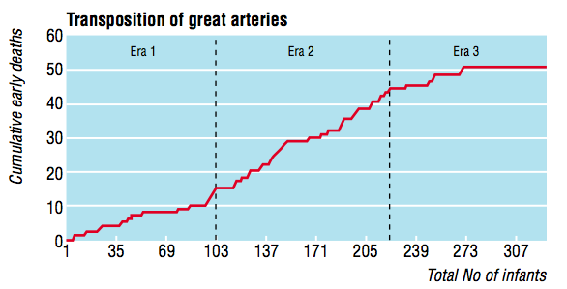
The introduction of the ‘switch’ procedure
Senning
Transitional
Switch
Early death rate
Senning 12%
Transitional 25%
Bull, et al (2000). BMJ, 320, 1168-1173.

Slide 40
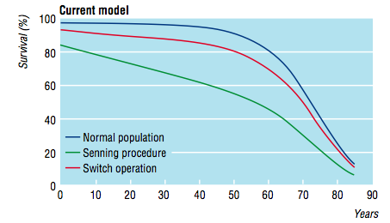
Impact on life expectancy
Life expectancy:
Senning: 46.6 years
Switch: 62.6 years

Slide 41
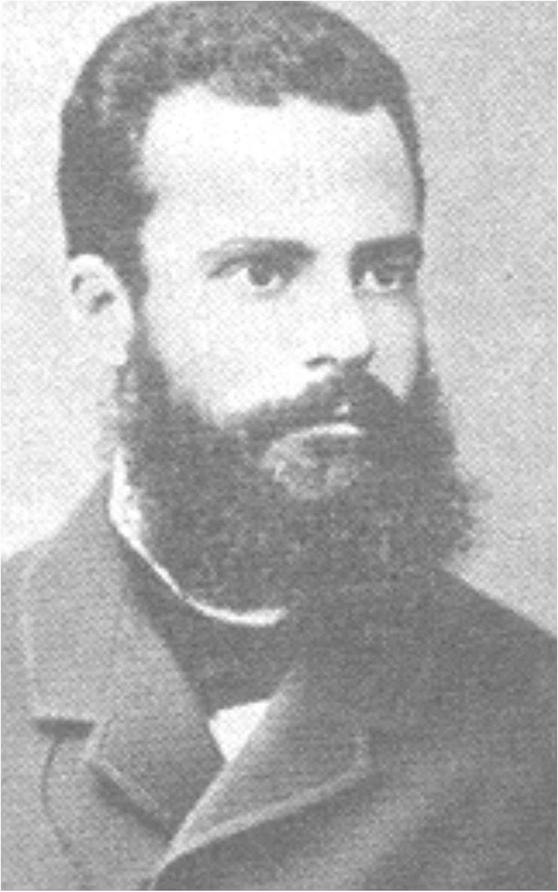
Pareto analysis
Vilfredo Pareto (1848-1923)
Economist and philosopher associated with the 80:20 rule
Pareto improvement
A change that can make at least one person better off without making anyone else worse off.
Pareto efficiency/Pareto optimality
An allocation of resource is Pareto efficient or Pareto optimal when there are no more Pareto improvements
Obstacles to Pareto improvements
The political economy of reform
It is very hard to stop people doing valuable things in order to give them time to do even more valuable things

Slide 42
Teacher learning communities
Plan that the TLC will run for two years
Identify 10 to 12 interested colleagues
Composition
Similar assignments (e.g. early years, math/sci)
Mixed-subject/mixed-phase
Hybrid
Secure institutional support for:
Monthly meetings (75 - 120 minutes each, inside or outside school time)
Time between meetings (2 hrs per month in school time)
Collaborative planning
Peer observation
Any necessary waivers from school policies

Slide 43
A ‘signature pedagogy’ for teacher learning
Every monthly TLC meeting should follows the same structure and sequence of activities
Activity 1: Introduction (5 minutes)
Activity 2: Starter activity (5 minutes)
Activity 3: Feedback (25-50 minutes)
Activity 4: New learning about formative assessment (20-40 minutes)
Activity 5: Personal action planning (15 minutes)
Activity 6: Review of learning (5 minutes)

Slide 44
Every TLC needs a leader
The job of the TLC leader(s)
To ensure that all necessary resources (including refreshments!) are available at meetings
To ensure that the agenda is followed
To maintain a collegial and supportive environment
But most important of all…
not to be the formative assessment “expert”

Slide 45
Peer observation
Run to the agenda of the observed, not the observer
Observed teacher specifies focus of observation
e.g., teacher wants to increase wait-time
Observed teacher specifies what counts as evidence
provides observer with a stop-watch to log wait-times
Observed teacher owns any notes made during the observation

Slide 46
Comments? Questions?

Slide 47
Force-field analysis (Lewin, 1954)
What are the forces that will support or drive the adoption of formative assessment practices in your school/district?
What are the forces that will constrain or prevent the adoption of formative assessment practices in your school/district?
+
—

Slide 48
Summary
Raising achievement is important
Raising achievement requires improving teacher quality
Improving teacher quality requires teacher professional development
To be effective, teacher professional development must address
What teachers do in the classroom
How teachers change what they do in the classroom
Formative assessment + Teacher learning communities
A point of (uniquely?) high leverage
A “Trojan Horse” into wider issues of pedagogy, psychology, and curriculum

