Slide 1
Assessment for learning: why, what, and how?
Presentation to Utdanningsdirektoratet
Conference, March, 2010: Oslo, Norway.
Dylan Wiliam www.dylanwiliam.net

Slide 2
Improving education: science and design
We need to improve student achievement
This requires improving teacher quality
Improving the quality of entrants takes too long
So we have to help the teachers we have improve
Teachers can change in a range of ways
Some will benefit students, and some will not.
Those that do involve changes in teacher practice
Changing practice requires new kinds of teacher learning
And new models of professional development.
Science
Design

Slide 3
Raising achievement matters…
For individuals
Increased lifetime salary
Improved health
Longer life
For society
Lower criminal justice costs
Lower health-care costs
Increased economic growth (Hanushek & Wößman, 2010)
Present value to Norway of raising PISA scores by 25 points: $1000bn
Present value of ensuring all students score 400 on PISA: $1500bn

Slide 4
…because the world of work is changing…
Which of the following categories of skill is disappearing from the work-place most rapidly?
Routine manual
Non-routine manual
Routine cognitive
Complex communication
Expert thinking/problem-solving

Slide 5
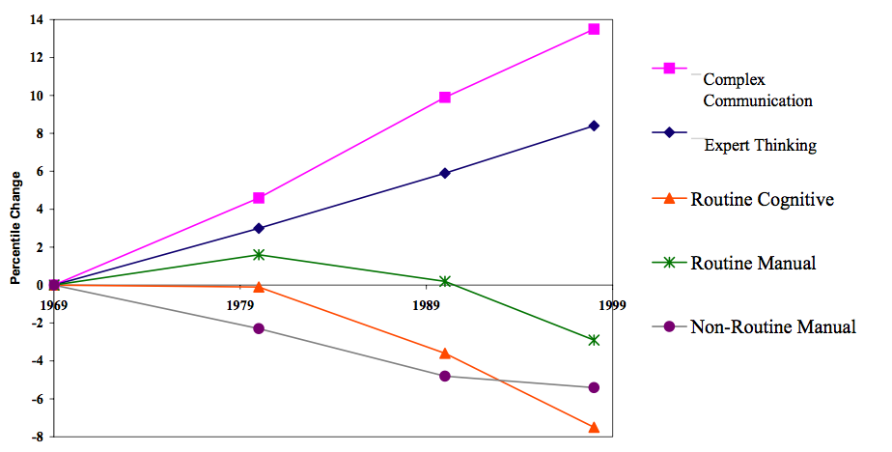
…in surprising ways…
Autor, Levy & Murnane, 2003

Slide 6
while the value of low skills is decreasing value…
Source: Economic Policy Institute

Slide 7
Where’s the solution?
Structure
Smaller/larger high schools
K-8 schools/”All-through” schools
Alignment
Curriculum reform
Textbook replacement
Governance
Charter schools/private schools
Education vouchers
Technology
Computers
Interactive white-boards
Workforce reforms
Classroom assistants

Slide 8
Government-funded schools
Privately-funded schools
Raw scores
Adjusted for social class
Percent Government funded
Performance on PISA
Private schools
are better
Public schools
are better

Slide 9
School effectiveness
Three generations of school effectiveness research
Raw results approaches
Different schools get different results
Conclusion: Schools make a difference
Demographic-based approaches
Demographic factors account for most of the variation
Conclusion: Schools don’t make a difference
Value-added approaches
School-level differences in value-added are relatively small
Classroom-level differences in value-added are large
Conclusion: An effective school is a school full of effective classrooms

Slide 10
Within schools
Between schools
OECD PISA data from McGaw, 2008

Slide 11
…and are small
Proportion of 16-year olds gaining reaching proficiency
90% to 93% of the variability in the proportion achieving this is nothing to do with the school, so
7% to 10% of the variability in the proportion achieving this is nothing to do with the school.
So, if 15 students in a class reach proficiency in the average school:
17 students will reach proficiency at a “good” school (1sd above mean)
13 students will reach proficiency at a “bad” school (1sd below mean)

Slide 12
It’s the classroom…
In the UK, variability at the classroom level is at least 4 times that at school level
It doesn’t matter very much which school you go to
But it matters very much which classrooms you are in…
It’s not class size
It’s not the between-class grouping strategy
It’s not the within-class grouping strategy

Slide 13
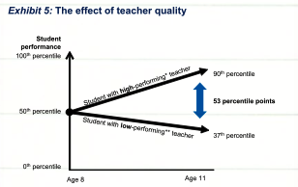
… and specifically, it’s the teacher…
Barber & Mourshed, 2007

Slide 14
Teacher quality is often ignored…
Because it is politically difficult
For teacher unions (who understandably resist performance-related pay)
For politicians (who often prefer to focus on teacher supply, rather than teacher quality)
And because it is hard to pin down
Advanced content matter knowledge 5%
Pedagogical content knowledge 15%
Further professional qualifications (MA, NBPTS) 5%
Total “explained” 25%
But this can result in the pursuit of policies with poor benefit to cost

Slide 15
Teachers do improve, but slowly…
.
Leigh, A. (2007). Estimating teacher effectiveness from two-year changes in student test scores.

Slide 16
Improving teacher quality takes time…
A classic labor force issue with 2 (non-exclusive) solutions
Replace existing teachers with better ones
Help existing teachers become even more effective
Replace existing teachers with better ones?
Increasing the quality of entrants to exclude the lowest performing 30% of teachers would in result in one extra student passing a test per class every three years…
So we have to help the teachers we have improve
The “love the one you’re with” strategy

Slide 17
Getting serious about professional development
Left to their own devices, teachers will improve, but slowly
The average improvement in student value-added by a teacher over 20 years is one-tenth of the difference between a good teacher and a weak teacher on the first day of their teaching career.
Because we have been doing the wrong kind of professional development
Professional “updating”
Recertification
Bigger improvements are possible
Provided we focus rigorously on the things that matter
Even when they’re hard to do

Slide 18
People like neuroscience
Descriptions of 18 psychological phenomena
Examples: mutual exclusivity, attentional blink
Designed to be comprehensible without scientific training
Each phenomenon was given four possible explanations
Basic (without neuroscience)
Good explanation (provided by the researchers)
Bad explanation (e.g., circular reasoning)
Enhanced (with neuroscience explanation)
Good explanation
Bad explanation
Added neuroscience did not change the logic of the explanation
Participants randomly given one of the four explanations
Asked to rate this on a 7-point scale (-3 to +3).

Slide 19
Sample explanations
 | Good explanation | Bad explanation
Without neuroscience | The researchers claim that this ‘curse’ happens because subjects have trouble switching their point of view to consider what someone else might know, mistakenly projecting their own knowledge onto others. | The researchers claim that this ‘curse’ happens because subjects make more mistakes when they have to judge the knowledge of others. People are much better at judging what they themselves know.
With neuroscience | Brain scans indicate that this ‘curse’ happens because of the frontal lobe brain circuitry known to be involved in self-knowledge. Subjects have trouble switching their point of view to consider what someone else might know, mistakenly projecting their own knowledge onto others. | Brain scans indicate that this ‘curse’ happens because of the frontal lobe brain circuitry known to be involved in self-knowledge. subjects make more mistakes when they have to judge the knowledge of others. People are much better at judging what they themselves know.

Slide 20
Seductive allure
 | Without neuroscience |  | With neuroscience
Explanation | Good | Bad | Good | Bad
Novices (n=81) | +0.9 | –0.7 | +0.9 | +0.2
Students (n=22) | +0.1 | –1.1 | +0.7 | +0.2
Experts (n=48) | +0.5 | –1.1 | –0.2 | –0.8
Weisberg et al., 2008

Slide 21
Brains recognizing words
Group-level activations for recognition of words versus a baseline condition (Miller, et al., 2002)

Slide 23
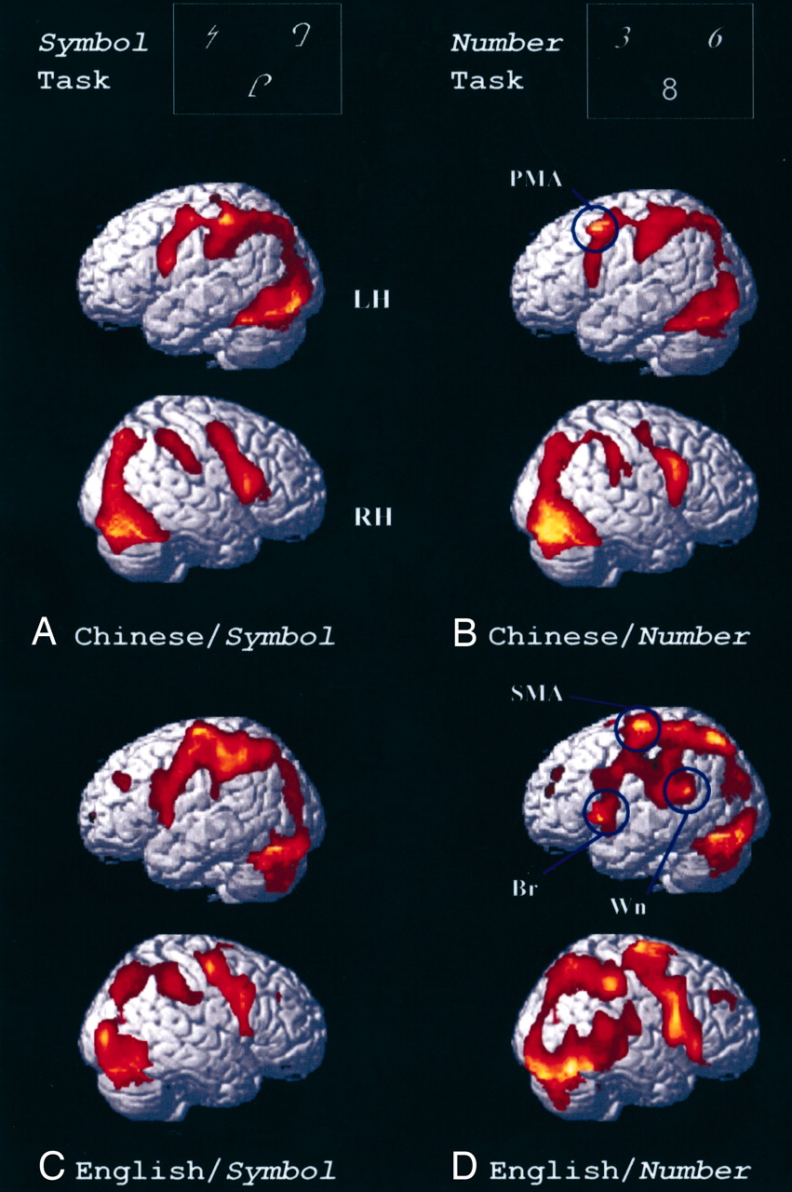
Dissociation in the brain representation of Arabic numbers between native Chinese speakers and native English speakers (Tang et al., 2008)

Slide 24
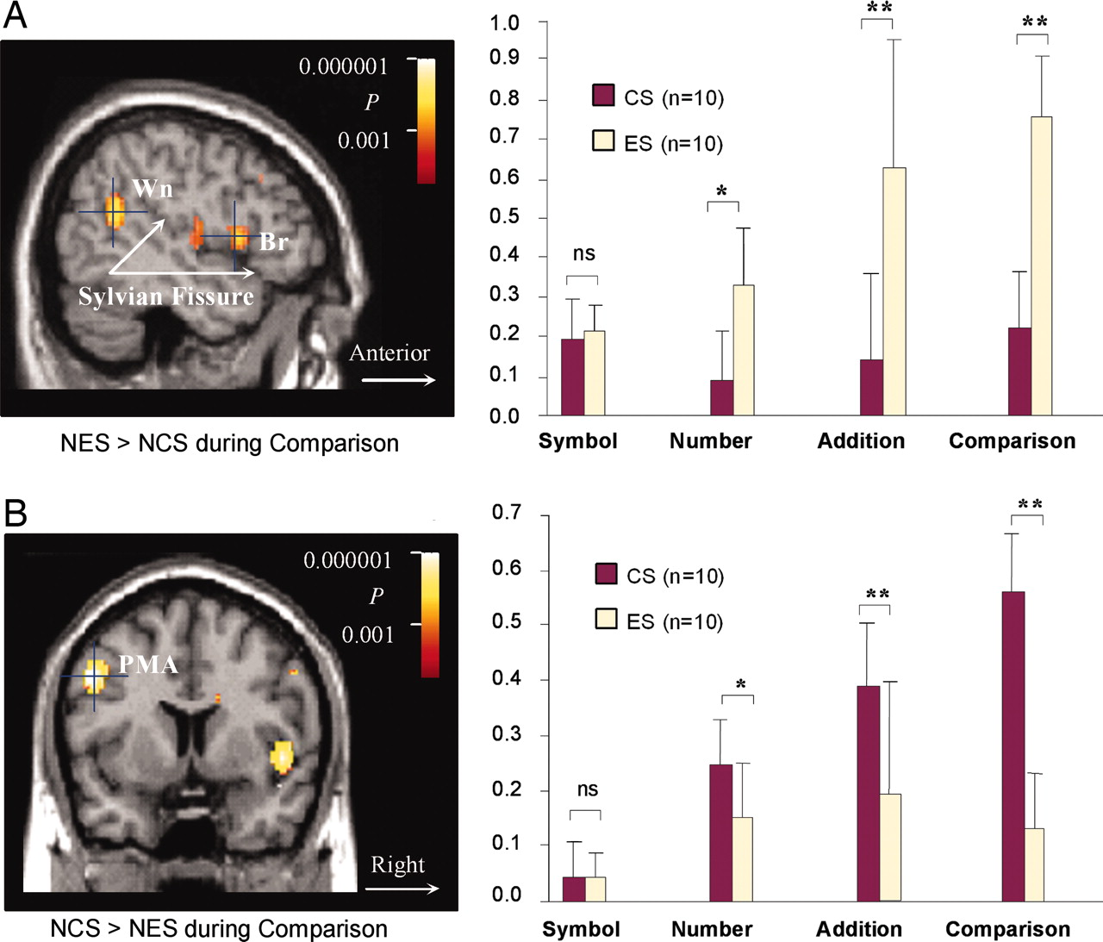
Differences in activation intensity between native Chinese speakers and native English speakers in the perisylvian language region (A) and the premotor association area (B) of the brain (Tang et al., 2008).

Slide 25
Cost/effect comparisons
Intervention | Extra months of learning per year | Cost/classroom/yr
Class-size reduction (by 30%) | 4 | $30k
Increase teacher content knowledge from weak to strong | 2 | ?
Formative assessment/ Assessment for learning | 8 | $3k

Slide 26
The formative assessment hi-jack…
Long-cycle
Span: across units, terms
Length: four weeks to one year
Impact: Student monitoring; curriculum alignment
Medium-cycle
Span: within and between teaching units
Length: one to four weeks
Impact: Improved, student-involved, assessment; teacher cognition about learning
Short-cycle
Span: within and between lessons
Length:
day-by-day: 24 to 48 hours
minute-by-minute: 5 seconds to 2 hours
Impact: classroom practice; student engagement

Slide 27
Unpacking formative assessment
Key processes
Establishing where the learners are in their learning
Establishing where they are going
Working out how to get there
Participants
Teachers
Peers
Learners

Slide 28
Aspects of formative assessment
 | Where the learner is going | Where the learner is | How to get there
Teacher | Clarify and share learning intentions | Engineering effective discussions, tasks and activities that elicit evidence of learning | Providing feedback that moves learners forward
Peer | Understand and share learning intentions | Activating students as learning resources for one another
Learner | Understand learning intentions | Activating students as owners of their own learning

Slide 29
Five “key strategies”…
Clarifying, understanding, and sharing learning intentions
curriculum philosophy
Engineering effective classroom discussions, tasks and activities that elicit evidence of learning
classroom discourse, interactive whole-class teaching
Providing feedback that moves learners forward
feedback
Activating students as learning resources for one another
collaborative learning, reciprocal teaching, peer-assessment
Activating students as owners of their own learning
metacognition, motivation, interest, attribution, self-assessment
(Wiliam & Thompson, 2007)

Slide 30
…and one big idea
Use evidence about learning to adapt instruction to meet student needs

Slide 31
Keeping learning on track
A good teacher
Establishes where the students are in their learning
Identifies the learning destination
Carefully plans a route
Begins the learning journey
Makes regular checks on progress on the way
Makes adjustments to the course as conditions dictate

Slide 32
Examples of techniques
Learning intentions
“sharing exemplars”
Eliciting evidence
“mini white-boards”
Providing feedback
“match the comments to the essays”
Students as owners of their learning
“coloured cups”
Students as learning resources
“pre-flight checklist”

Slide 33
Sustaining the adoption of formative assessment with teacher learning communities

Slide 34
Looking at the wrong knowledge…
The most powerful teacher knowledge is not explicit
That’s why telling teachers what to do doesn’t work
What we know is more than we can say
And that is why most professional development has been relatively ineffective
Improving practice involves changing habits, not adding knowledge
That’s why it’s hard
And the hardest bit is not getting new ideas into people’s heads
It’s getting the old one’s out
That’s why it takes time
But it doesn’t happen naturally
If it did, the most experienced teachers would be the most productive, and that’s not true (Hanushek, 2005)

Slide 35
Hand hygiene in hospitals (Pittet, 2001)
Study | Focus | Compliance rate
Preston, Larson & Stamm (1981) | Open ward | 16%
 | ICU | 30%
Albert & Condie (1981) | ICU | 28% to 41%
Larson (1983) | All wards | 45%
Donowitz (1987) | Pediatric ICU | 30%
Graham (1990) | ICU | 32%
Dubbert (1990) | ICU | 81%
Pettinger & Nettleman (1991) | Surgical ICU | 51%
Larson et al. (1992) | Neonatal ICU | 29%
Doebbeling et al. (1992) | ICU | 40%
Zimakoff et al. (1992) | ICU | 40%
Meengs et al. (1994) | ER (Casualty) | 32%
Pittet, Mourouga & Perneger (1999) | All wards | 48%
 | ICU | 36%

Slide 36
A model for teacher learning
Content, then process
Content (what we want teachers to change)
Evidence
Ideas (strategies and techniques)
Process (how to go about change)
Choice
Flexibility
Small steps
Accountability
Support

Slide 37
Creating a climate for improvement
Teacher learning is just like any other learning in a highly complex area
In the same way that teachers cannot do the learning for their learners, leaders cannot do the learning for their teachers
What is needed from teachers
A commitment to the continuous improvement of practice; and
A focus on those things that make a difference to students
What is needed from leaders
A commitment to engineer effective learning environments for teachers :
creating expectations for the continuous improvement of practice
keeping the focus on the things that make a difference to students
providing the time, space, dispensation and support for innovation
supporting risk-taking

Slide 38
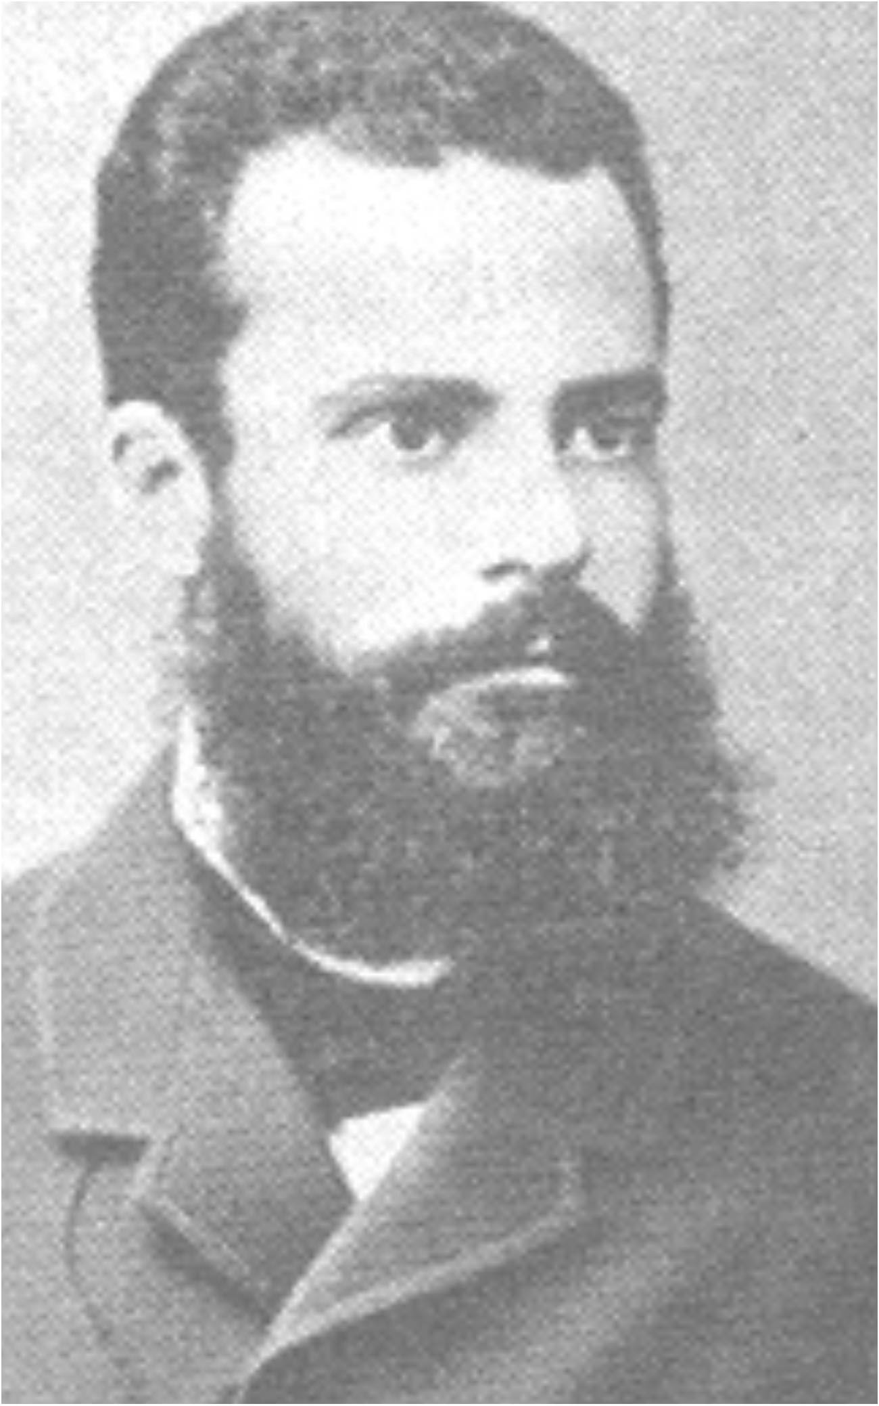
Pareto analysis
Vilfredo Pareto (1848-1923)
Economist and philosopher associated with the 80:20 rule
Pareto improvement
A change that can make at least one person better off without making anyone else worse off.
Pareto efficiency/Pareto optimality
An allocation of resource is Pareto efficient or Pareto optimal when there are no more Pareto improvements
Obstacles to Pareto improvements
The political economy of reform
It is very hard to stop people doing valuable things in order to give them time to do even more valuable things

Slide 39
Summary
Improving student achievement is a national economic priority
Improving student achievement requires improving teacher quality
Improving the quality of entrants is important, but takes too long
So we have to help the teachers already in post to improve
Existing forms of professional development have negligible impact
So we have to concentrate on what has the best cost-benefit ratio
That means formative assessment
But the formative assessment with the biggest impact is hard to do
So we also need different models of professional development
Specifically school-based teacher learning communities
Unprecedented improvements in achievement are possible, if we focus

Slide 40
Comments? Questions?

