Slide 1
Teacher quality: what it is, why it matters and how to get more of it
Annual Conference of The Schools Network 2011
Dylan Wiliam
www.dylanwiliam.net

Slide 2
What kinds of schools do we need?
School model | Ethos | Key process
Talent refineries | School must provide opportunities for students to show what they can do | Ensuring good teaching and syllabus coverage
Talent incubators | All students students can learn, but not all students can achieve at high levels | Drawing out what is within the student
Talent factories | All students can achieve at high levels | Whatever it takes

Slide 3
Where’s the solution?
Structure:
Smaller/larger high schools
K–8 schools/“All-through” schools
Alignment:
Curriculum reform
Textbook replacement
Governance:
Specialist schools
Academies, free schools
Technology:
Computers
Interactive whiteboards
Workforce reforms

Slide 4
School effectiveness
Three generations of school effectiveness research:
Raw results approaches:
Different schools get different results.
Conclusion: Schools make a difference.
Demographic-based approaches:
Demographic factors account for most of the variation.
Conclusion: Schools don’t make a difference.
Value-added approaches:
School-level differences in value-added are relatively small.
Classroom-level differences in value-added are large.
Conclusion: An effective school is a school full of effective classrooms.

Slide 5
Within schools
Between schools
(McGaw, 2008)

Slide 6
Raw scores
Controlling for social class
%
Private schools perform better
Government schools perform better

Slide 8
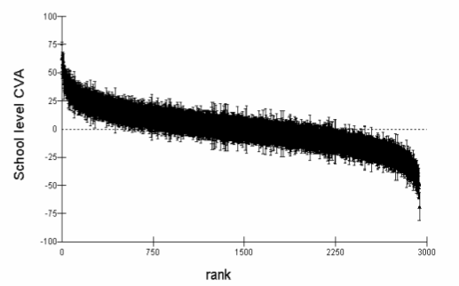
Differences in CVA are often insignificant…
Middle 50%: differences
in CVA not significantly different from average
(Wilson & Piebalga, 2008)

Slide 9
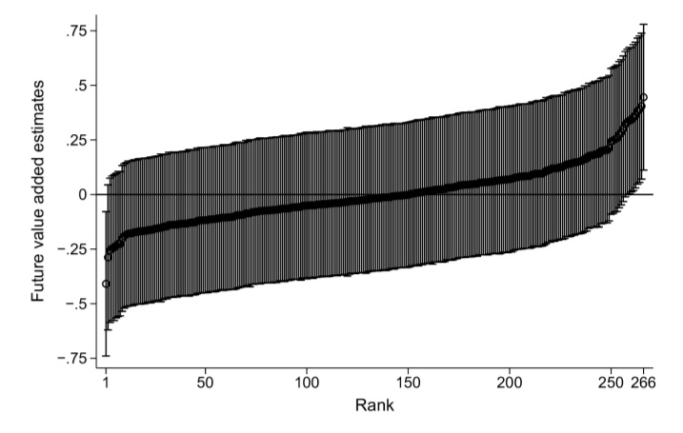
…are transient…
Future school effects for the 2014 cohort based on 2007 data with 95% confidence intervals
(Leckie & Goldstein, 2009)

Slide 10
…and are small
Proportion of 16-year olds gaining 5 GCSE grades at grade C or higher
7% of the variability in the proportion achieving this is attributable to the school, so
93% of the variability in the proportion achieving this is nothing to do with the school
So, if 15 students in a class get 5 A*-C in the average school:
17 students will do so at a “good” school (1sd above mean)
13 students will do so at a “bad” school (1sd below mean)

Slide 11
Information for parents
Choosing schools on the basis of school performance data (Allen & Burgess, 2010)
Compared with random choice, the use of information increases the chance of getting the best school by:
Best CVA: 33%
Best % 5A*-C: 92%
Best capped GCSE points: 104%
Impact of getting the best school over the average:
One grade higher in 3 subjects out of 8
10% of students will cross a “threshold” such as 5xA*-C

Slide 12
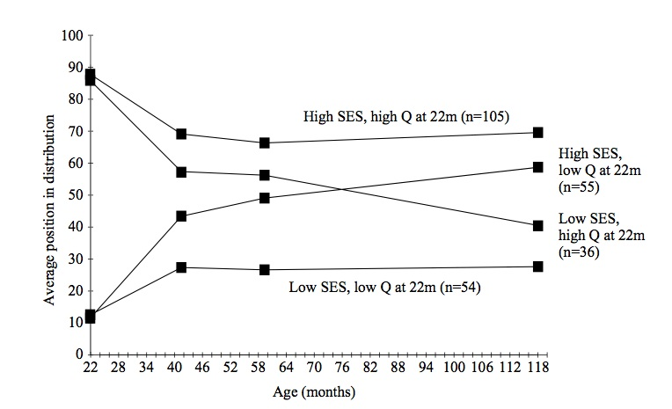
Why are differences between schools small?
Differences between students are large
Differences in home backgrounds are large
Feinstein (2003)

Slide 13
Meaningful differences
Hour-long samples of family talk in 42 US families
Number of words spoken to children by adults by the age of 36 months
In professional families: 35 million
In other working-class families: 20 million
In families on welfare: 10 million
Kinds of reinforcements:
positive negative
professional 500,000 50,000
working-class 200,000 100,000
welfare 100,000 200,000
Hart & Risley (1995)
Notes:
Analysis of transcripts of hour-long samples of family talk in 42 American families suggests that by the age of 36 months, approximately 10 million words were uttered to children in families on welfare, 20 million to children in other working-class families, and 35 million to children in professional families. By the same age, children in professional, working-class and welfare families will have received 500,000, 200,000 and 100,000 encouraging remarks or positive reinforcements respectively, while the number of negative reinforcements and discouragements were 50,000, 100,000 and 200,000 respectively.

Slide 14
We need to focus on classrooms, not schools
In the UK, variability at the classroom level is at least four times that at school level.
As long as you go to school, it doesn’t matter very much which school you go to.
But it matters very much which classrooms you are in.
It’s not class size.
It’s not the between-class grouping strategy.
It’s not the within-class grouping strategy.

Slide 15
And most of all, on teachers
Take a group of 50 teachers:
Students taught by the most effective teacher in that group of 50 teachers learn in six months what those taught by the average teacher learn in a year.
Students taught by the least effective teacher in that group of 50 teachers will take two years to achieve the same learning
(Hanushek & Rivkin, 2006)
And furthermore:
In the classrooms of the most effective teachers, students from disadvantaged backgrounds learn at the same rate as those from advantaged backgrounds
(Hamre & Pianta, 2005).

Slide 16
The ‘dark matter’ of teacher quality
We know that teachers make a difference
But what makes the difference in teachers?
What teachers know?
What teachers do?

Slide 17
The ‘dark matter’ of teacher quality (1)
What teachers know | %
Teacher pre-service qualifications | <5%
Teacher inservice qualifications | <5%
Teacher subject knowledge | <5%
Teacher pedagogical content knowledge
Primary | 10%
Secondary | 30%

Slide 18
The ‘dark matter’ of teacher quality (2)
What teachers do (Danielson, 1996) | %
Planning and preparation
The classroom environment
Instruction
Professional responsibilities
Total

Slide 19
A framework for teaching (Danielson, 1996)
Domain 2: The classroom environment
2a: Creating an environment of respect and rapport
2b: Establishing a culture for learning
2c: Managing classroom procedures
2d: Managing student behavior
2e: Organizing physical space
Domain 3: Instruction
3a: Communicating with students
3b: Using questioning and discussion techniques
3c: Engaging students in learning
3d: Using assessment in instruction
3e: Demonstrating flexibility and responsiveness

Slide 20
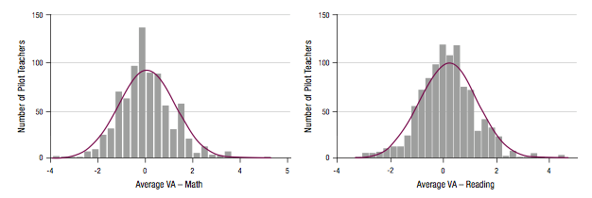
Teacher value-added ratings
Sartain et al., (2011)

Slide 21
Teacher ratings and student growth

Slide 22
Reading

Slide 23
Mathematics

Slide 24
Findings
Principals were six times more likely than observers to rate practice as “distinguished”
Teacher ratings were slightly higher on classroom environment than on instruction
In five of the sub-domains, teacher ratings were slightly lower in unscheduled observations (one seventh of one category)
An increase in one category is associated with an increase in the rate of learning of less than 10%
So although the framework is powerful, it captures only around one-eighth of teacher quality

Slide 25
The ‘dark matter’ of teacher quality (2)
What teachers do (Danielson, 1996) | %
Planning and preparation
The classroom environment
Instruction
Professional responsibilities
Total | 10-15%

Slide 26
The ‘dark matter’ of teacher quality (3)
Components of teacher quality | %
What teachers know | 10-30%
What teachers do | 10-15%
Total (given overlaps) | 30-40%

Slide 27
Improving teacher quality
A classic labour force issue with two (non-exclusive) solutions:
Replace existing teachers with better ones
Help existing teachers become even more effective

Slide 28
Replace existing teachers with better ones?
Raising the bar for entry into the profession?
Exclude the lowest performing 30% from getting in
5 points on PISA (in 30 years time)
Firing ineffective teachers?
De-selecting least effective 10% and replace them with average teachers
2 points on PISA (right away, if it can be done)

Slide 29
So we have to improve the teachers we have
The “love the one you’re with” strategy
But what should we improve?
Teacher knowledge?
Teacher effort?
Teacher skills?

Slide 30
Left on their own, teachers improve, but slowly
Over the first 20 years of their careers, average teachers become 5% more productive
Leigh, 2007, 2010

Slide 31
How do we speed up teacher improvement?
Merit pay for effective teachers?
Can’t be done fairly, and doesn’t work
Create a culture of continuous improvement
Responsibilities of teachers
To continue to improve classroom skill for the whole career
To focus the improvement on ideas supported by evidence
Responsibilities of leaders
Create the expectation for continuous improvement
Keep the focus on what is likely to improve achievement
Provide support
Encourage risk taking

